Slide 1
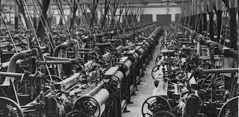
American Industrial Revolution
Mr. Condry’s Social Studies Class

Slide 2
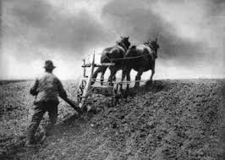
Pre-Industrial Revolution Demographics
90% of the population lived in independent farms.
These farms needed to survive or they traded goods to get what they needed.

Slide 3
Pre-Industrial Revolution Demographics
Infant mortality rate 1 out of 10 est. in 1800
Most children would experience death of a family member
Remarriage was common
Low life expectancy
1750 30 (South) 40 (North)
1800 36 (East Coast)
1850 36 (East Coast)

Slide 4
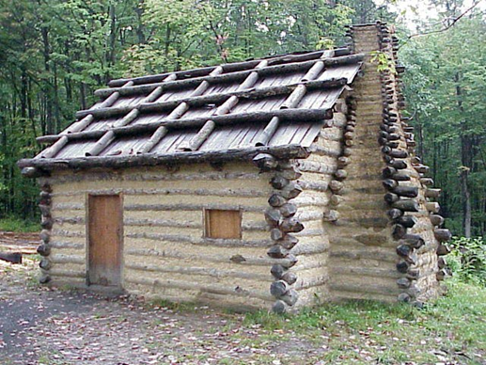
Pre-Industrial Revolution Goals
#1 goal was to keep the family alive!
Must provide every need independent of others
Food
Shelter
Clothing

Slide 5
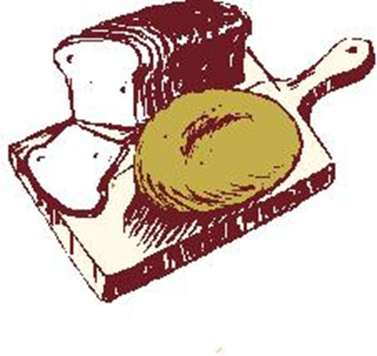
Pre-Industrial Revolution Diet
Lack of food was common.
Food sources dependent on weather and outside forces
Diet was repetitive
People ate bread, cheese, butter, porridge, eggs, raw fruits, and fresh veggies in season, and canned ones out of season. Meat was consumed when available.

Slide 6
Pre-Industrial Revolution Sickness
Illness was a normal part of life.
What medicine there was, was not available to most of the population.
Standard of living increased illnesses
Dirty homes, bodies
Physicality of work
Danger of environment

Slide 7
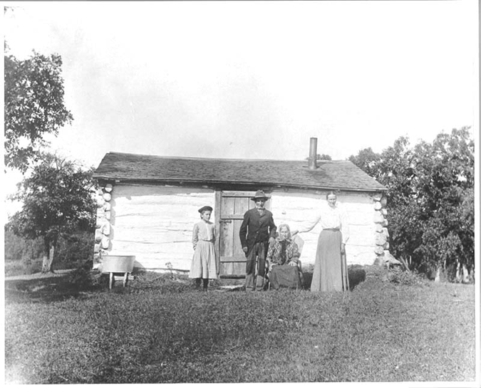
Pre-Industrial Revolution Social Class
Majority of population was poor
Small middle class
Small elite upper class

Slide 8
Children were taught gender skills by parents. Their work included carrying water, wood, simple cloth mending and harvest activities.
Pre-Industrial Revolution Gender Roles
Men
Women
Firewood
Farming
Making of tools
Wood, leather, and metal working
Animal husbandry
Cooking
Cleaning
Making clothing
Raising of children
Teaching of children

Slide 9
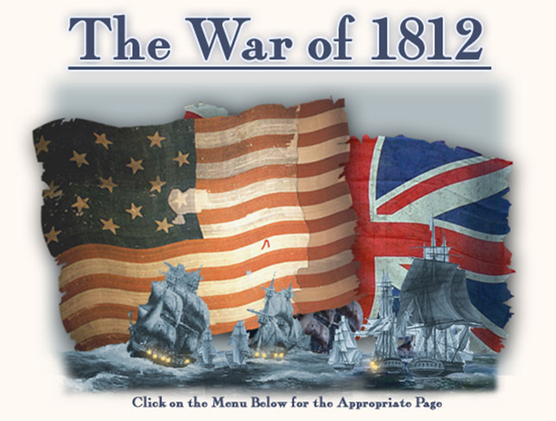
Early Industrial Revolution
Reason for the Industrial Revolution
War of 1812
War with Britain created a need for industrialization in America.
We were unable to trade for the things we needed, and therefore had to start manufacturing them ourselves.

Slide 10
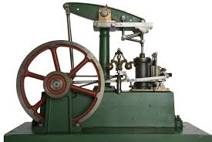
Early Industrial Revolution Key Inventions
Steam Engine
Used in almost every new invention of this time period
Argued to be the single most important invention of the 19th century.
Improved manufacturing, transportation, and mining

Slide 11
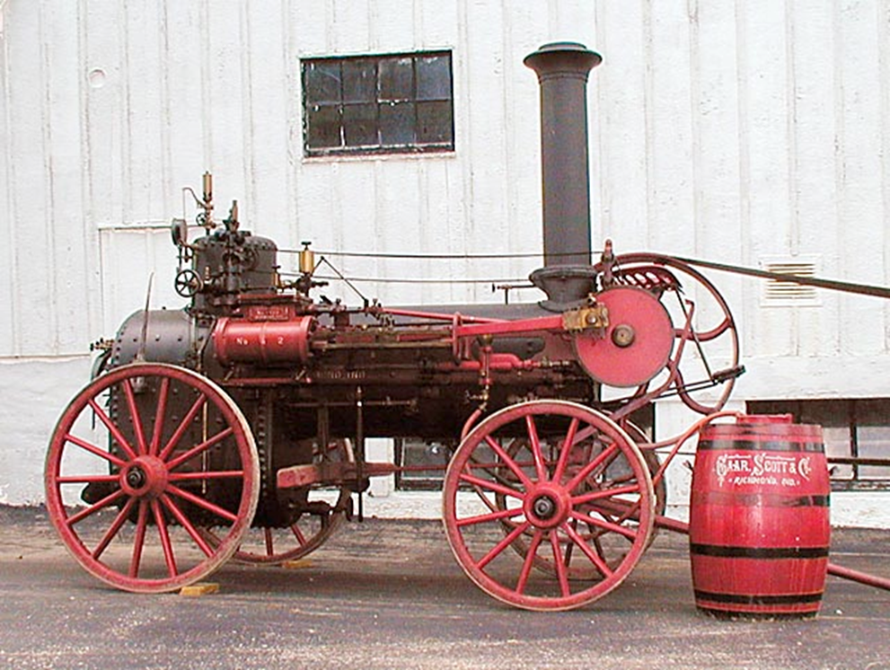
An Original Steam Engine

Slide 12
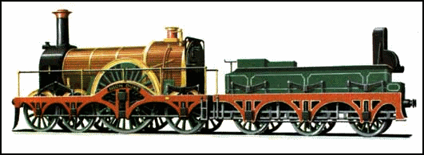
Steam Locomotive

Slide 13
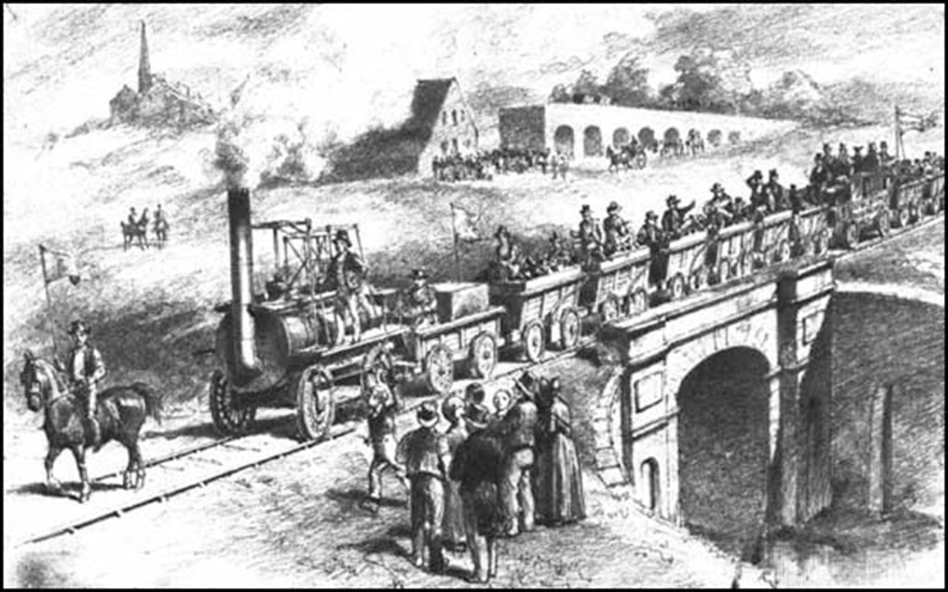
Passenger Carriers

Slide 14
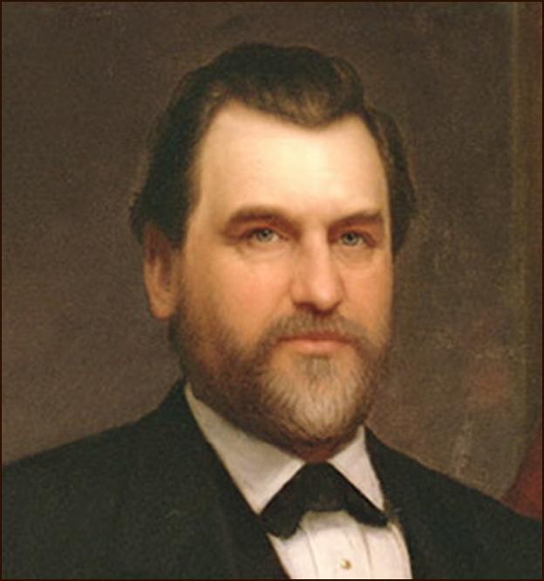
Leland Stanford
A business tycoon
Co founder of the Central Pacific Railroad, creator of Stanford University, and the governor of California

Slide 15
Railroads
Early railroads were unsafe, uncomfortable and slow.
1820 to 1850- 30,000 miles of track were laid
By 1850 railroads had replaced canals as transportation of goods and people.
Railroads fueled the Industrial Revolution

