Slide 1
Evolution of cloth manufacturing

Slide 2
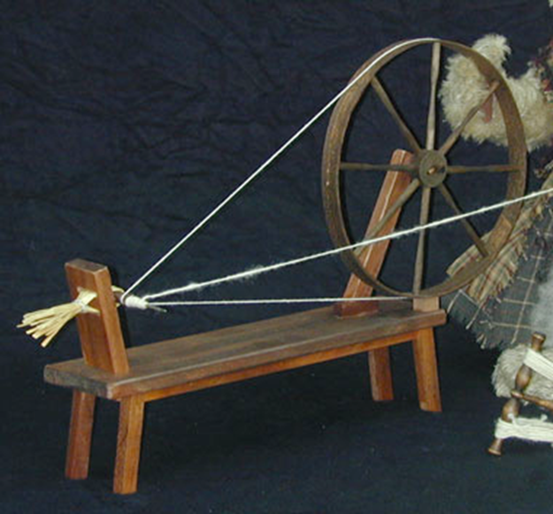
Pre-Industrial Invention Spinning Wheel
The spinning wheel was the first invention, but it was slow.
Threads were spun one at a time by hand

Slide 3
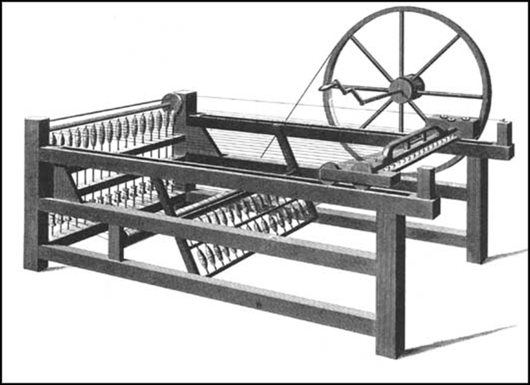
Early-Industrial Invention The Spinning Jenny
The Spinning Jenny could spin up to eight thread at a time.
The Spinning Jenny was much faster then the spinning wheel

Slide 4
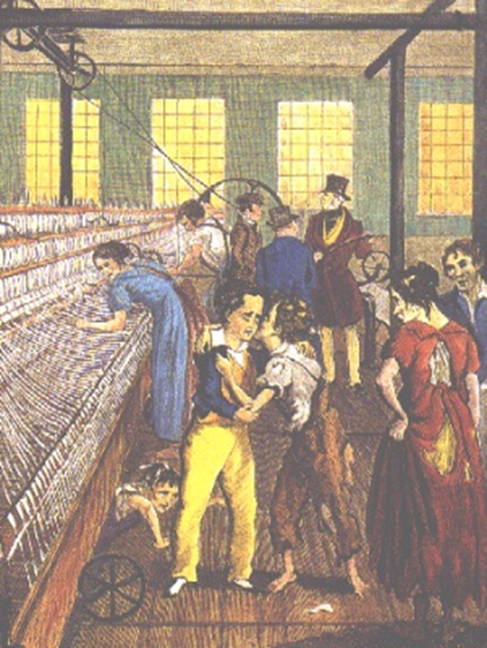
Industrial Invention The Spinning Mule
Used water power to spin the thread, which was much faster then doing it by hand.
More cloth could now be made.

Slide 5
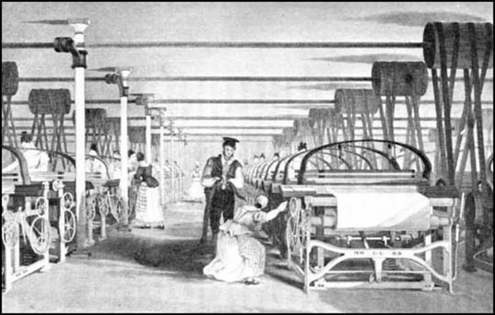
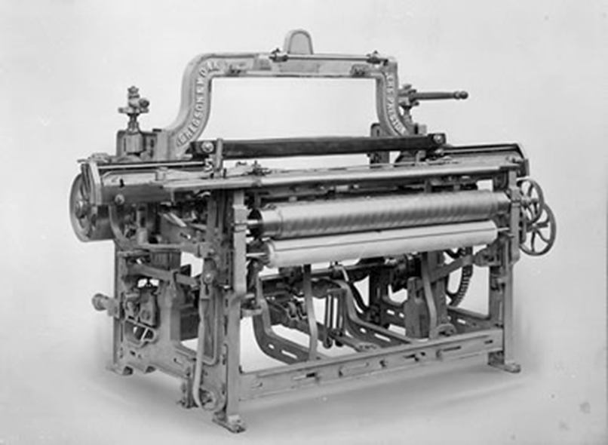
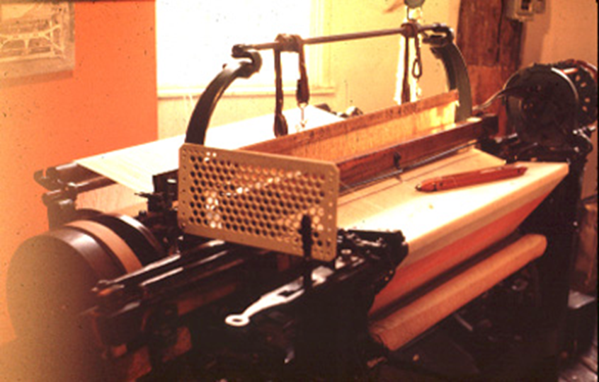
The Power Loom
Used water power to weave cloth.
People could make a lot of cloth quickly.

Slide 6
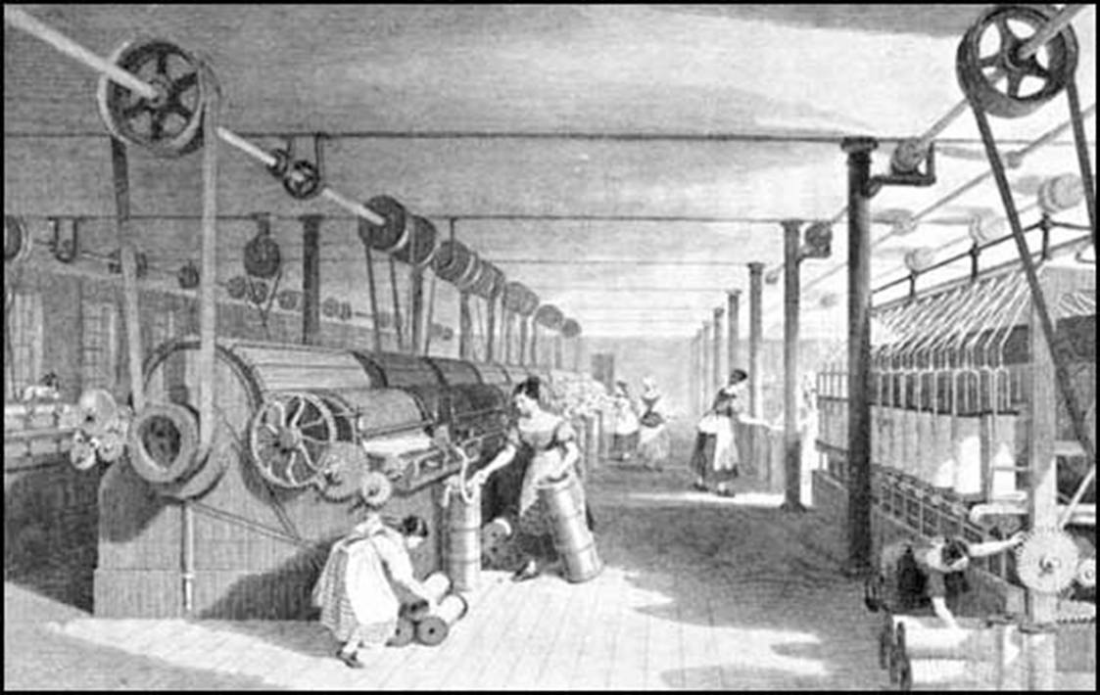
A Cotton Factory

Slide 7
Evolution of Farming

Slide 8
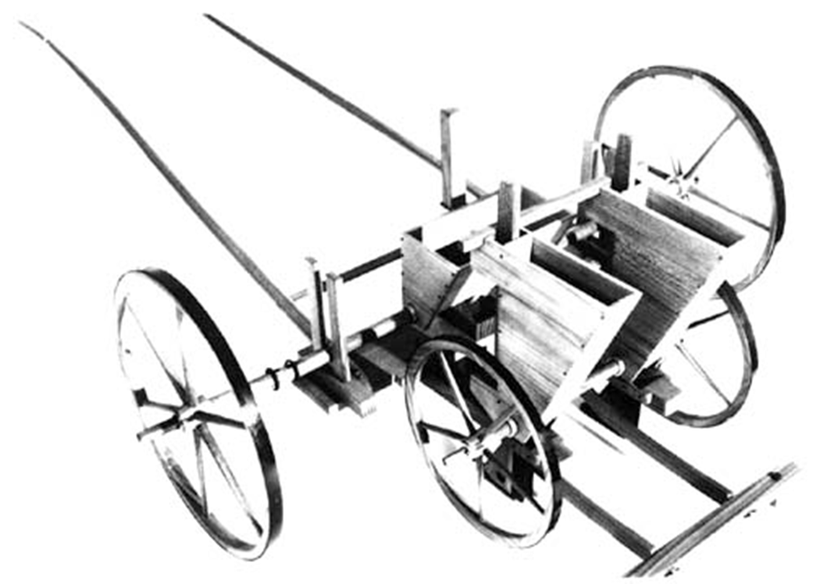
Seed Drill
Allowed farmers to plant seeds much more quickly.
More crops could now be grown feeing an increasing population

Slide 9
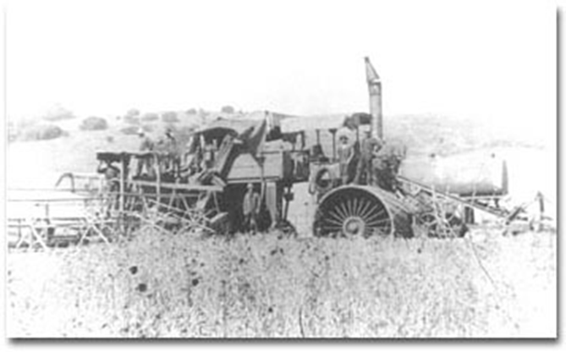
Mechanical Reaper
Allowed farmers to harvest their crops more efficiently.

Slide 10
Evolution
of
Manufacturing

