Slide 1
Steel
Buildings could be made much taller
Steel was much harder than iron, which would bend if made too tall.
The steel industry created many new products, and led to the invention of the car.

Slide 2
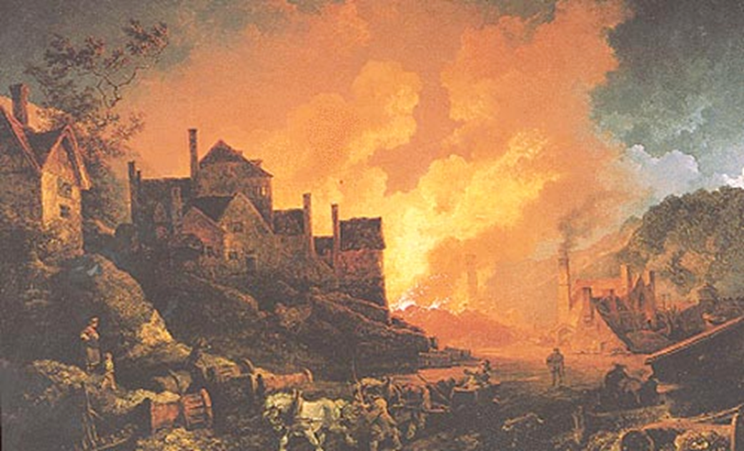
A Melting Plant

Slide 3
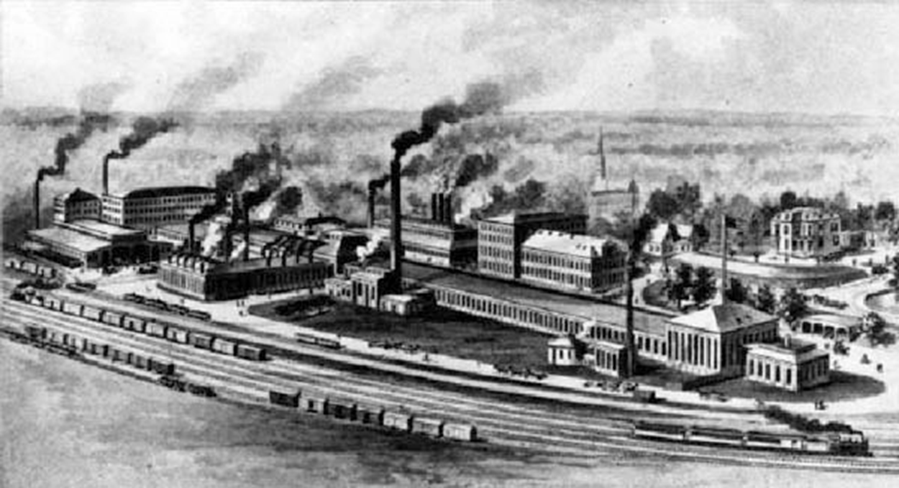
Steel Factory

Slide 4
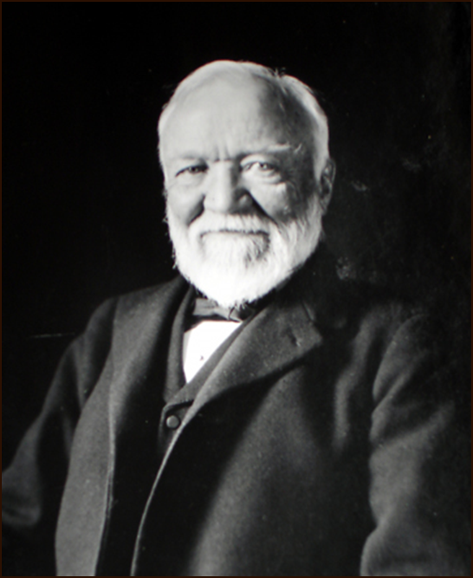
Andrew Carnegie
Became a millionaire in the steel business by putting all his competitors out of business.
He created U.S. Steel Pittsburg.

Slide 5
New Technologies

Slide 6
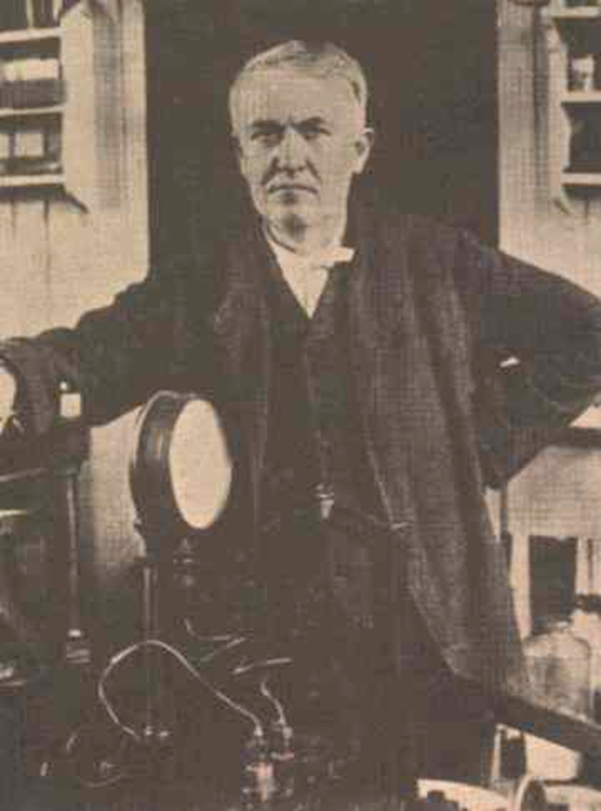
The Electric Light
Created by Thomas Edison
Failed 2000 times before he invented the light bulb.

Slide 7
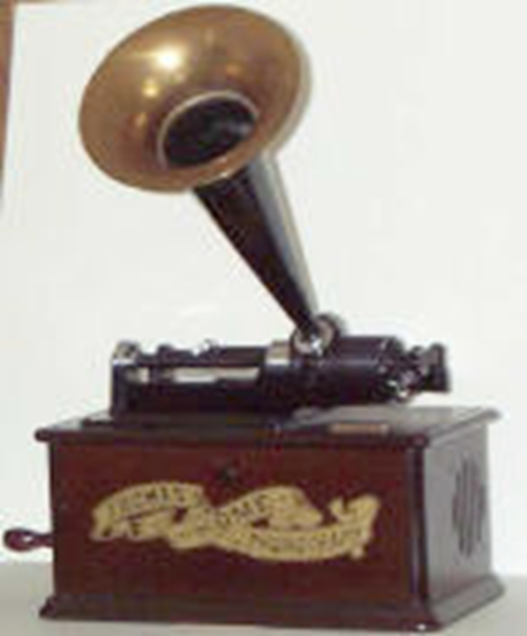
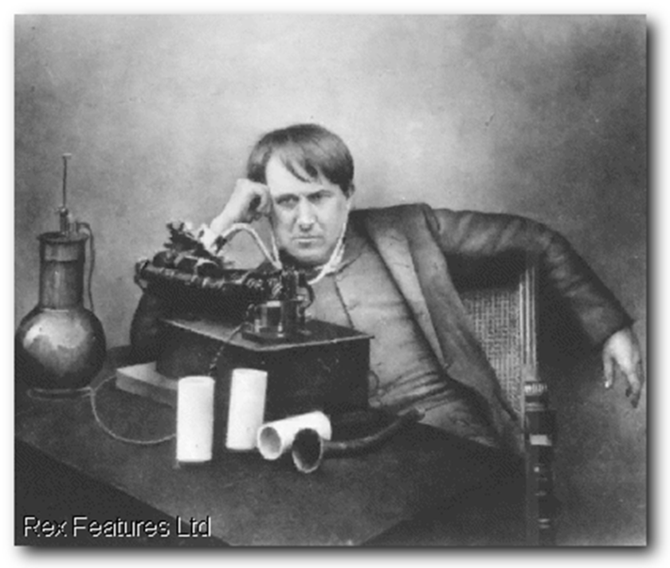
The Phonograph
Created by Thomas Edison
Used spindles on a roller to make music
Funnel attachment was the speaker

Slide 8
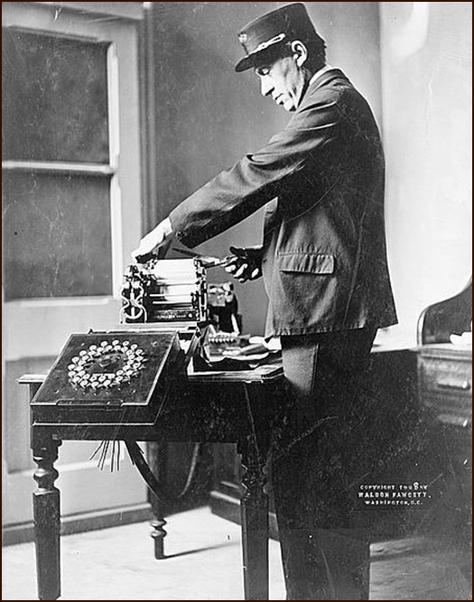
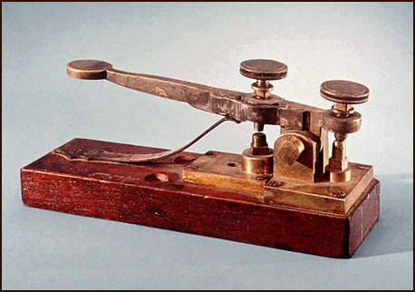
Telegraph
Invented in 1844 by Samuel Morse
Used dots and ashes to send messages over electric lines.
Dots and dashes became known as Morse Code.

Slide 9
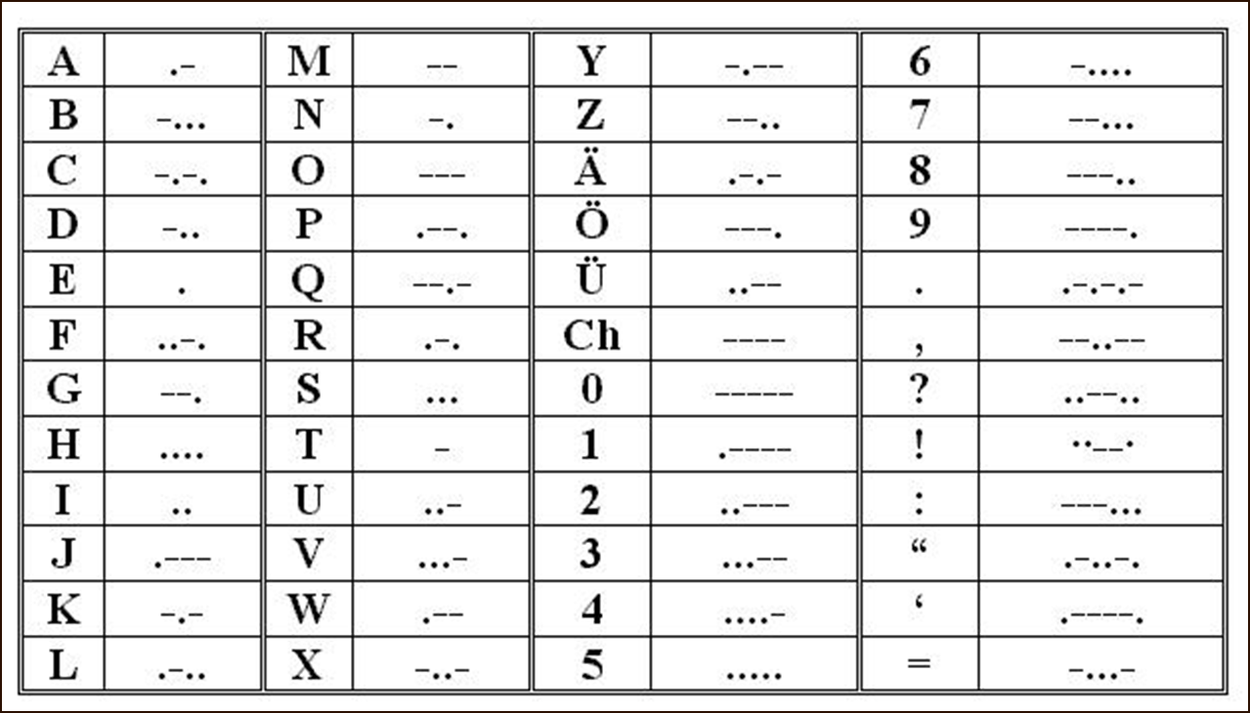

Slide 10
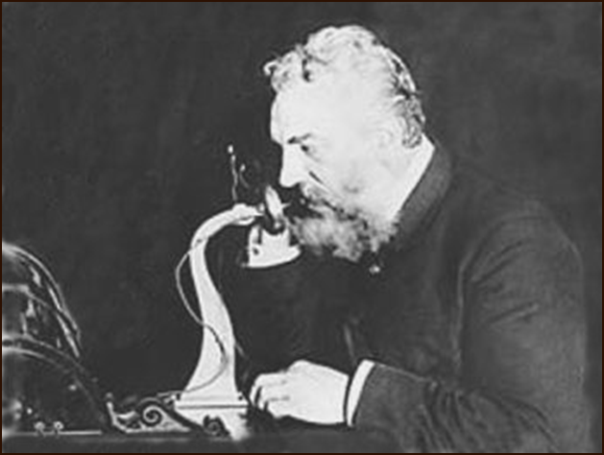
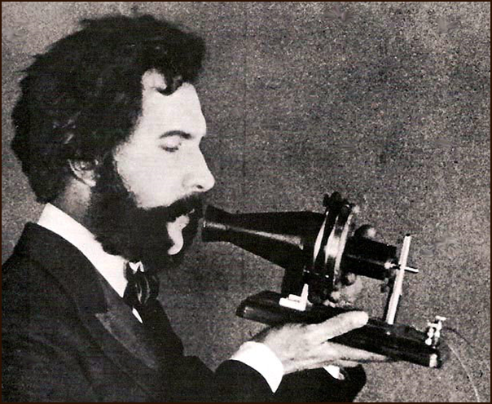
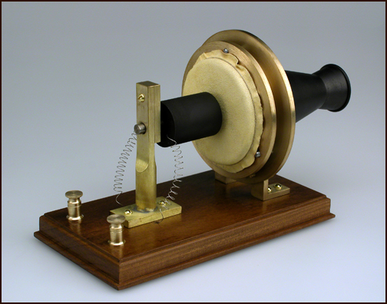
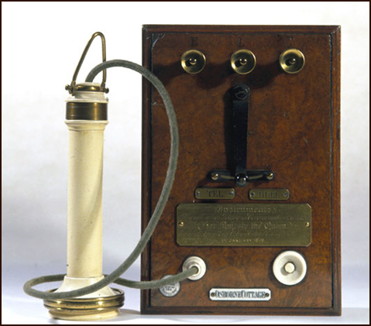
Telephone
Invented by Alexander Graham Bell in 1876

Slide 11
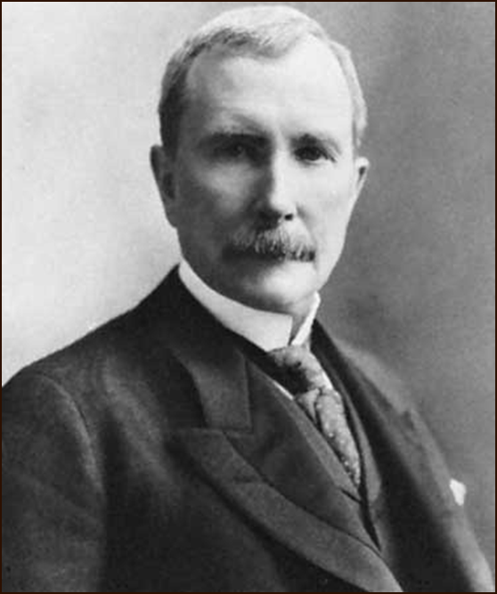
John D. Rockefeller
Became the richest man in the world in the oil business.
He created Standard Oil Company
Oil began being used in all types of machines.

Slide 12
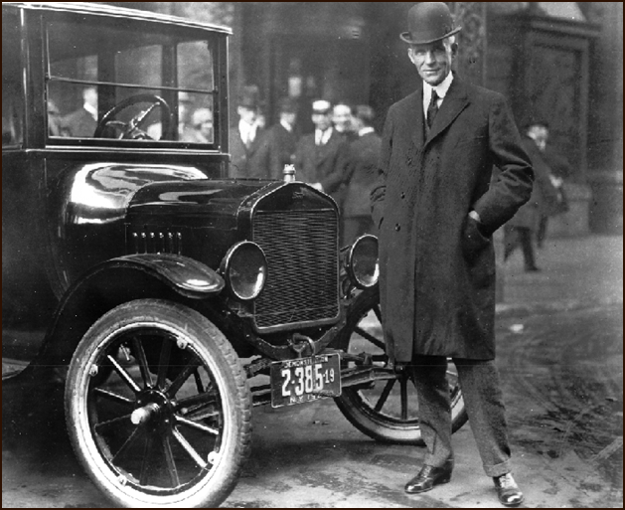
Henry Ford
Invented the first practical car, the Model T.
The car had been invented earlier, but Ford was the first to make the car affordable.

Slide 13
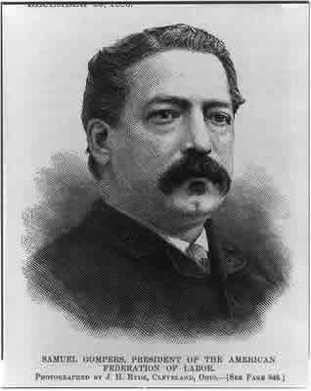
Samuel Gompers
Created the American Federation of Labor
Organization of other labor unions that had bonded together to protect the rights of workers.

