Slide 1
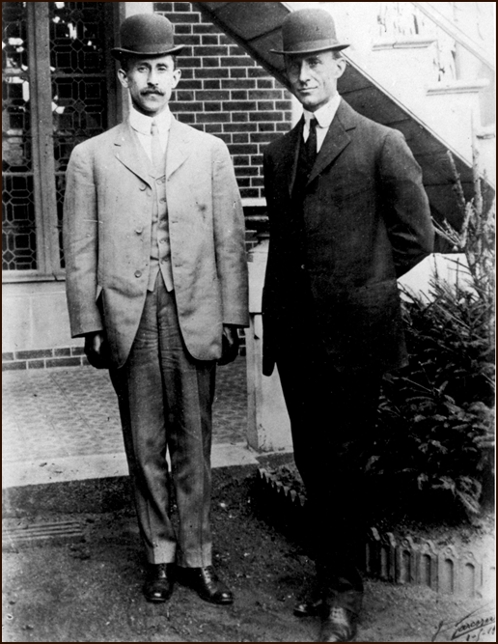
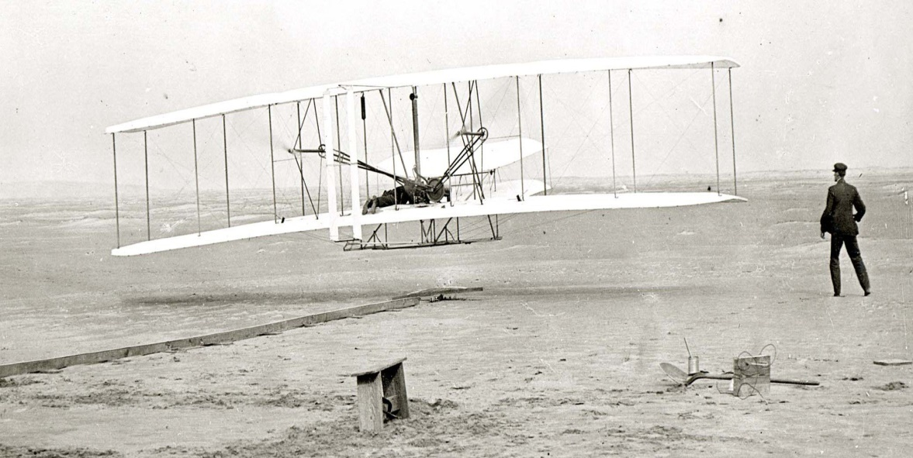
Orville and Wilber Wright
The first men to successfully fly an airplane.
The flight lasted only twelve seconds, but it proved men could fly.

Slide 2
Changes in the Home
Early factories produced things for ordinary people
Flour
Textiles (plain cloth)
Household items
Men’s work was moving outside of the household for wages. The wages would be used to buy produced goods.
Women’s work increased.
Children’s labor was replaced. Children started to go to school. Education was encouraged.

Slide 3
Negative Effects on Industrial Revolution
Factories
Dangerous (3-5% of workforce killed or injured on the job)
Pushed employees and machines to the limit
Ways of life threatened
Railroads eliminate small towns that were not along lines
Cultures became more homogenized from area to area.
Native Americans ways of life threatened
Buffalo killed by trains and hunting expeditions (decline of 10’s of millions
Farmers hated railroad and progress through their lands.

Slide 4
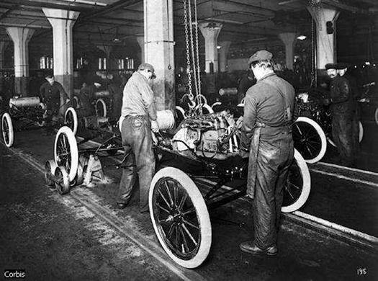
Late Industrial Revolution Mass production and “Fordism”
Interchangeable parts
Large volume production of a single model
Low-priced goods; lo margin and profit
Economies for sale
Special purpose machines
Low skill requirements of workers
Moving assembly line

Slide 5
Late Industrial Revolution Impact of Mass Production
Mass consumption
German and Russian Industrialization
Cultural influences
Art
Music
Film (i.e. Charlie Chaplin – Modern Times
Architecture.

Slide 6
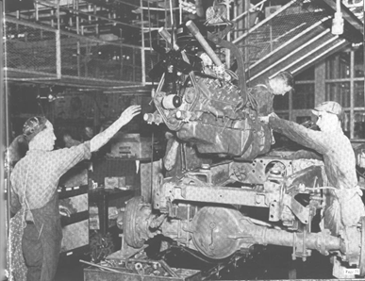
Late Industrial Revolution Labor Experience
Clock vs. Task Orientation
Working along with the machine
Working on only one small piece
Two competing experiences/demands

Slide 7
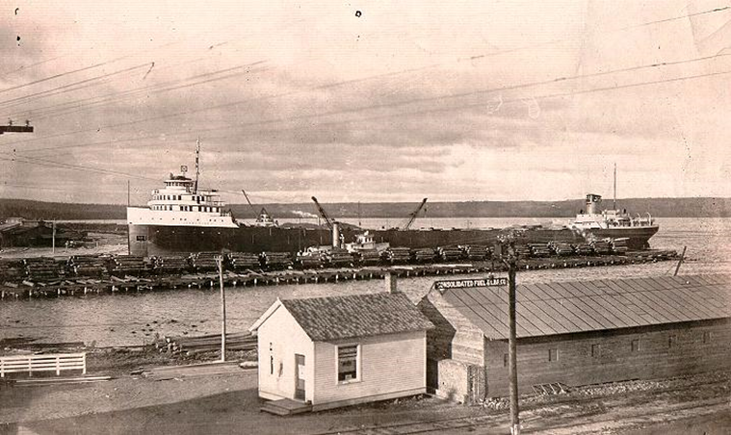
Industries Increase
Mining – iron ore, limestone, copper, etc.
Shipping – large freighters
Logging – more demand for lumber

Slide 8
Ford wants Independence
Ford didn’t want to depend on anyone else for his automobile industries.
He set out to own all aspects
Lumber: Upper Peninsula
Iron ore, copper, limestone: Upper Peninsula, Minnesota
Coal: Kentucky, West Virginia
Rubber Planation: Brazil (2.5 million acres)
Railroads and shipping

Slide 9
Ford in the Upper Peninsula
Ford’s demand for natural resources
Bought mines, ships, and built railroads
Acquired 500,000 acres of forest in Upper Peninsula
Proper resource management
Worked with U.S. Forest service

Slide 10
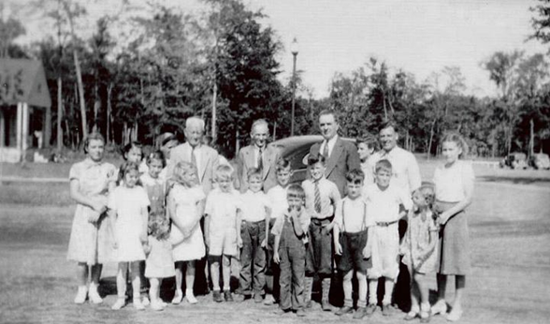
Ford Creates “Village Industries”
Kingsford (1923)
Built homes, schools, and hospitals
14 assembly plants, sawmill, steam power plant, dam, hydroelectric facility, chemical charcoal plant.
Built “Woodie” station wagon and Glider for World War 2
Alberta
Built as a result of more demand for resources
Built homes, schools, and social buildings.

Slide 11
Ford Dies
Ford died in 1947
By 1950’s wood was no longer needed in auto industry
Company management began closing down Upper Peninsula operations around 1955.

