Slide 1
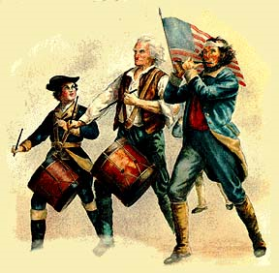
Causes of the American Revolution
Mr. Condry’s Social Studies Class

Slide 2
Causes of American Revolution
1. French and Indian War
2. Proclamation of 1763
3. Sugar Act
4. Stamp Act
5. No Taxation without Representation
6. Townshend Act
7. Quartering Act
8. Boston Massacre
9. Tea Act
10. Boston Tea Party
11. Intolerable Act
12. 1st Continental Congress
13. Lexington and Concord

Slide 3
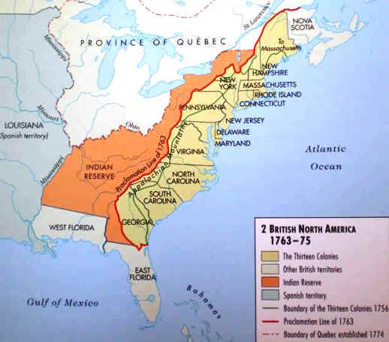
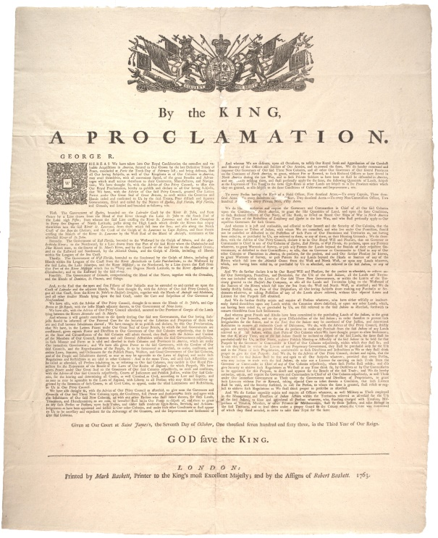
Proclamation of 1763
Banned colonization west of the Appalachian Mountains
Those who already lived there must move east.

Slide 4
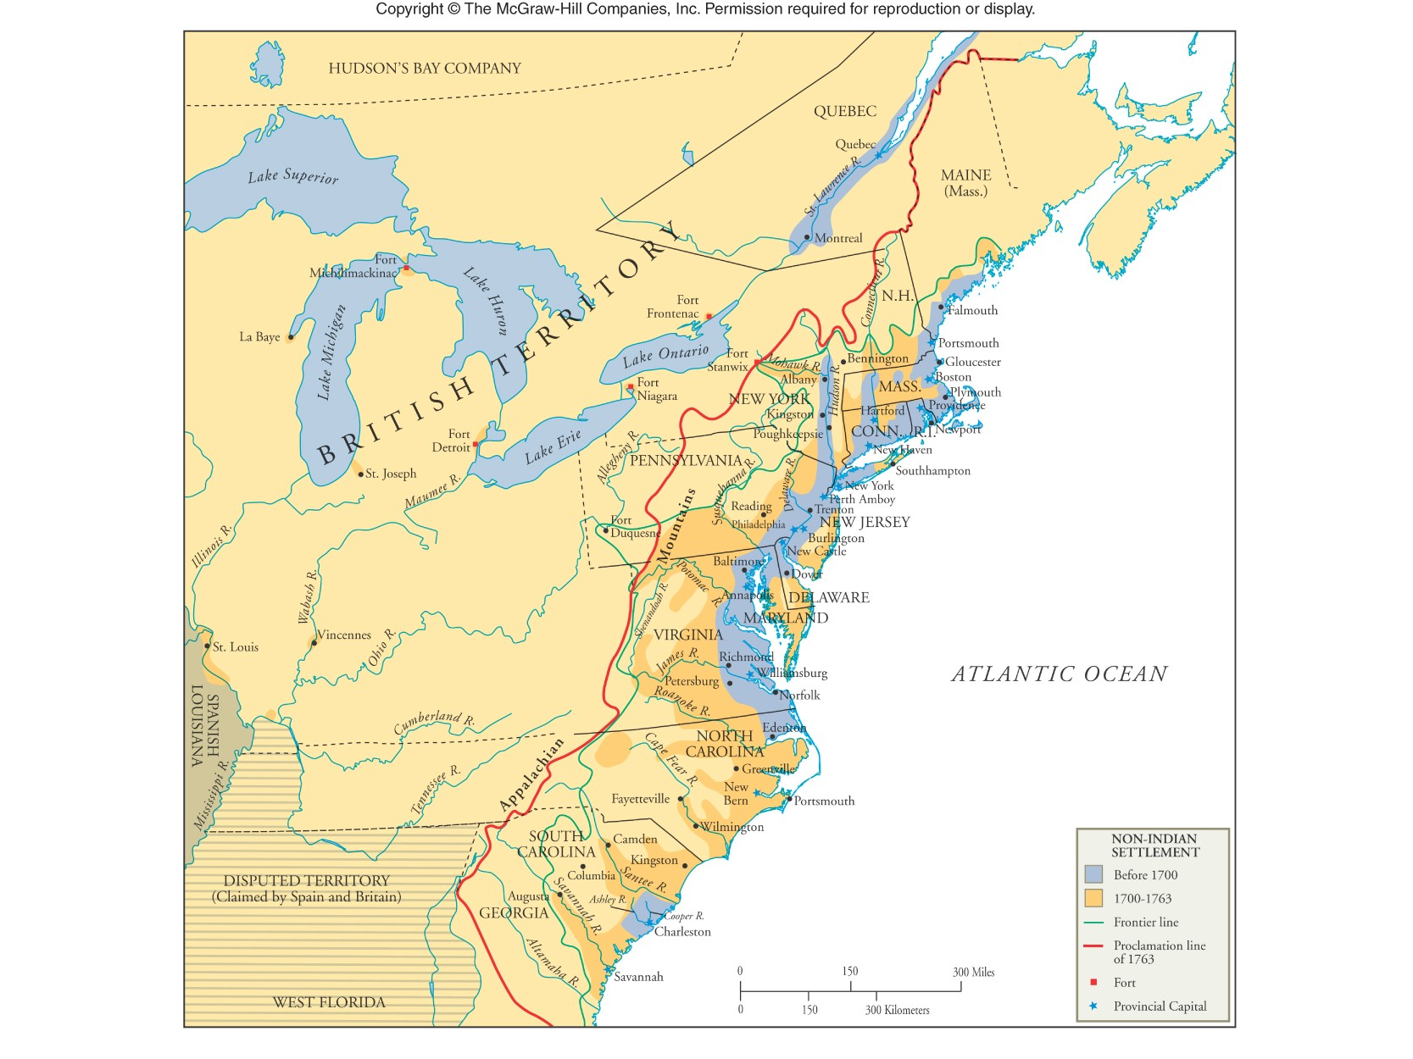

Slide 5
Ways Around Taxes
New Englanders worked their way around the tax by smuggling, and bribing customs officials.
British enforcement officers were aware of what was happening, but followed London's tacit “salutary neglect" of the colonies.
Merchants on both sides of the Atlantic were prospering before 1764

Slide 6
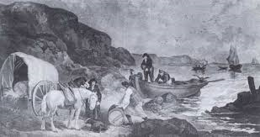
Smuggling

Slide 7
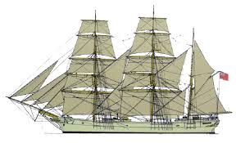
Smuggling Ships

Slide 8
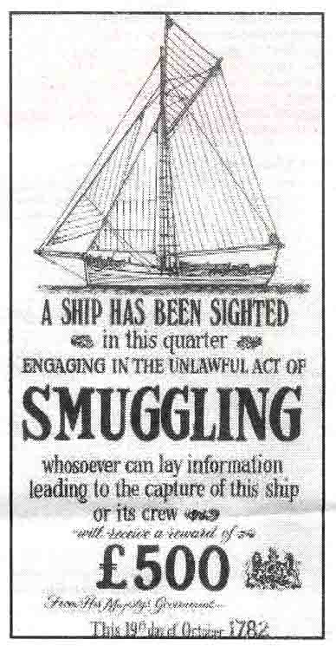

Slide 9
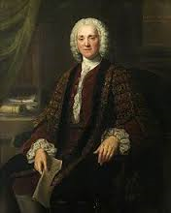
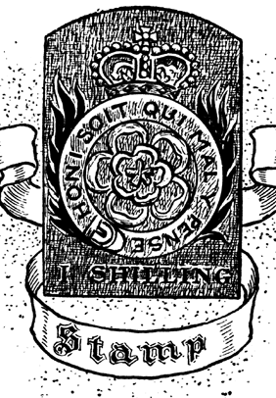
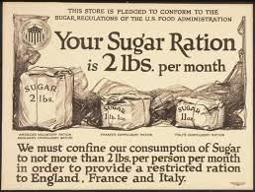
Sugar Act of 1764
Created by Prime Minister George Greenville
All sugar and molasses coming into the colonies would be taxed six pence
Used to pay for British troops used during the French and Indian War.

Slide 10
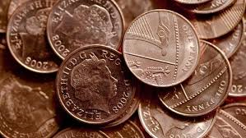
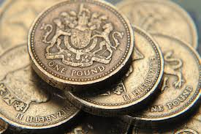
Understanding British Money
1 pence is equal to 1 penny
1 pound is equal to $1.25

Slide 11
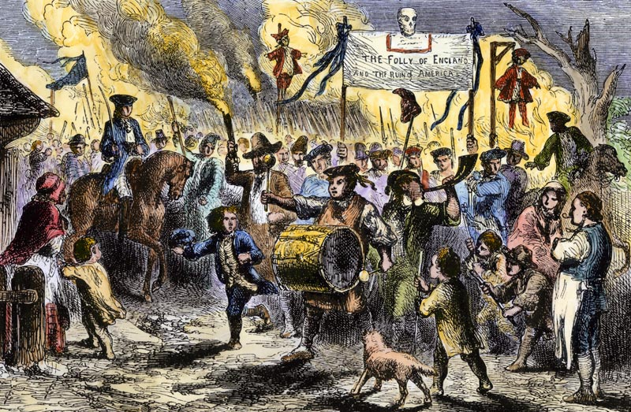

Slide 12
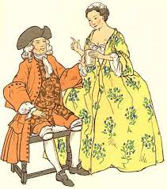
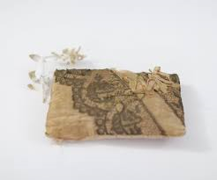
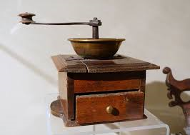
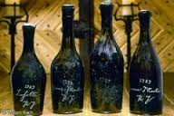
Tax on Imports
The original tax of sixpence per gallon was cut in half, but the government fully intended to collect the three-pence duty
The list of taxable items was expanded far beyond sugar — specified wines and cloth, coffee, tropical foods and silk were now subject to importation duties

Slide 13
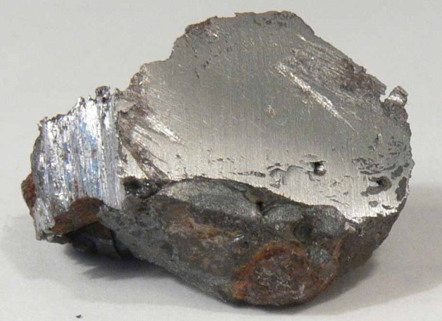
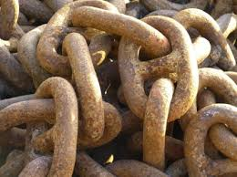
Tax on Exports
American exports, notably iron and lumber, were subjected to close supervision.
Shippers were required to complete a cumbersome bonding procedure before loading their cargoes.

Slide 14
Tax Effects on the Colonies
Enforcement of the Revenue Act of 1764, as it was formally known, caused immediate economic hardship in New England and the Middle Colonies.
Rum distilling slumped badly and colonial exports overall dropped sharply. The slowing economy was further impacted by currency contraction as people, uncertain of the future, tried to keep their money.
Efforts were made to settle debts with paper money rather than gold or silver.

Slide 15
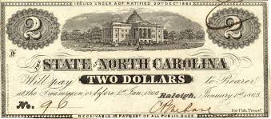
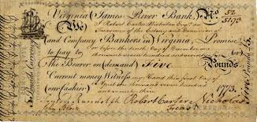
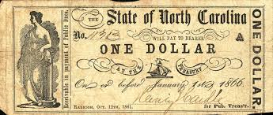
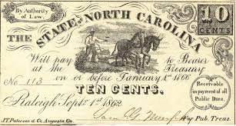
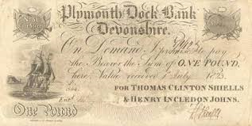
All Colonies had a Different Type of Currency

Slide 16
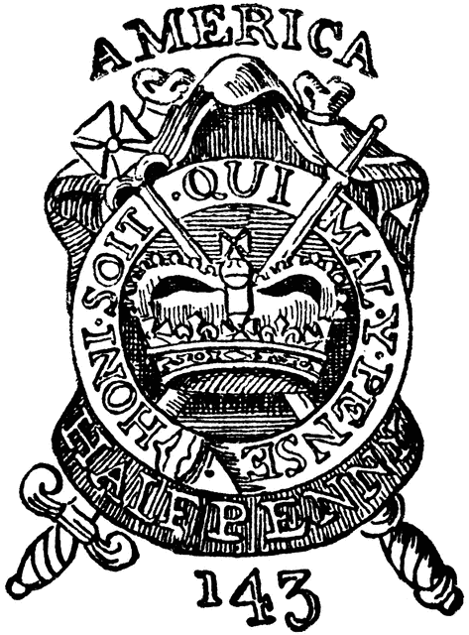
Stamp Act of 1765
Stamps tax on:
Newspapers
Magazines
Legal and commercial documents
Playing cards
Etc.
Had to be paid in British currency not in colonial paper money
Very unpopular among colonists. They considered it a violation of their rights as Englishman to be taxed without their consent.

Slide 17
Stamp Act Repealed in 1766
“There is not gold and silver enough in the colonies to pay the stamp duty (tax) for one year.”
Benjamin Franklin
“Such another experiment as the Stamp-Act wou’d produce a general Revolt in America”
George Mason, 1766

Slide 18
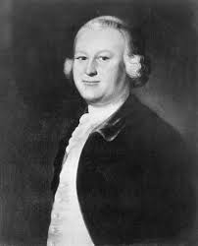
No Taxation without Representation
The King and Parliament began to enforce trade laws and impose taxes to help pay their debt caused by the French and Indian war
Men like James Otis raised the issue
There was no one in England to represent the colonies to help with these new laws.

Slide 19
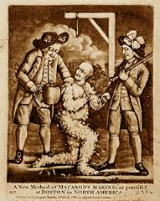
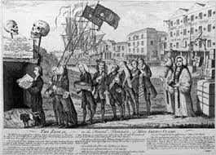
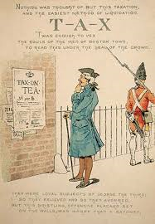
Townshend Act 1767
Imposed taxes on glass, lead, paints, paper, and tea imported into the colonies.
1770 Parliament repealed all the Townshend taxes except the tax on tea

Slide 20
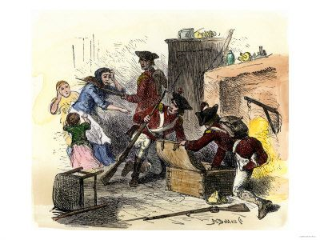
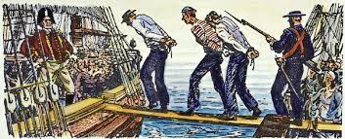
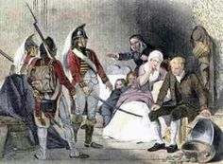
Writs of Assistance
Allowed the British to search and seize any home or ship that was suspect of having illegal (untaxed) items.

Slide 21
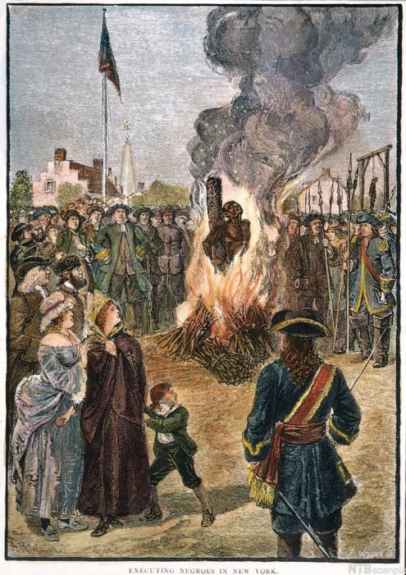
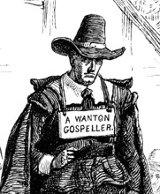
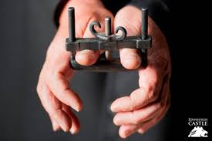
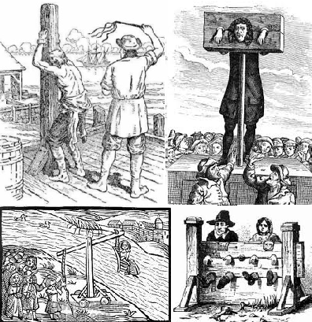
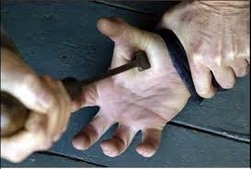
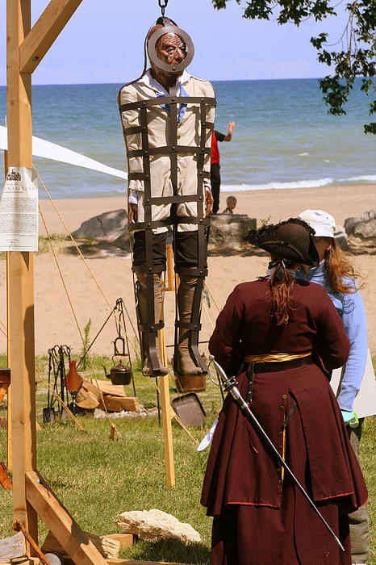
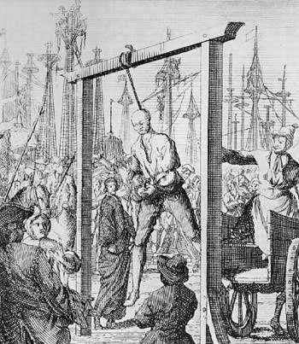

Slide 22
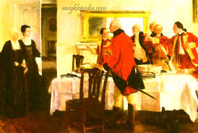
Quartering Act of 1765
Made the colonist supply the British soldiers with:
lodging
Food
Supplies
Transportation
Etc.

Slide 23
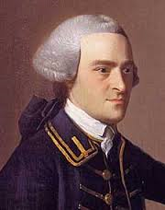
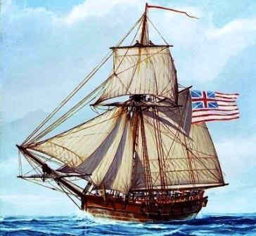
Leading up to the Boston Massacre
A ship, Liberty, owned by John Hancock was sized in 1768 for having illegal goods
Taxes and the seizure of ships leads to violence in Boston and an increase in troops

Slide 24
Boston Massacre
In 1768 British troops were stationed in Boston in order to protect and support crown-appointed colonial officials attempting to enforce unpopular legislation.
Incident on March 5, 1770
British Army soldiers killed 5 male civilians and injured six others
Includes Crispus Attucks considered the first casualty of the American Revolution

Slide 25
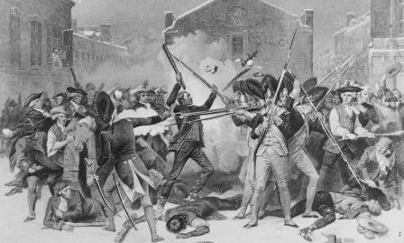

Slide 26
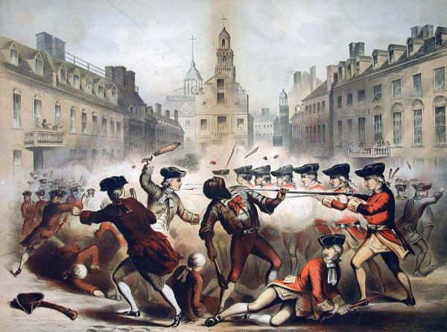

Slide 27
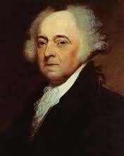
Boston Massacre
Eight soldiers, one officer, and four civilians were arrested and charged with murder.
John Adams (2nd president) defended the soldiers
Six of them were acquitted
Two were convicted of manslaughter and given reduced sentences by branding on their hands.

Slide 28
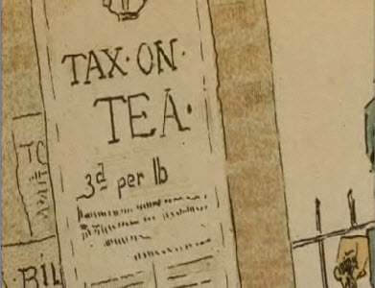
Tea Act of 1773
Granted the British East India Company a tea monopoly.
Monopoly is when only one company sells a certain item.

Slide 29
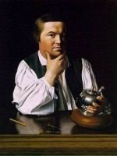
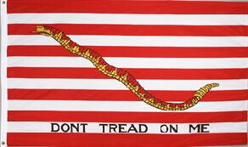
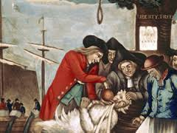
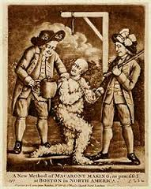
Sons of Liberty
Formed by Samuel Adams
Protested against taxes
Sometimes used intimidation and physical violence to achieve their goals

Slide 31
Boston Tea Party
Sons of Liberty dump British tea in to the Boston Harbor in 1773
Disguised as Mohawk Indians
Boarded 3 British Ships
Dumped 342 chests of tea into the water

Slide 32
Boston Tea Party
92,000 pounds of tea roughly 46 tons of tea
£9,659 reported damage cost
$1,700,000 in todays money

Slide 33
English Tea

Slide 35
The Intolerable Acts of 1774
Boston Port Bill
Closes Boston Harbor Until tea was paid for
Administration of Justice Act
British officials could not be charged with a crime
Massachusetts Government Act
Massachusetts charter is revoked
Quebec Act
Canada given more territory, taken away from Virginia, Connecticut, and Massachusetts

Slide 36
Thomas Paine (1737-1809)
Published Common Sense, a pamphlet, in 1776
Talked about the problems of the monarchy
Made people think of independence
Sold more than 150,000 copies

Slide 37
1st Continental Congress
A meeting of 56 delegates from twelve of the Thirteen Colonies
Georgia did not attend as they did not want to upset the British. They needed their help with the Native Americans
Meet on September 5 to October 26 1774
Meet at Carpenters’ Hall in Philadelphia, Pennsylvania

Slide 39
Outcomes of the 1st Continental Congress
1. Boycott British goods beginning on December 1, 1774
British goods drop 97% in 1775
Implemented to make the British get rid of the Intolerable Acts
2. Allow to provide for a second continental congress to meet on May 10, 1775

Slide 40
Members of the 1st Continental Congress
56 members total including:
George Washington
Patrick Henry
Samuel Adams
John Adams

