Slide 1
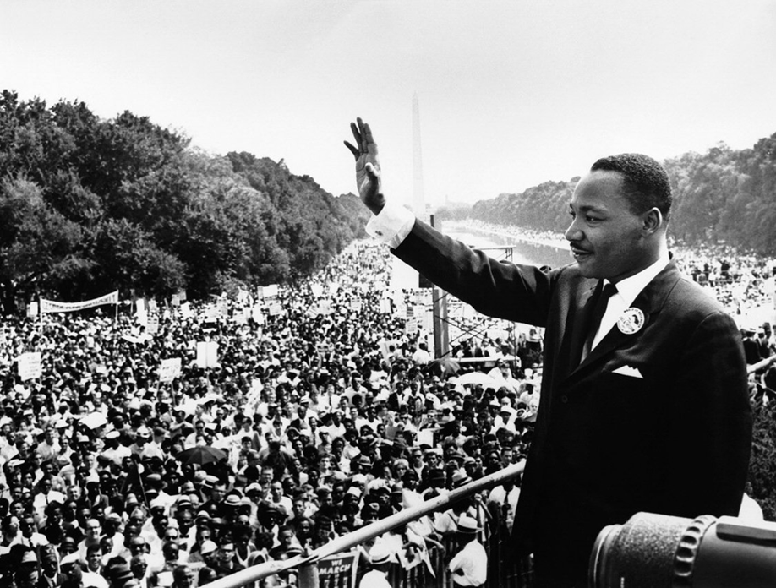
Civil Rights Movement 1954 - 1968
Mr. Condry’s Social Studies Class

Slide 2
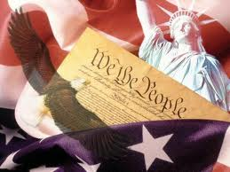
Reconstruction Amendments
13th Amendment
Outlawed slavery
14th Amendment
Made African Americans citizens
Guaranteed equal protection under the law
15th Amendment
Guaranteed African Americans the right to vote

Slide 3
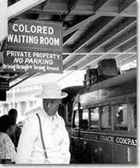
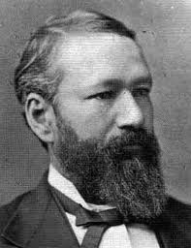
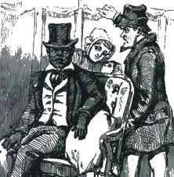
Plessy v. Ferguson (1896)
U.S. Supreme Court case that made segregation legal in the United States.
“Separate but Equal”

Slide 4
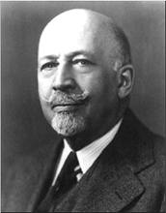
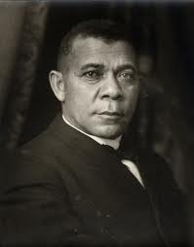
Early Civil Rights Leaders
W.E.B. DuBois
pushed for immediate civil rights and equality.
Leader of NAACP
Booker T. Washington
Founder of the Tuskegee Institute.

Slide 5
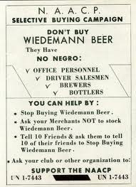
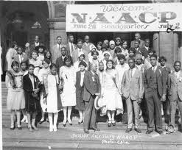
NAACP (1909)
National Association for the Advancement of Colored People was established.
Worked to end segregation

Slide 6
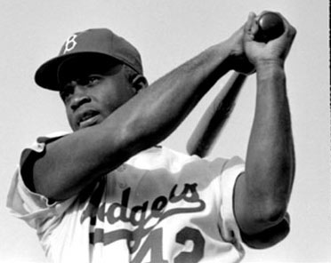
Integration of Baseball
Jackie Robinson was born in Cairo, Georgia in 1919
1944, Robinson played in the Negro leagues on a team called the Kansas City Monarchs.
1946 Brooklyn Dodgers sign Jackie
Jackie Robinson, at the age of 27, became the first African American baseball player in the major league history.

Slide 7
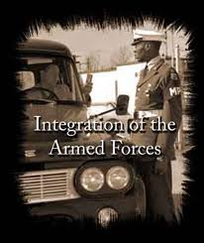
Integration of the Military (1948)
President Truman integrates the military in 1948

Slide 8
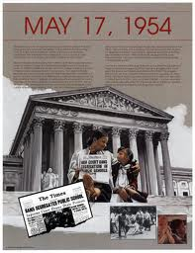
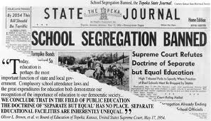
Brown v. Board of Education (1954)
Supreme Court rules “separate educational facilities are inherently unequal.”
Violated the 14th Amendment
Ends school segregation

Slide 9
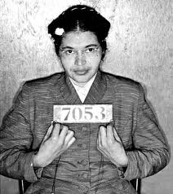
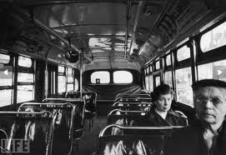
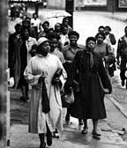
Montgomery Bus Boycott (1955)
Rosa parks arrested for refusing to move to the back of the bus.
A boycott follows, leading to desegregation.

Slide 10
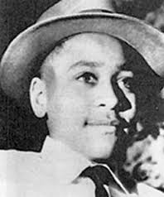
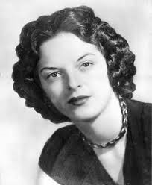
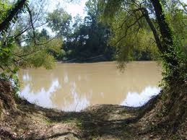
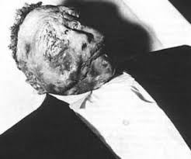
Emmitt Till (1955)
14 year old boy from Chicago whose murder in 1955 made national news.
He was lynched and murdered after he said “bye baby” to a white woman who was a cashier at a store in Money, Mississippi.

Slide 11
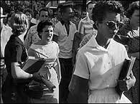
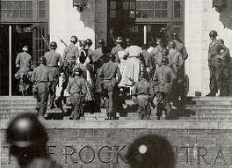
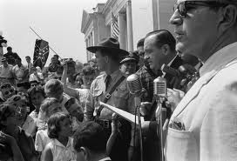
Integration of Schools (1957)
Little Rock, Arkansas
“The Little Rock Nine”
President Eisenhower sends federal troops after Arkansas governor Orval Faubus uses the National Guard to deny entrance to African American Students at Central High School

Slide 12
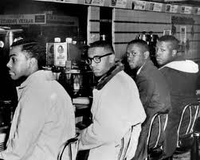
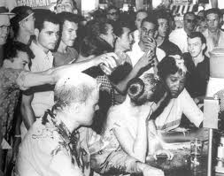
Greensboro Sit-ins (1960)
College students in Greensboro, NC stage a sit-in at the Woolworth’s lunch counter
Passive form of protests

Slide 13
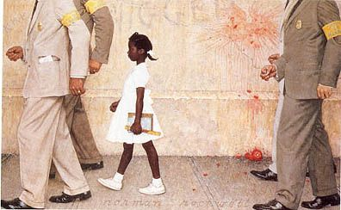
Ruby Bridges (1960)
Became the first African American elementary school child to attend a white school.
Had to be escorted to school by federal marshals
Many teachers refused to teach her and many of the white students went home.
She went to school everyday.

Slide 14
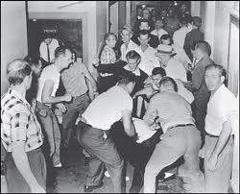
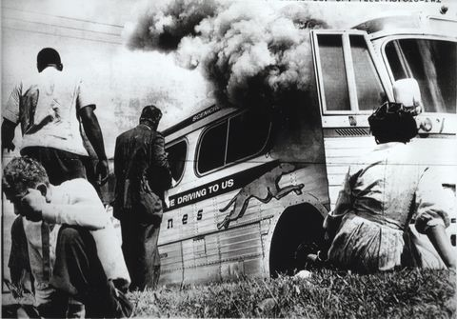
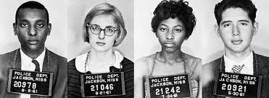
Freedom Rides (1961)
Protests the segregation of interstates and busses.
Volunteers (all races), took buses into the South to test new desegregation laws, often meet with violence.

Slide 15
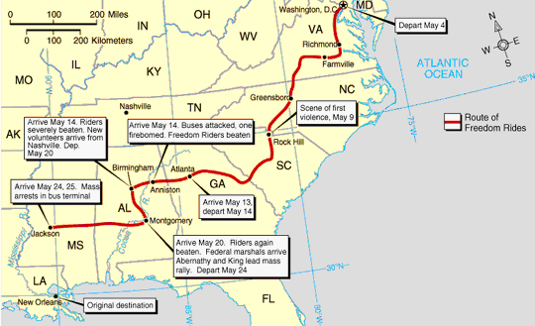

Slide 16
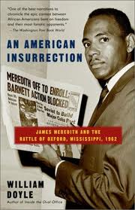
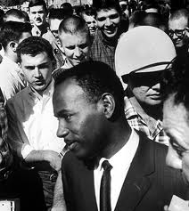
University of Mississippi (1962)
James Meredith, the school’s first African American student
President Kennedy sends 5000 federal troops to Mississippi

Slide 17
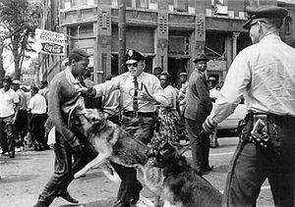
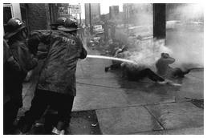
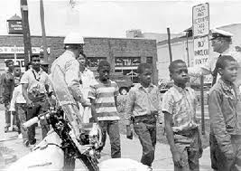
Birmingham, Alabama (1963)
Martin Luther King and the Southern Christian Leadership Conference (SCLC) focus on segregation in Birmingham.
Protests end in violence, riots, and arrests of adults and children.

Slide 18
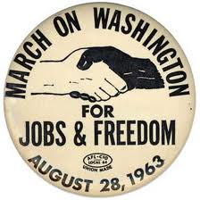
March on Washington (1963)
To protest job discrimination and freedom for all.
200,000 people hear Martin Luther King’s “I have a Dream” speech in Washington, D.C.

Slide 19
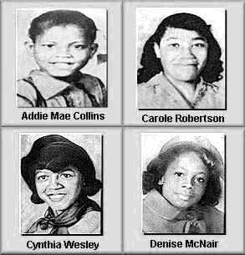
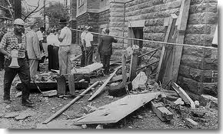
Bombing in Birmingham (1963)
16th St. Baptist Church, a bomb explodes on a Sunday morning, killing four young girls.
KKK member seen planting bomb was arrested and found guilty of possessing dynamite without a permit.
Fined $100 and serves six months in jail.

Slide 20
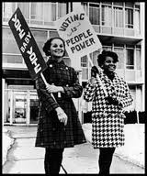
24th Amendment (1964)
Outlawed poll taxes.
African American voter registration begins to increase.

Slide 21
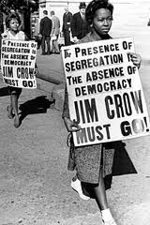
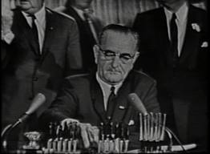
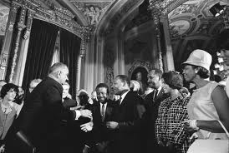
Civil Rights Act 1964
Outlaws discrimination based on race.

Slide 22
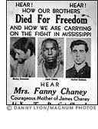
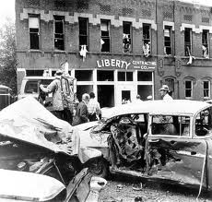
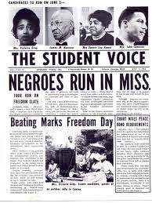
Mississippi Freedom Summer (1964)
Civil rights activists attempt to register African Americans to vote

Slide 23
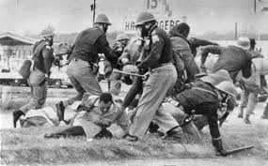
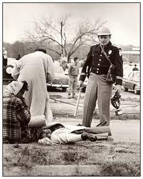
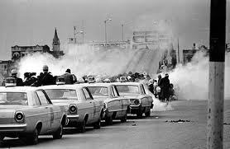
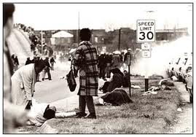
Selma March (1965)
Demanding voting rights, 600 protesters plan to march to Montgomery.
6 blocks into the march, they meet state troopers armed with nightsticks and tear gas.

Slide 24
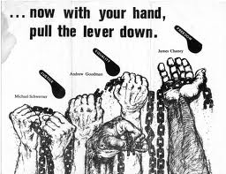
Voting Rights Act (1965)
In the aftermath of Selma, President Johnson calls for passage of a voting rights bill.
Outlaws literacy tests, established federal oversight

Slide 25
Protests – Different views
Martin Luther King, Jr.:
Non-violent, passive resistance
Influenced by Gandhi
Black Power:
Proactive, militant, focus on black pride and African heritage.
Term popularized by Stokely CarmichaeL

Slide 26
Malcolm X
Born Malcolm Little, he learned the ideas of black pride and self-reliance from his father, a follower of Marcus Garvey and member of the UNIA
While in Prison, he converted to Islam and joined the Nation of Islam.
Upon release, he changed his name; the X represented the African heritage he would never know.
He preached the superiority of blacks and separation from whites; he scorned King’s non-violence saying black people should use any means to protect themselves.
Between 1952 and 1963, the Nation of Islam grew from 500 members to 25,000.

Slide 27
Malcom X
In 1964, Malcolm X made a pilgrimage to Mecca.
After seeing Muslims of different races treating each other as equals, he changed his views.
After a meeting in February 1965, Malcolm X was assassinated by two members of the Nation of Islam.
The men were caught and imprisoned for their crime, but they proclaimed their innocence.
Became the most well known African American radical

Slide 28
Urban Race Riots (1965-1967)
A call for economic rights
Watts, California
Detroit, Michigan
Newark, New Jersey

Slide 29
Martin Luther King, Jr. Assassinated (1968)
King was shot by James Earl Ray in Memphis, Tennessee

