Slide 1
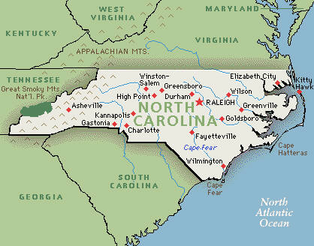
Geography of North Carolina
Mr. Condry’s Social Studies Class

Slide 2
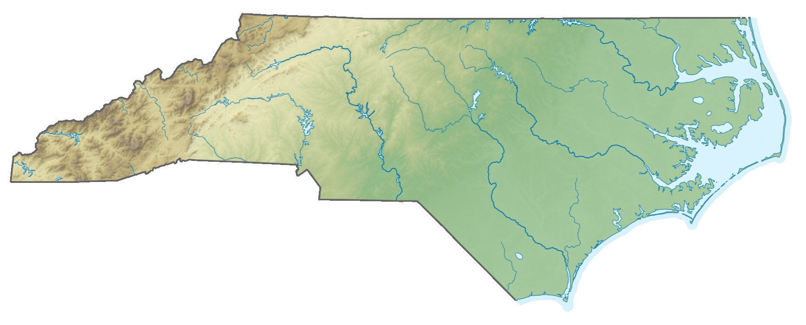
Geography
The study of physical features of the Earth
North Carolina has a varied geography from the beaches to the highest mountains in the Eastern United States.

Slide 3
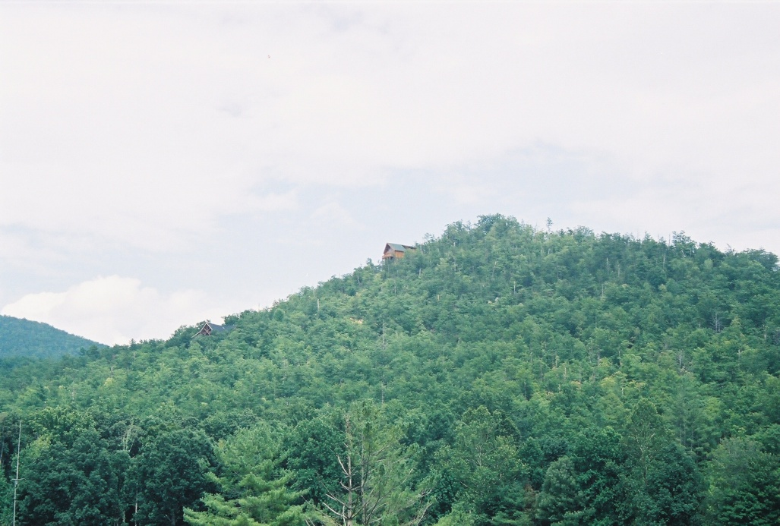
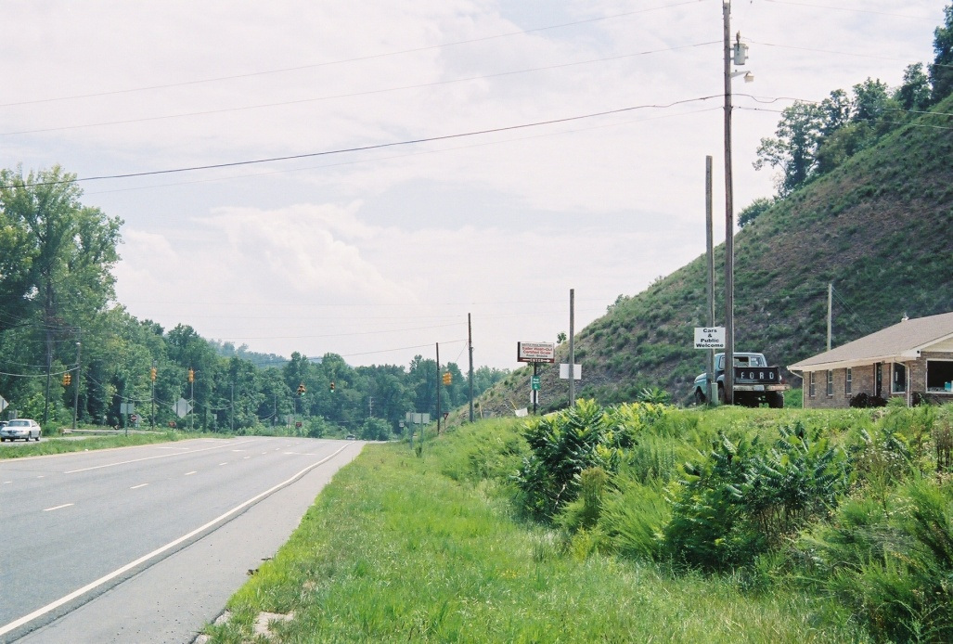
Human-Environmental interaction
The geography of North Carolina has had major influences on how the people live. People have also had a major impact on the geography of our state.
People have drained swamps, clear cut forests, damming of rivers, and leveling of hills and mountains.
Before…… After…….

Slide 4
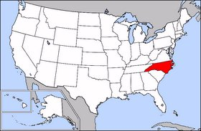
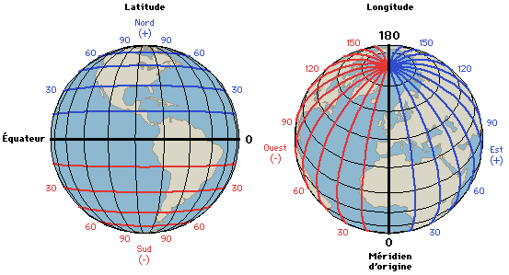
Location
North Carolina’s Relative Location is the Southeastern United States
Relative location: close to something
North Carolina’s Absolute location is 34 degrees North Latitude and 75 degrees to 84 degrees West longitude
Absolute location: an exact location

Slide 5
Regions of North Carolina
Mountains
Piedmont
Coastal Plains
Tidewater
Fall Line: an imaginary line that runs through NC, that marks where falls are first found on rivers. These lines separate the different regions.
North Carolina covers over 53,000 square miles and is about the size of England.

Slide 6
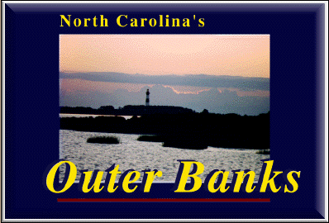
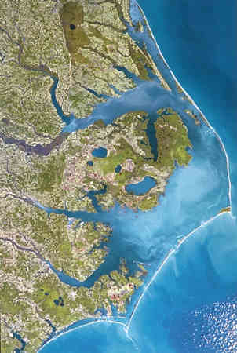
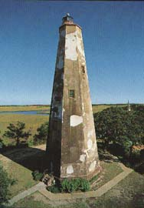
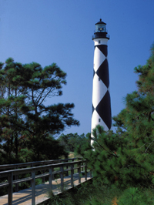
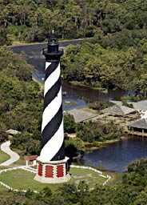
Tidewater Region
Is a series of islands called “Outer Banks”
Part of these islands that jut out into the ocean are called capes
Capes: part of the coast that juts out into the ocean.
There are 3 capes in North Carolina
1 .Cape Fear
2. Cape Lookout
3. Cape Hatteras

Slide 7
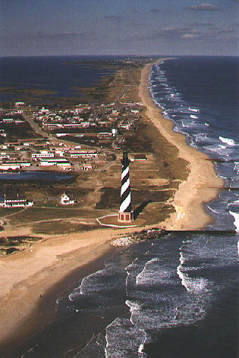
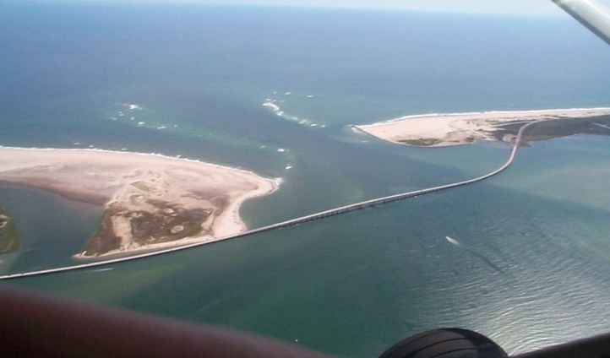
Tidewater Continued…
Capes are characterized by shallow water.
Many ships have run aground near Cape Hatteras
It is known as the “Graveyard of the Atlantic”
This area still remains known for its beauty and isolation
The Outer Banks “Barrier Islands” have many inlets
Inlet: a break in a barrier island that allows ocean water to come in and out.

Slide 8
These maps show the many recorded ship wrecks and reefs located on the coast of North Carolina.

Slide 9
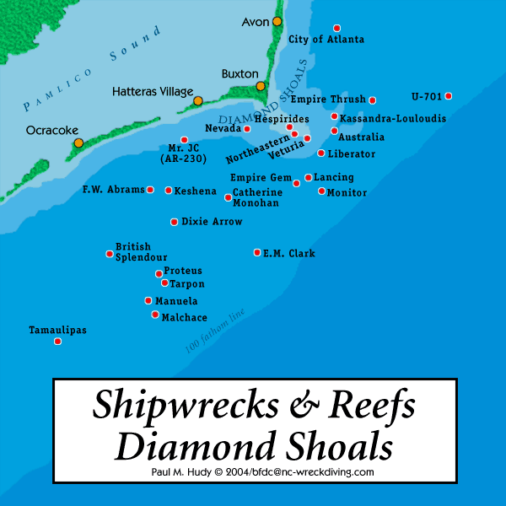

Slide 10
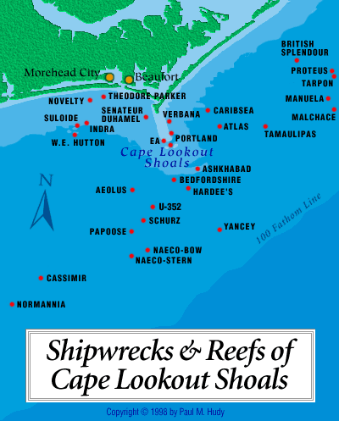

Slide 11
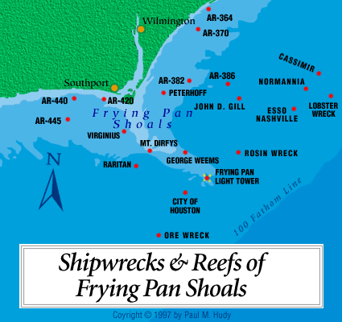

Slide 12
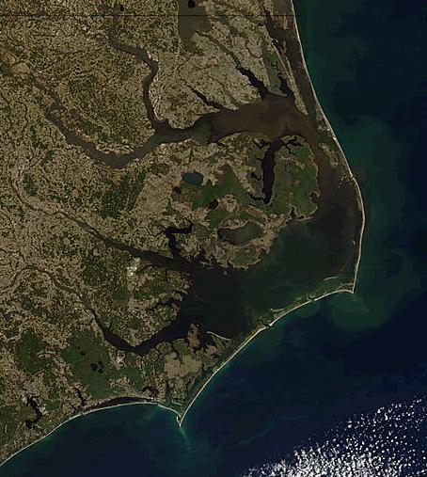
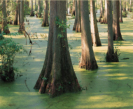
Across the Albemarle and Pamlico sounds in the main tidewater region lie many swamps.
Sounds: large inland body of water that contains a mixture of salt and fresh water.
A large portion of the tidewater is wetland
Wetland: a place where soil is soaked or flooded with water year round.

Slide 13
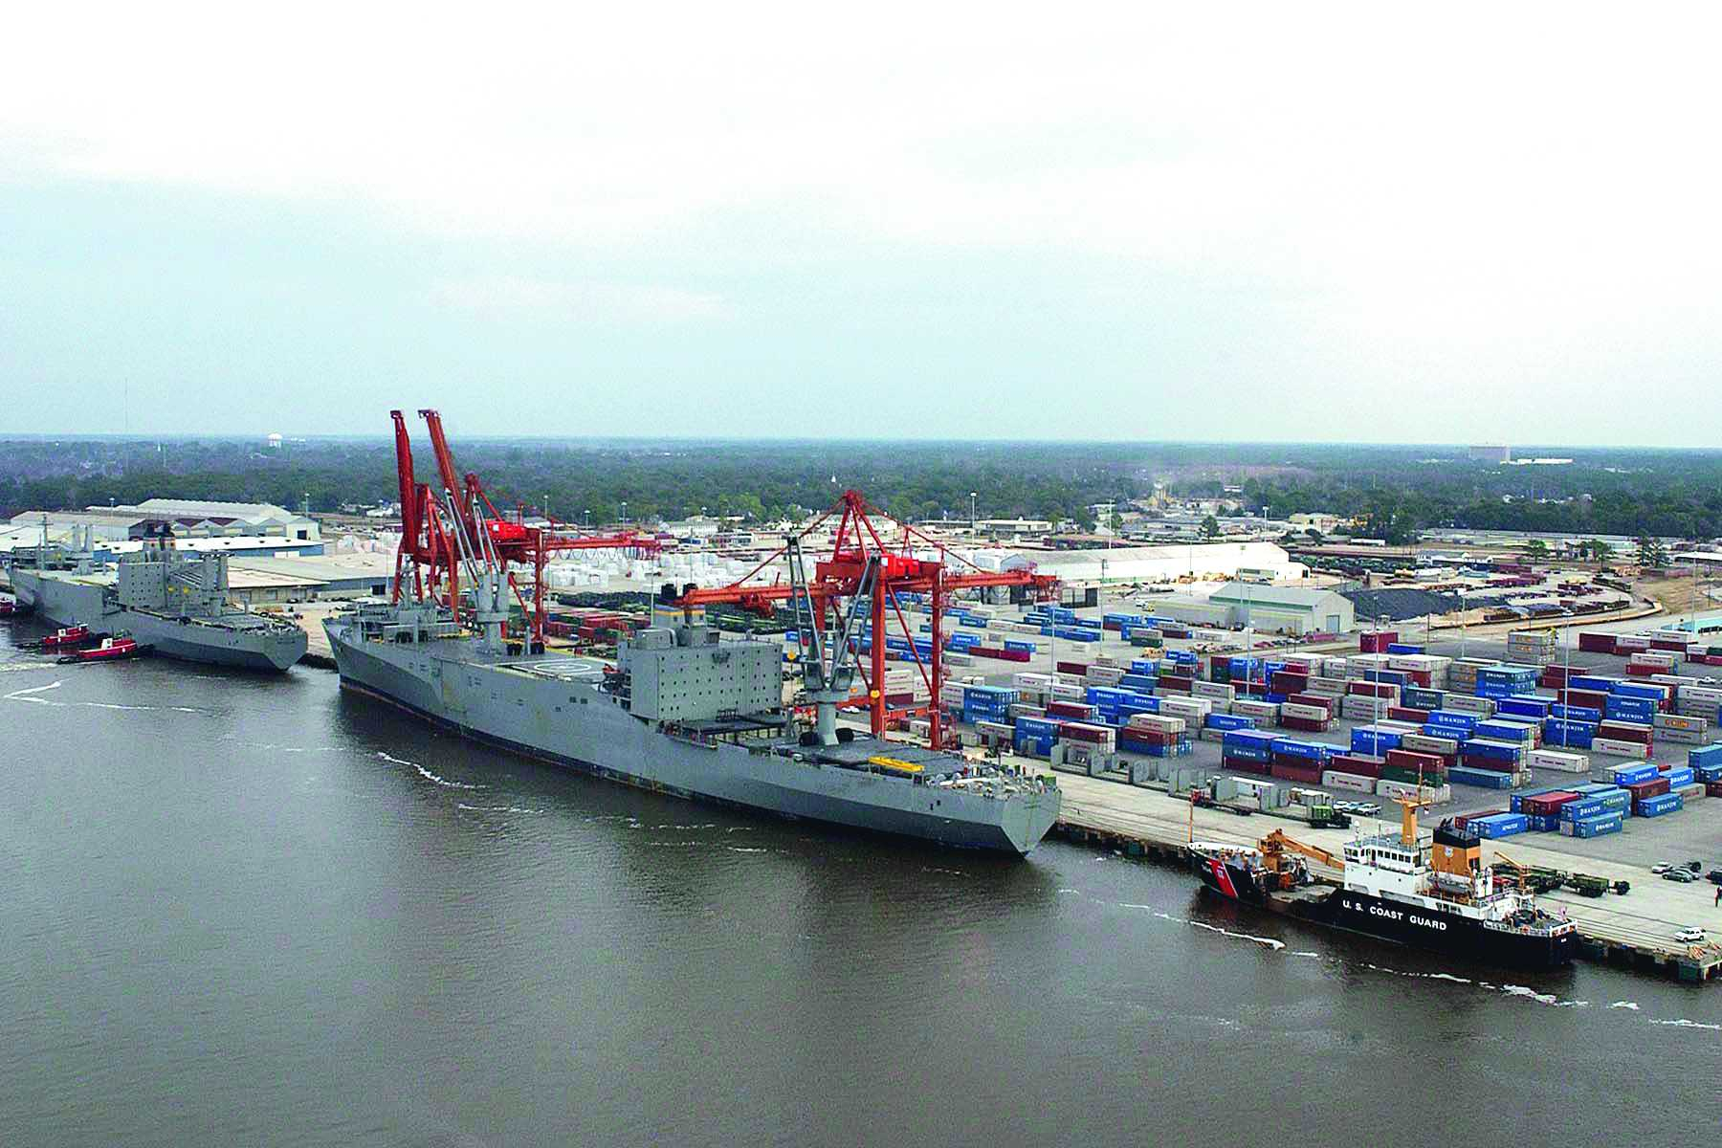
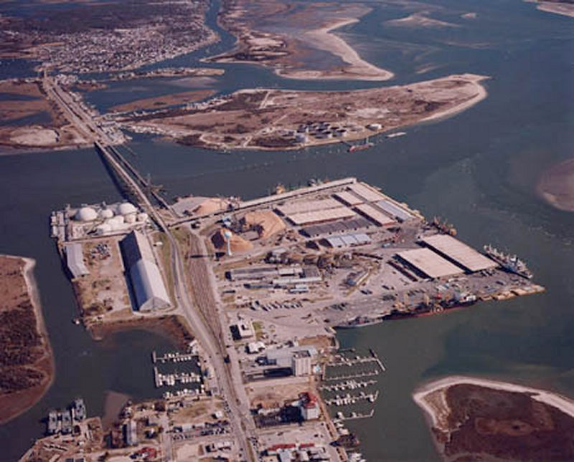
Why are these ports of North Carolina important?
Wilmington Morehead City

Slide 14
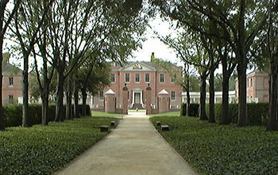
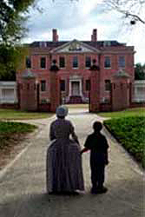
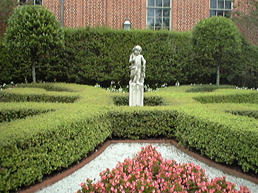
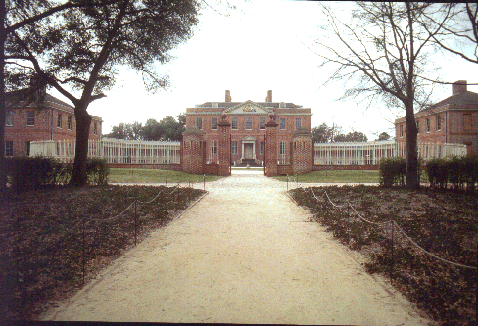
Tryon Palace
Was the home for the British Colonial government in New Bern

Slide 15
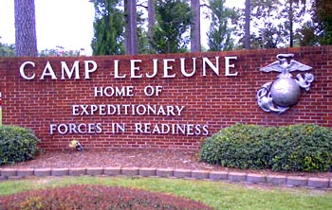
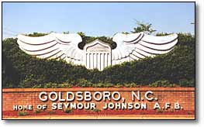
Coastal Plain Region
Contains 4 major military bases.
Camp Lejeune
Cherry Point Marine Corp Base
Fort Bragg/Pope Air Force Base
Seymour Johnson Air Force Base
How does this impact NC?
Economy
Security
Status

Slide 16
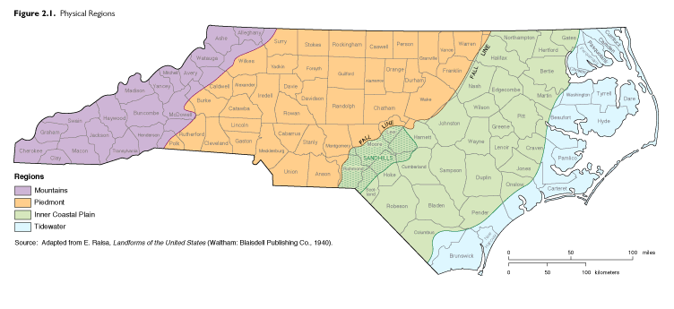
The map shows NC’s 4 regions. The light green and light blue are the Coastal Plain and Tidewater Regions.
The Coastal Plain and Tidewater Region contain nearly ½ the states land.
The richest soil in the state is found in the Coastal plain.

Slide 17
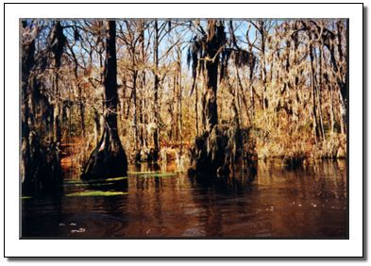
The nation's oldest canal is located in this region in the Dismal Swamp.
Major phosphate deposits are found in the tidewater area, these are used to make fertilizers.

Slide 18
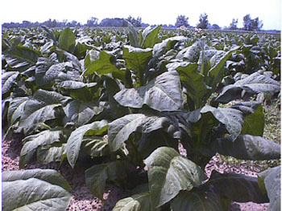
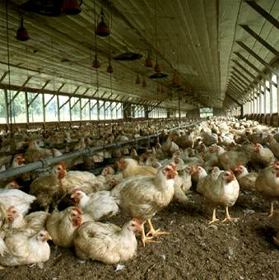
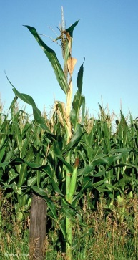
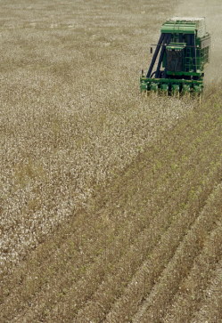
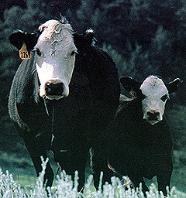
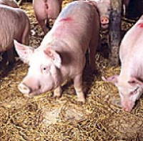
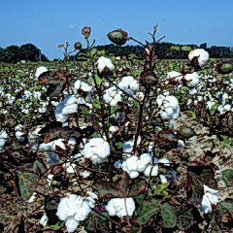
Coastal Plain Continued.
Sandy soil makes for the states best agriculture region
Tobacco, Cotton, Corn, Wheat are just a few of the crops grown here.
This area is also known for dairy and beef cattle, along with hogs and poultry farms.

Slide 19
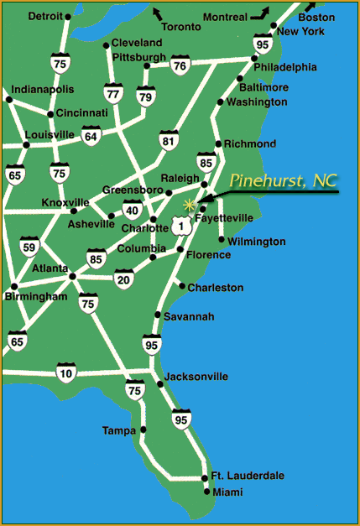
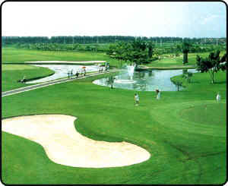
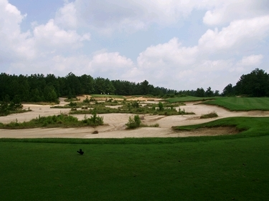
Coastal Plain Continued
Fayetteville is the largest city in the region
The Coastal Plain/Sand Hills are also noted for their golf courses. Pinehurst is home to the World of Golf Hall of Fame.
This brings in tourist and money for the state.

Slide 20
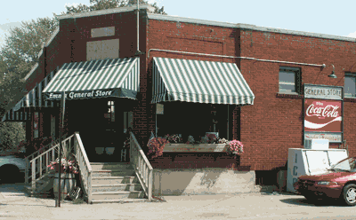
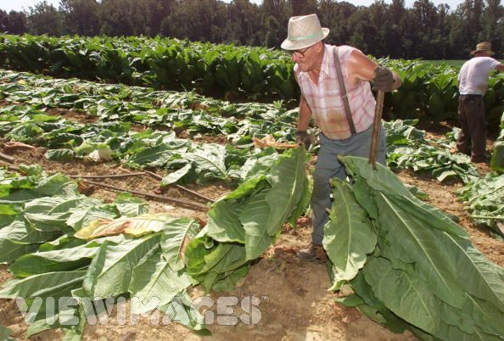
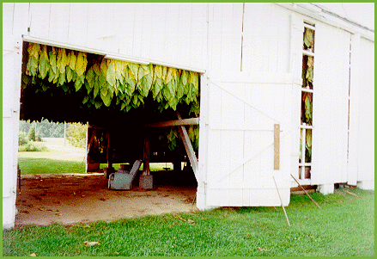
Tobacco Towns
Containing nearly 1/3 of NC’s land and having few urban areas (cities), the region is full of little Crossroads Hamlets
Crossroads Hamlet: Small towns that provide goods and services to nearby farmers
Throughout the 1900’s everyone in rural NC scheduled their business around tobacco harvest. Tobacco was crucial in the development of NC.
Since the 1990’s these “Tobacco Towns” have dwindled due to the stigma and health risks that have become associated with tobacco use.

Slide 21
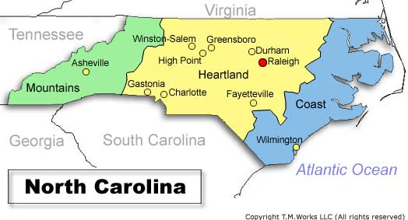
Piedmont Region
Piedmont: at the foot of the mountain.
Located between the fall line and NC mountains.
Middle of the state.
Red clay is the major soil characteristic
All of NC’s largest cities are found here.

Slide 22
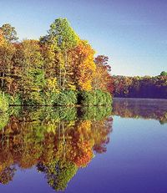
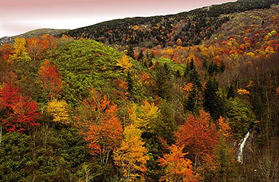
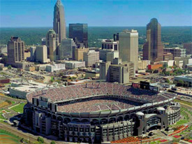
Geography of the region
Rolling hills hardwood forests
Mineral deposits
Red clay
The Piedmont Region is the center of the states urban (city) population and headquarters for business, manufacturing, and technology industries
Railroads helped these cities grow.
Largest cities in the state are located here:
Charlotte (the largest)
Raleigh
Greensboro
Durham
Winston-Salem

Slide 23
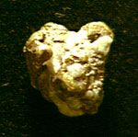
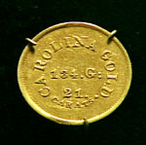
Piedmont Region Continued……
NC was one the worlds leading producers of
Textiles
Tobacco
Furniture
with many of our industry jobs going over seas- this region is having to change its focus of manufacturing to technical and biotechnical fields.
NC was once the leading gold producing states before the California Gold Rush. Gold was even minted in Charlotte.

Slide 24
Kudzu
originally brought to NC to help control the erosion of the piedmont soil. Kudzu is a native plant of Asia and can grow up to several feet in one day.

Slide 25
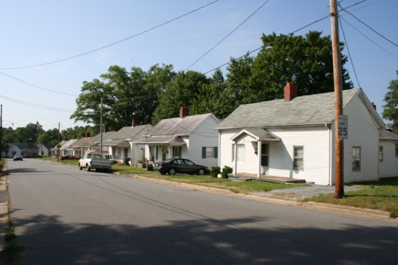
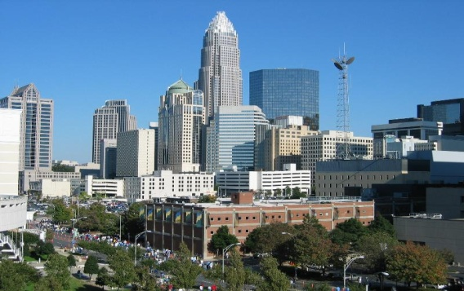
Evolution of the Piedmont
Traditional farming soon gave way to the blue collar factory jobs of the piedmont
Textiles, tobacco, an now technology have all impacted the way people in the piedmont work and live.
Much of our area still contain Mill Village houses
Mill Villages: clusters of homes and communities surrounding a textile mill.

Slide 26
Piedmont Region Continued….
With the moving of textile jobs overseas and to Mexico, the piedmont has moved to white collar professional jobs. This change has made charlotte one of our nations most important cities.
Charlotte is considered the center for international banking
NASCAR calls Charlotte NC home. NASCAR’S Hall of Fame is located there.
The Piedmont also is home to such companies as Food Lion (NC’s Largest private employer) and many other larger corporations.

Slide 27
College Education
The piedmont is considered the center of higher education for our state.

Slide 28
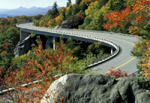
Mountain Region
Located between the Piedmont and Tennessee.
Part of the Appalachian Mountain Chain.
Elevation ranges from about 1500 to 6600 feet.
Elevation: height above sea level
Mount Mitchell (6684 ft.), in Yancey County, is the highest peak East of the Mississippi.

Slide 29
Cherokee Indian Reservation
Located in the mountain region.

Slide 30
Mountain Region Continued….
Agriculture is important.
Major cash crops are tobacco and Christmas trees.
Cash Crops: crop grown to sell for profit.
Mining, logging, and tree farming are major contributors to the economy of the mountains.

Slide 31
Tourism
The most important way the region makes money.
People visit here for the Blue Ridge Parkway, Appalachian Trail, Skiing, Mining, Hiking, Arts and Crafts, Music and to get away from the city.

Slide 32
Biltmore House
Built on 8,000 acres.
Built by George Vanderbilt
Completed in 1895
250 room mansion
Modeled after a French Chateau
Today the estate encompasses the house, gardens, restaurants, gift shops, inn, and winery.
Biltmore House is located in Asheville, NC was built as a vacation home for the Vanderbilt Family to get away from the summer heat of New York City.

