Slide 1
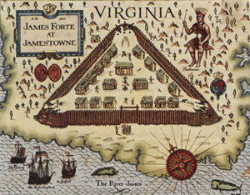
The Jamestown colony
Mr. Condry’s Class

Slide 2
Establishment of the colony
America’s first permanent English colony
Established in Virginia in 1607
The government language, customs, beliefs and aspirations of these early Virginians are all part of the United States’ heritage today.

Slide 3
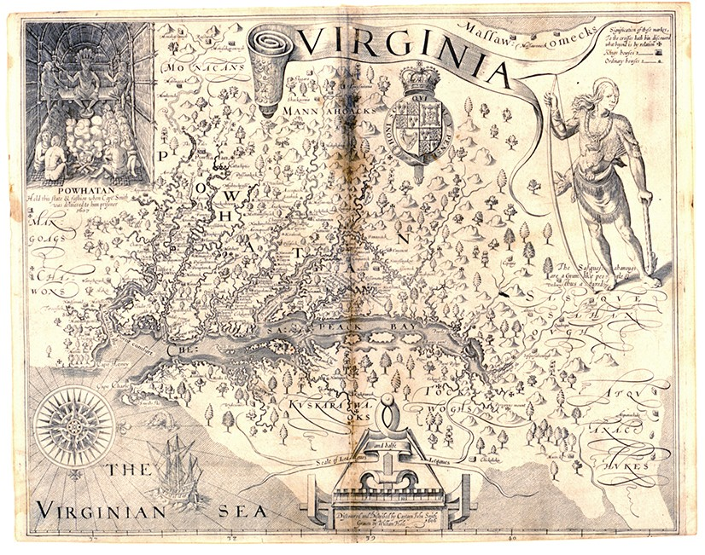
Map of Virginia by John Smith in 1612

Slide 4
Establishment of the colony cont.
Sponsored by the Virginia Company of London
This group hoped to profit from the venture.
Chartered in 1606 by King James I
Sought a northwest passage to Asia
Wanted to convert the Virginia Native Americans to the Anglican Religion.

Slide 5
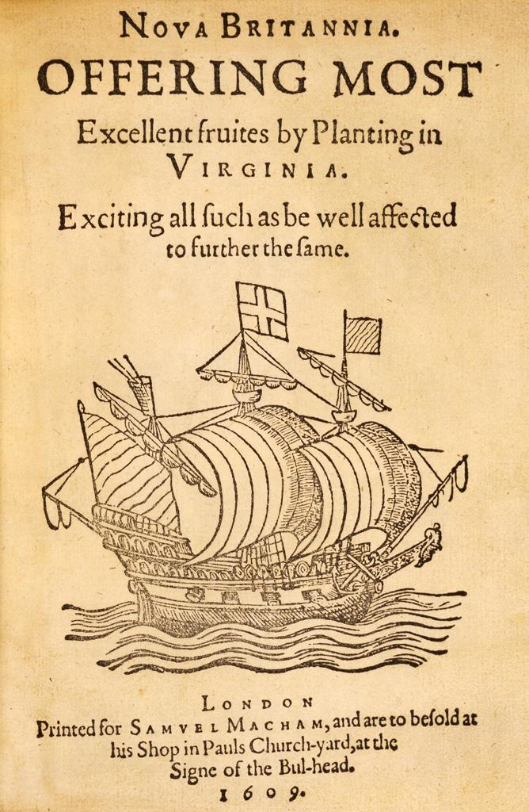
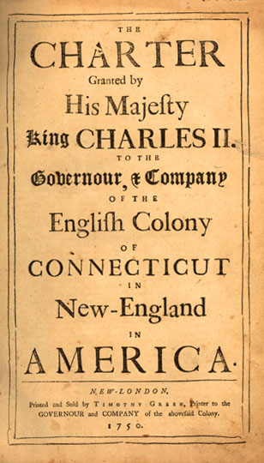
Propaganda posters used to get people excited about traveling to the new world.

Slide 6
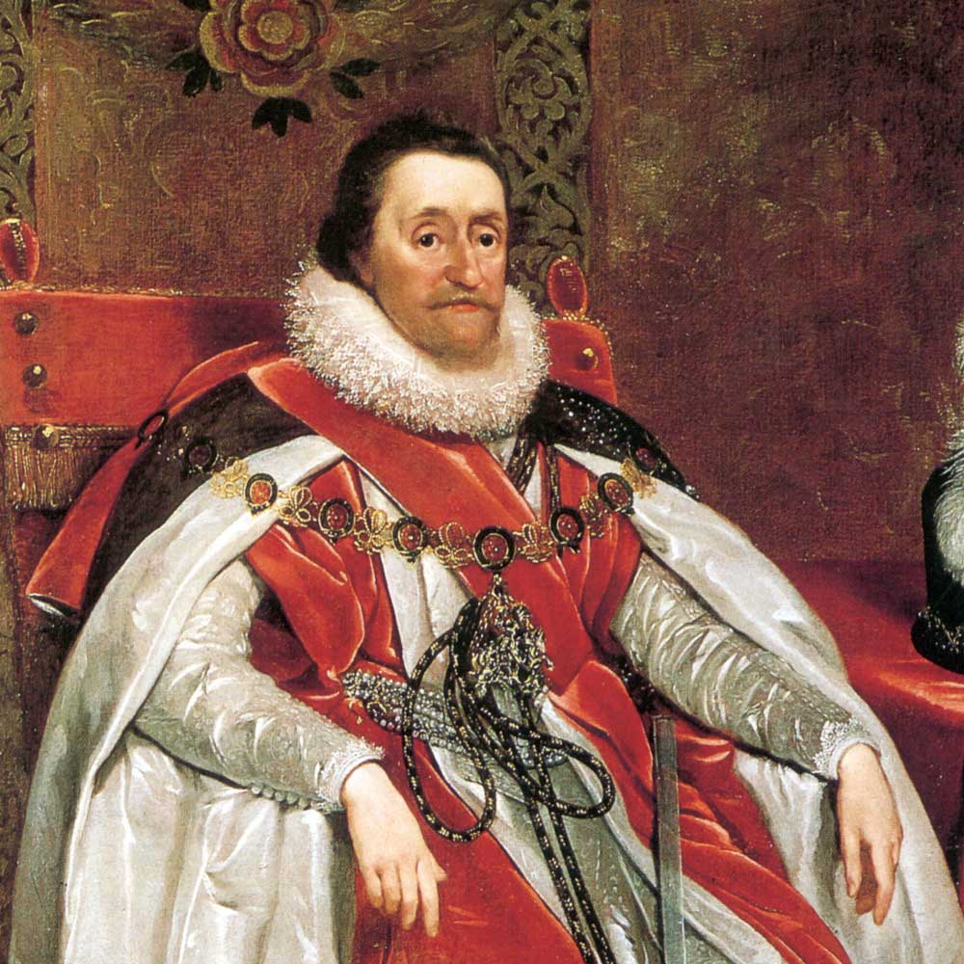
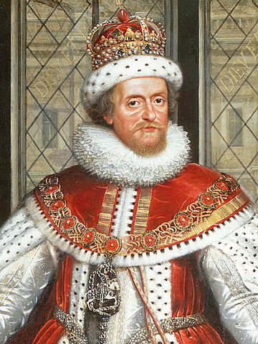
King James I
Had the bible converted to English

Slide 7
Anglican Religion
Under King Henry VIII in the 16th century, the Church of England (Protestant) broke with Rome (Catholic), largely because Pope Clement VII refused to grant Henry an annulment of his marriage to Catherine of Aragon
The Book of Common Prayer originally issued in 1549 represents the faith’s independence from Rome
Still around today estimating 9,000 to 33,000 different denominations of Protestant

Slide 9
The Ships of the Colony
Three ships were sent
Susan Constant
Godspeed
Discovery
Total number of passengers
105
One would die on the voyage over

Slide 10
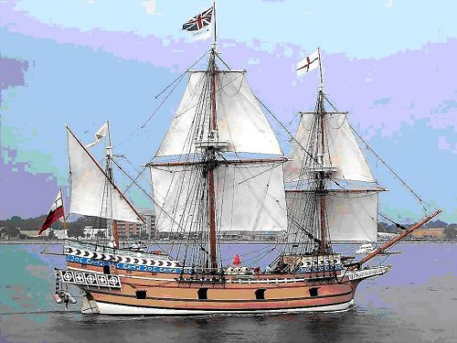
Susan Constant

Slide 11
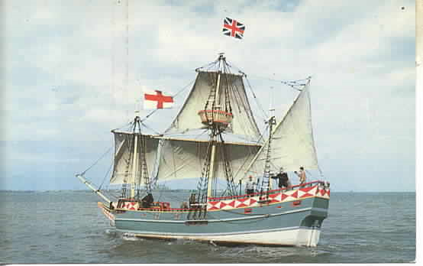
Godspeed

Slide 12
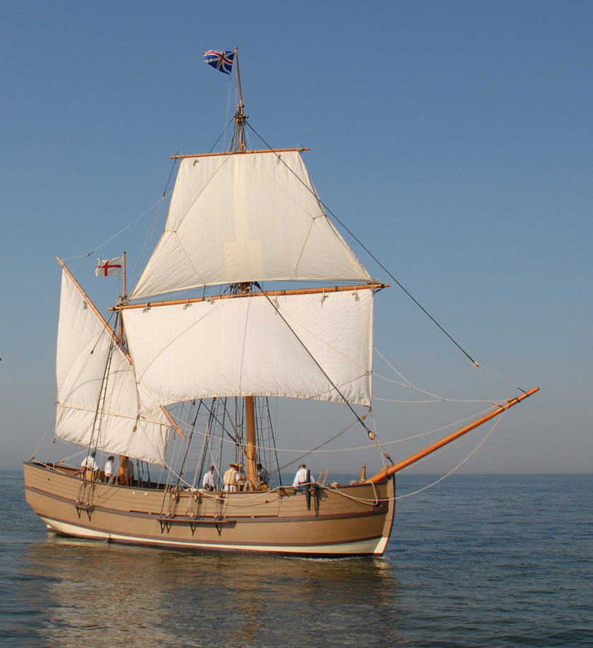
Discovery

Slide 13
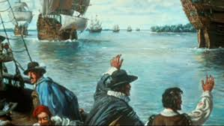
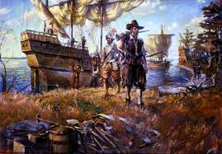
Voyage to the Colony
The ships left England in December 1606
Arrived the Virginia coast in April 1607

Slide 14
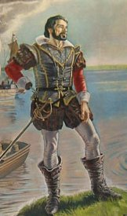
Expedition for the colony
Captain Christopher Newport led the expedition
May 13th arrived at a site on the James River
Passengers arrived on May 14th

Slide 15
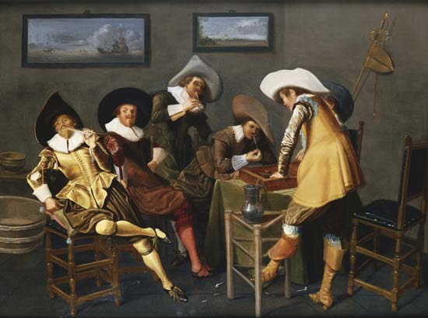
Council of Seven
Ruled the colony
one member acting as president

Slide 16
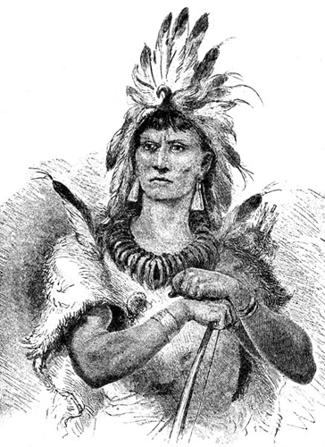
Native Life
Colony was in the middle of 14,000 Algonquian-speaking natives who were led by Powhatan
Trade was established
Relations were delicate

Slide 17
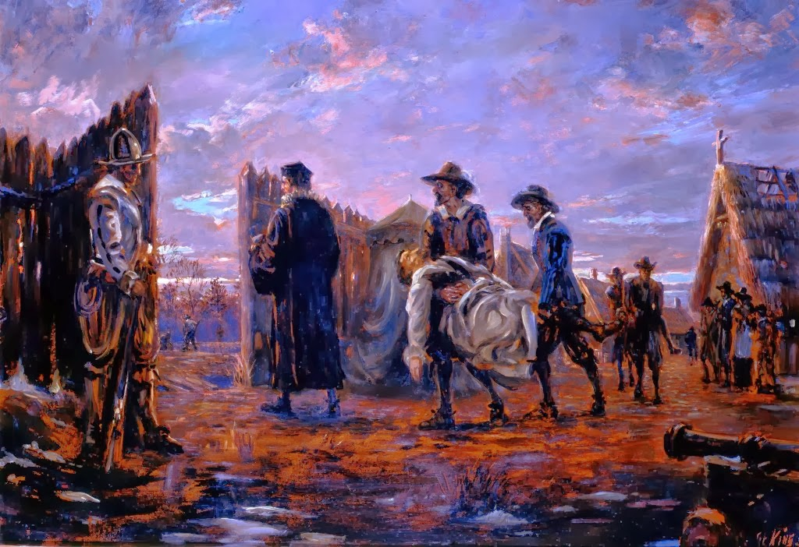
Colonial Life
Water supply was low
Lack of food
Prolonged drought
Disease and death
Many of the original colonist were upper class and did not have sufficient laborers and skilled farmers.

Slide 18
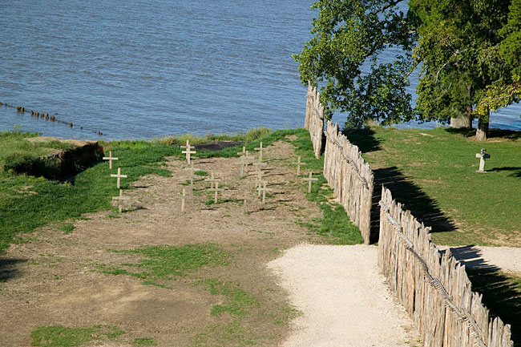
Colonial graves at Jamestown

Slide 19
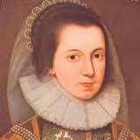
Mistress Forrest
One of the first women in Jamestown
Arrived in 1608
Joined husband in colony

Slide 20
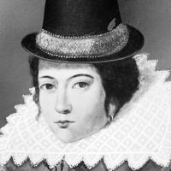
Anne Burras
One of the first women in Jamestown
Arrived September 30, 1608
14 year old maid
first woman to marry in Jamestown
Gave birth to the first child

Slide 21
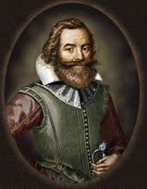
Captain John Smith
Became the leader in September 1608
Established a “no work, no food” policy
Traded with the Powhatan for food
Left the colony in 1609 after being injured by gunpowder

Slide 22
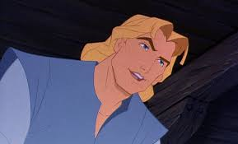
Reality v. Fiction

Slide 23
Captain John Smith cont.
Never returned to Virginia
Promoted colonization until his death in 1631
Published many articles about the colony that historians use to find out what life was like.
NEVER met Pocahontas

Slide 24
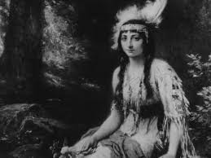
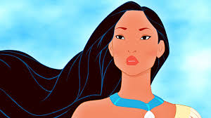
Reality v Fiction

Slide 25
Life after Smith
Smith departure was known as the “starving time”
Colonist would abandon Jamestown in Spring 1610

