Slide 1
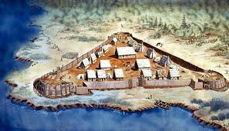
New Jamestown
New settlers arrived with supplies
Would be ruled with military law that carried harsh punishments for those who did not obey

Slide 2
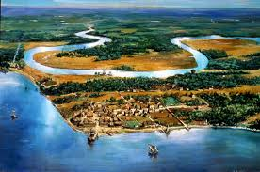
New Jamestown

Slide 3
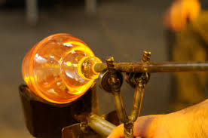
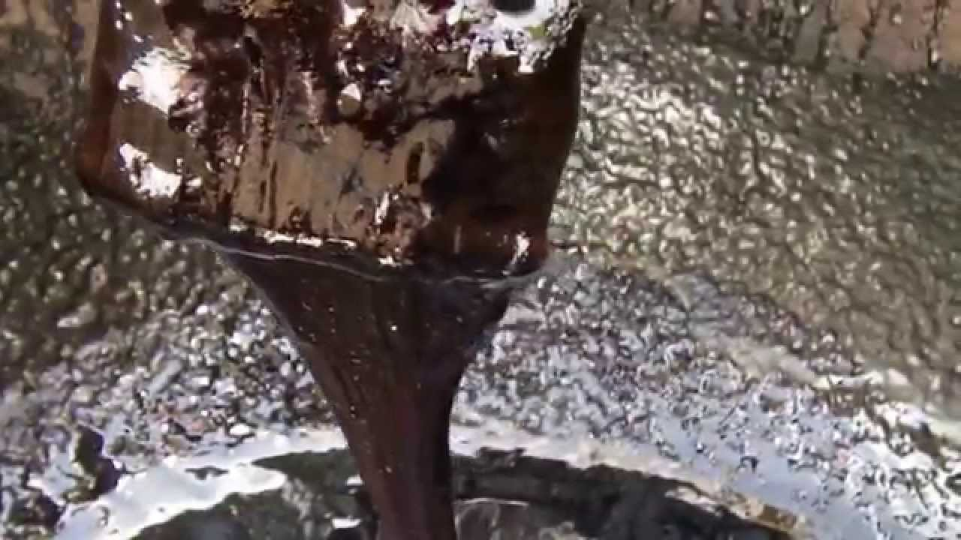
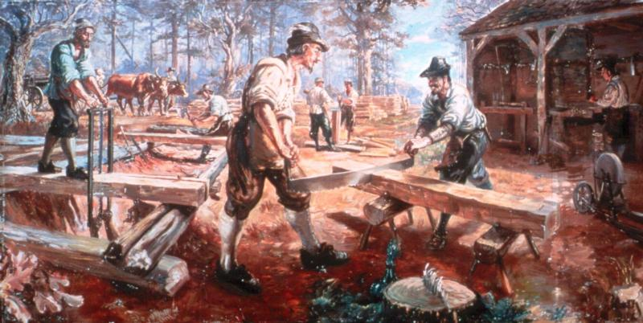
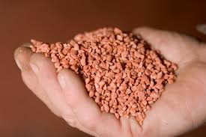
New Jamestown
Began new small industries 1610-1613
Glassmaking
Wood production
Pitch and Tar
Potash Manufacture (salt)

Slide 4
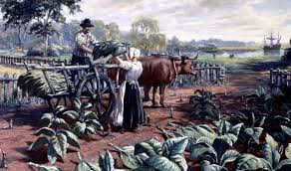
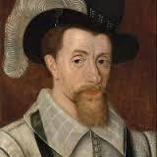
New Jamestown
A new cash crop was established in 1613
Tobacco
Brought over by John Rolfe

Slide 5
John Rolfe and Pocahontas
Rolfe was about 10 years older than Pocahontas
They were married April 5, 1614
Had the blessing of Chief Powhatan and the governor of Virginia

Slide 6
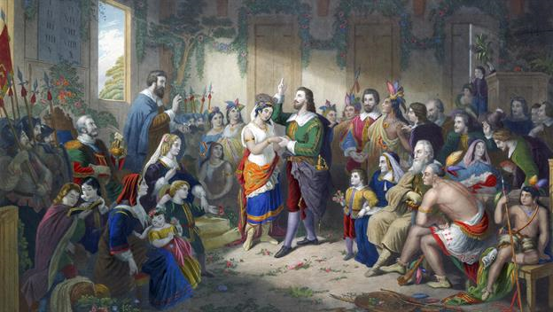
John Rolfe and Pocahontas

Slide 7
Businesses in Jamestown
All of the businesses in Jamestown were failures
Tobacco cultivation required large amounts of land and labor and stimulated the rapid growth of the Virginia colony
Settlers increased land holdings
Indentured servants came to Virginia

Slide 8
Indentured servants v. slaves
INDENTURED SERVANTS ARE NOT SLAVES

Slide 9
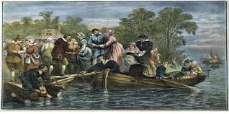
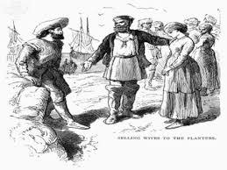
Indentured servants
Men, women and sometimes children signed a contract with a master to serve a term of 4 to 7 years.
Would have their passage paid for as well as food, clothing, and their shelter once they arrived in the colonies.

Slide 10
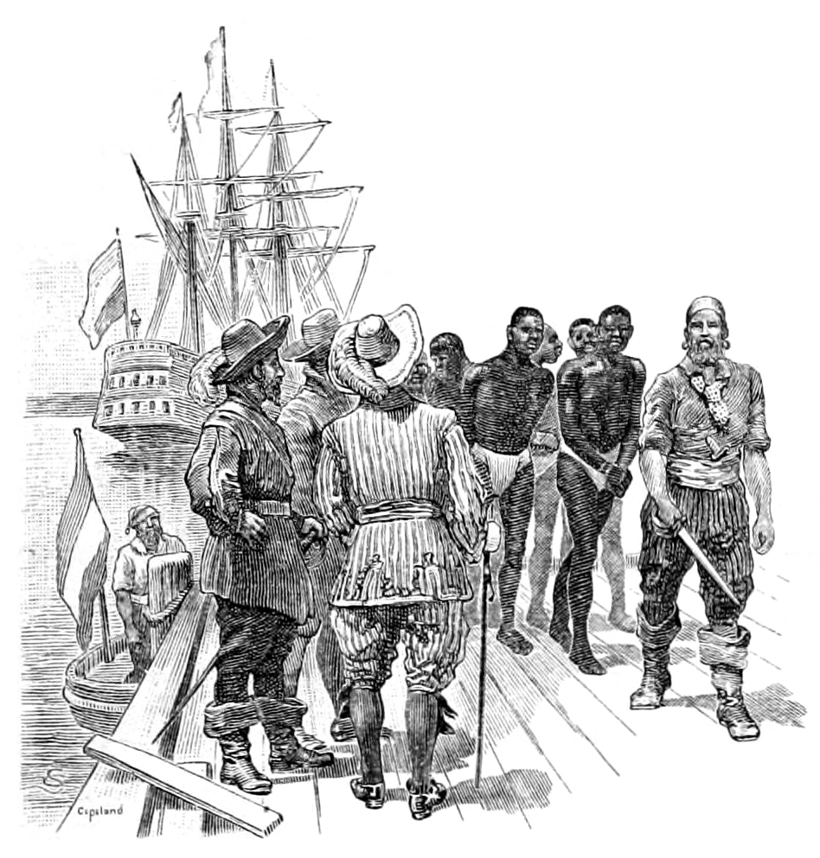
First Africans in Virginia
Arrived in 1619
From the kingdom of Ndongo in Angola
Captured with the war with the Portuguese.
Were treated as indentured servants

Slide 11
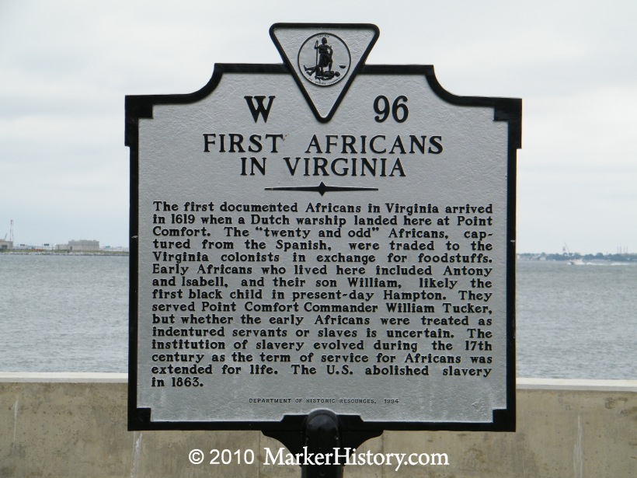

Slide 12
Indentured Servants to Slaves
The number of African slaves increased significantly in the second half of the 17th century.
Replaced indentured servants as the primary source of labor

Slide 13
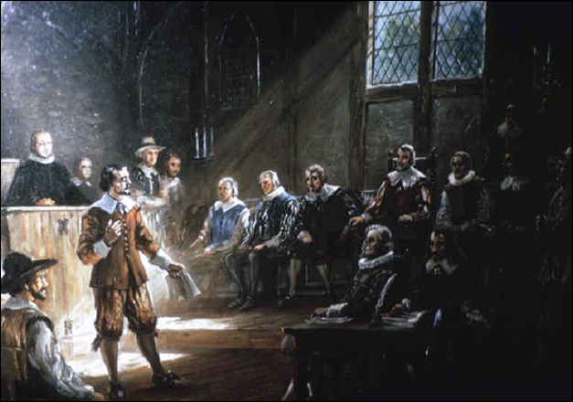
Government in Jamestown
First general assembly in 1619
This was established by the colonist to give the people an input in the laws.

Slide 14
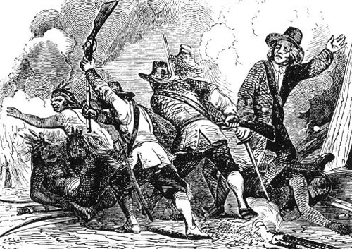
War with the Powhatan
War broke out in 1622

Slide 15
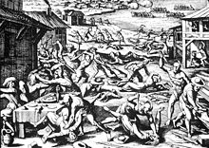

Slide 16
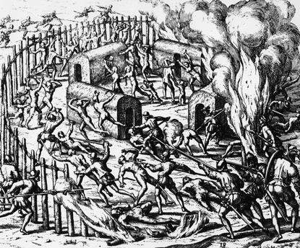

Slide 17
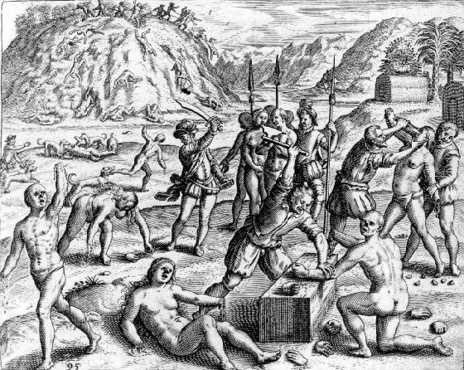

Slide 18
Breakdown of the colony
Misconduct among some of the Virginia Company leaders caused the king to dissolve the company in 1624
Became a royal colony
Center of Virginia’s political and social life until 1699 when it stopped functioning as a city

Slide 19
Videos for Jamestown
http://www.historyisfun.org/jamestown-settlement/history-jamestown/
https://www.youtube.com/watch?v=eHr8VBWobTI

