Slide 1
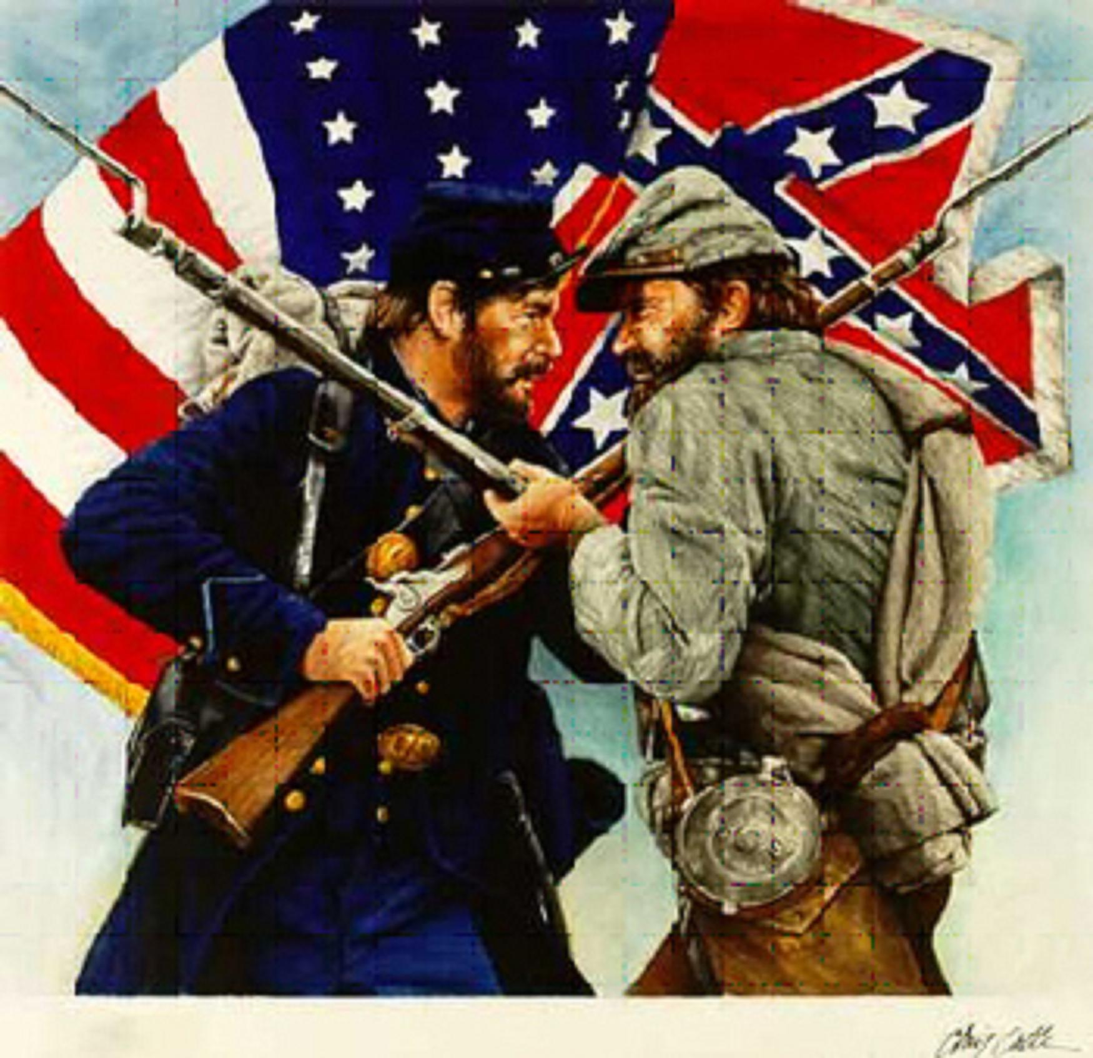
Nation Divide
Mr. Condry’s Social Studies Class

Slide 2
3/5th Compromise
A compromise between southern and northern states that helped insure ratification of the Constitution.
Three-fifths of the population of slaves counted for purposes of the distribution of taxes and the number of members each state was allowed in the House of Representatives
The compromise would lead to increasing sectionalism.

Slide 3
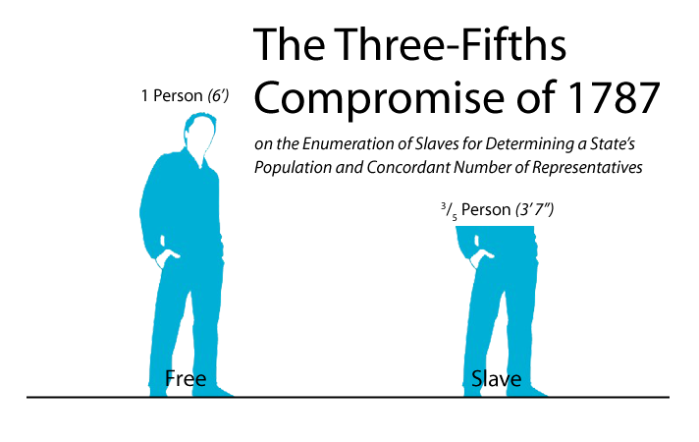

Slide 4
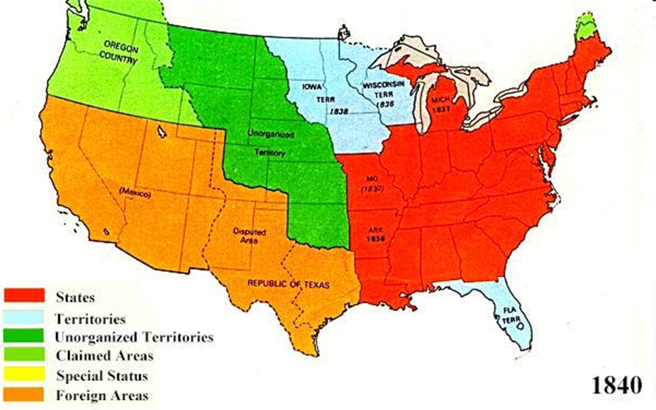
Growing tensions over slavery
Between 1820 and 1840, four new slave states and four new free states entered the union.
15 states on each side now

Slide 5
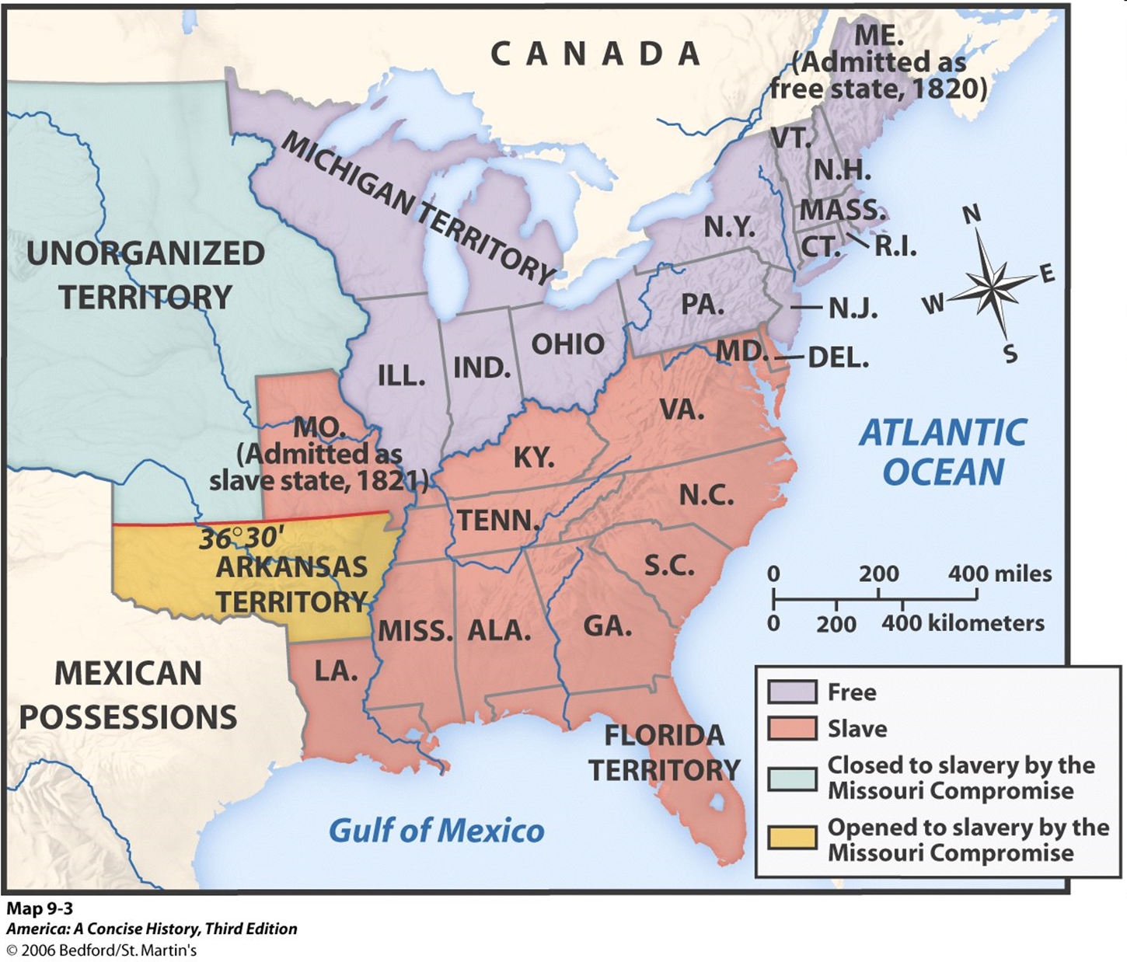

Slide 6
Invention of the Cotton Gin
Eli Whitney's invention of the cotton gin revolutionized the cotton industry and made the removal of the seeds 50 faster
Led to a greater demand for slaves

Slide 7
Louisiana Purchase
After the Louisiana Purchase in 1803, the United States doubled in size.
Manifest Destiny principle spurred Westward Expansion and the fight over slavery.
This purchase gave the United States control of the vast lands west of the Mississippi.

Slide 9
Compromise of 1820
The first confrontation over slavery in the West.
Missouri applied as a slave state.
The admission of Missouri would upset the balance of power in the Senate where at the time there were 11 free and 11 slave states.
In 1820, it was suggested that Missouri enter as a slave state and Maine as a free state to keep the balance of power

Slide 10
Nullification Crisis
South Carolina nullified the tariffs of 1828 and 1832.
South Carolina threatened to secede if the federal government attempted to collect tariff duties.
President Jackson immediately sent ships to Charleston, SC.
Crisis was avoided with a new tariff acceptable to South Carolina.
First act of defiance in south threatening secession over policies in the north.

Slide 11
Compromise of 1850
California applied for admission as a free state and the balance of power in the Senate was threatened again.
The rest of the Mexican cession was divided in to New Mexico and Utah. In each state, voters would decide the issue of slavery.
Popular sovereignty would decide issues

