Slide 1
Fugitive Slave Law
The law was very controversial.
It required that all (north and south) citizens were obligated to return runaway slaves.
People who helped slaves escape would be jailed and fined

Slide 2
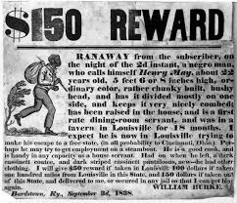

Slide 3
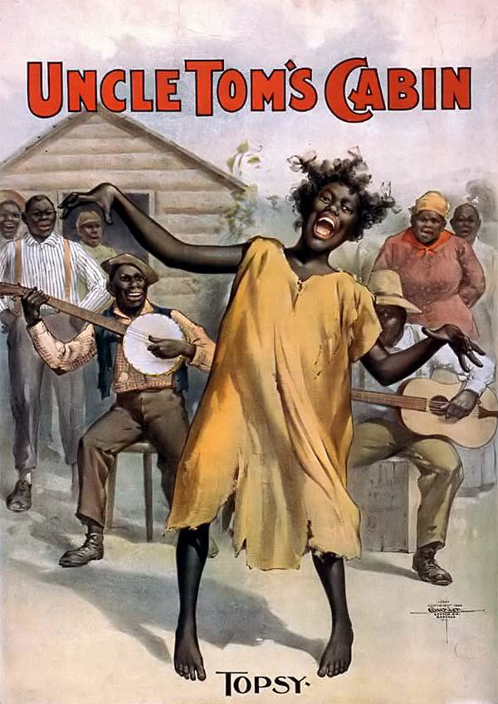
Uncle Tom’s Cabin
Written by Harriet Beecher Stowe
A novel that told the story of an enslaved African American, and his cruel master, Simon Legree
In the novel, Stowe wrote of the evils and cruelty of slavery. The novel had an enormous influence in the north.
It helped change the way many people felt about slavery.

Slide 4
Kansas-Nebraska Act
Stephen Douglas of Illinois proposed that Nebraska be divided into two territories – Kansas and Nebraska
The settlers of the new territories would decide (popular sovereignty) whether they would be slave or free.
Southerner supported the act, while Northerners felt it was a betrayal.
Thousands of pro and anti slavery supporters flood Kansas to vote and fight for their position on slavery – Civil War about to erupt.

Slide 6
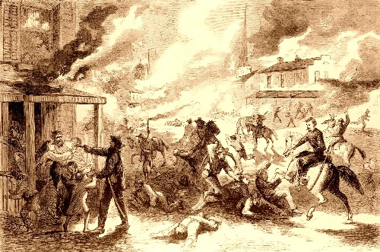
Bloody Kansas
The act set off bitter violence in the Kansas territory.
More then 200 people died over the issue of slavery

Slide 8
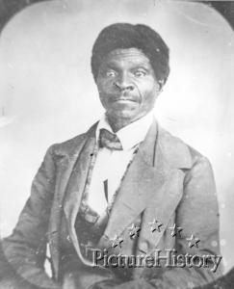
Dred Scott Supreme Court Decision
Dred Scott was a slave who claimed that because his master had taken him to the free territories of Illinois and Wisconsin he should be free.
The court ruled that because Scott was not considered a citizen, but property, he could not file a lawsuit.
Court also ruled that Congress had no power to decided the issue of slavery in the territories. This meant that slavery was legal in all the territories and the Missouri Compromise was unconstitutional.

Slide 9
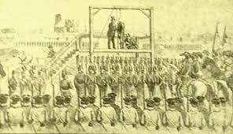
Harper’s Ferry
John Brown and a group of abolitionists organized a raid on Harpers Ferry, Virginia, a federal arsenal.
Brown hoped that slaves would come to the arsenal and he would then lead a massive slave uprising.
Brown was unsuccessful and captured. He was found guilty of murder and treason and sentenced to death.

Slide 10
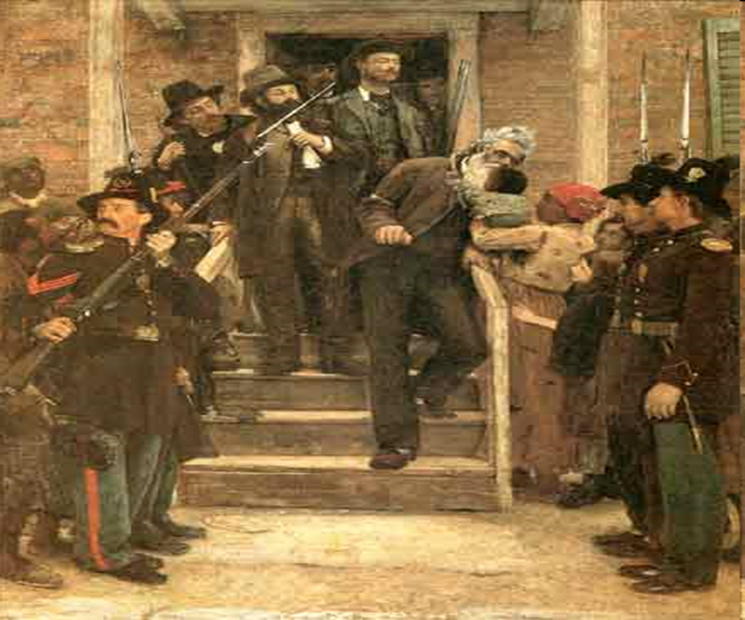

Slide 11
Lincoln Elected President 1860
Southerners’ felt the country had put an abolitionist in the White House.
South felt secession was the only option.
The Declaration of Independence stated that “it is the right of the people to alter or to abolish” a government that denies the right of its citizens.
Southerners believed he would deny them the right to own slaves.

Slide 12
Secession of Southern States
In 1860, South Carolina seceded from the Union.
In 1861, Mississippi, Florida, Alabama, Georgia, Louisiana, Texas, Virginia, Arkansas, North Carolina, Tennessee had seceded.

Slide 13
Fort Sumter
In April, 1861, the Confederates asked for the fort’s surrender.
Major Robert Anderson of the Union refuesed to surrender.
The Confederate troops proceeded to shell Fort Sumter.
Anderson ran out of ammunition and was forced to surrender.

Slide 14
