Slide 1
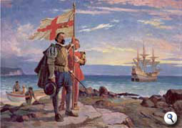
Native Americans and Early Explorers in North Carolina

Slide 2
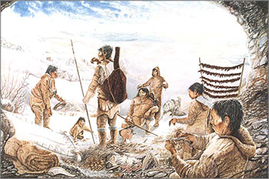
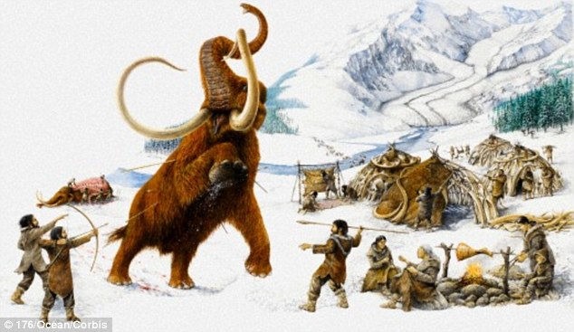
The First Inhabitants

Slide 3
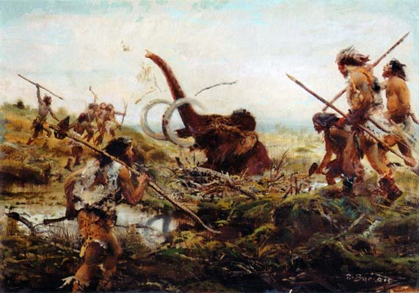
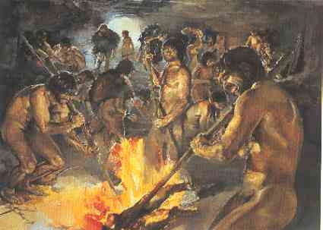
Paleolithic Period
10,000 BC to 7000 BC
The early part of the Stone Age, when early human beings made chipped stone tools, from 750,000 to 15,000 years ago.

Slide 4
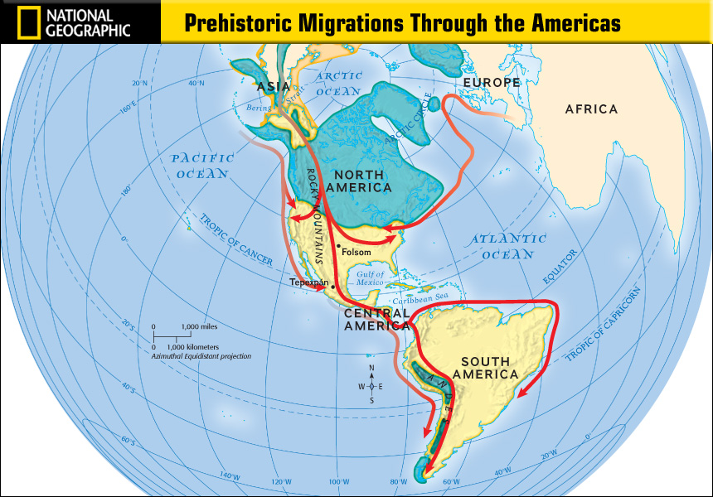

Slide 5
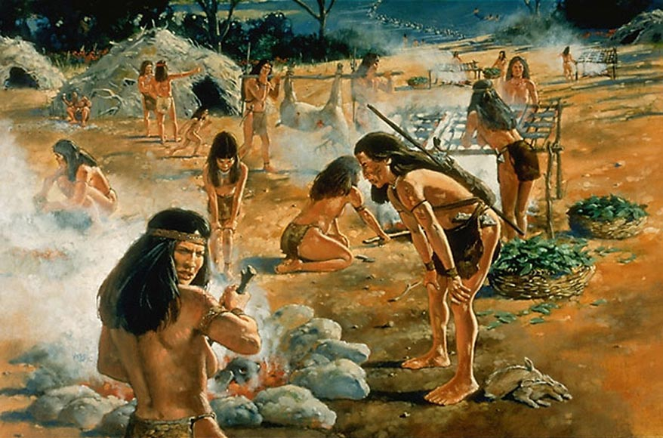
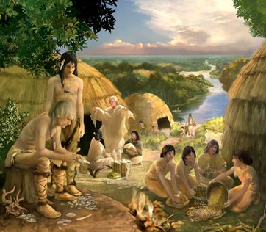
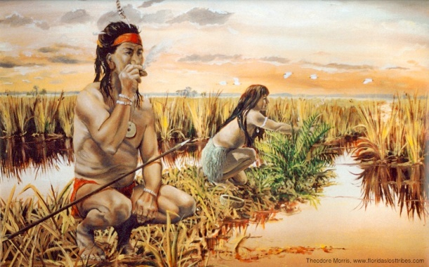
The Archaic Period
7000 BC to 500 BC
Characterized by subsistence economies supported through the exploitation of nuts, seeds, and shellfish.
As its ending is defined by the adoption of sedentary farming.

Slide 6
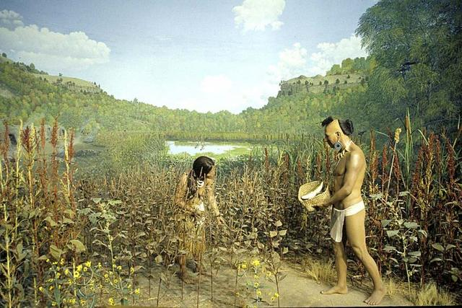
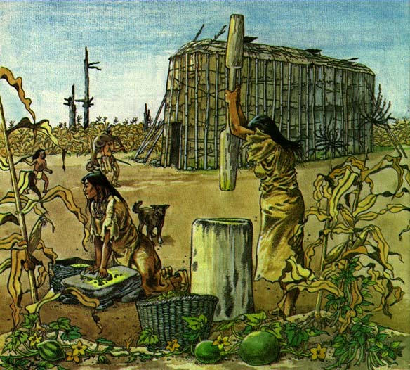
The Woodland Period
1000 BC to 1000 AD
Continuous development in stone and bone tools, leather crafting, textile manufacture, cultivation, and shelter construction.

Slide 7
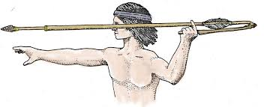
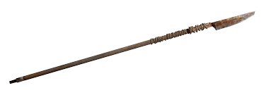
The Woodland Period Continued…
Many Woodland peoples used spears and atlatls until the end of the period, when they were replaced by bows and arrows; however Southeastern Woodland peoples used blowguns.
The most cited technological distinction of this period was the widespread use of pottery.

Slide 8
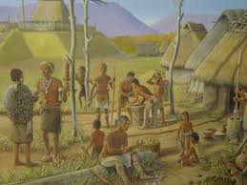
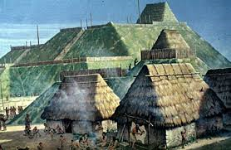
Mississippian Influence
800 AD to 1500 AD
It was composed of a series of urban settlements and satellite villages liked together by a loose trading network.
the largest city being Cahokia, which is believed to be a major religious center

Slide 9
4 Major Tribes in NC
Croatoan
Tuscarora
Catawba
Cherokee
Native Tribes Regions
Northeastern Woodlands
Southeastern Woodlands
Plains
Desert Southwest
Pacific Northwest
Artic

Slide 11
Algonquin
Language spoken by groups along the coast
The groups included the Chowanoc, the Pasquotank, and the Waccamaw.
Tribes depended on fish, fruits, and vegetables
The paintings of John White of the Lost Colony feature the Algonquin.

Slide 12
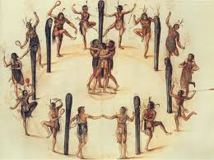
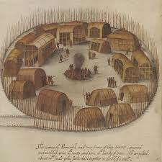
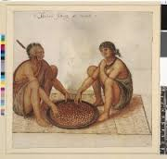
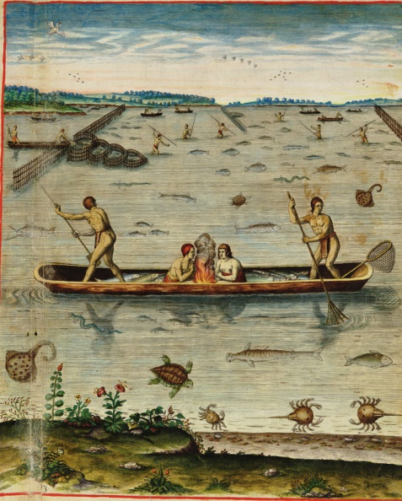
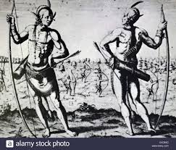
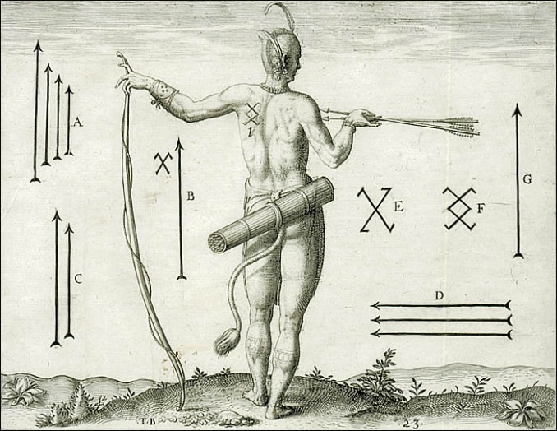

Slide 13
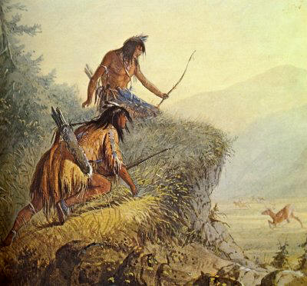
The Tuscarora
Lived on the Coastal Plain, along the Neuse and Tar Rivers.
Used hemp to make rope and binding cord. The name means “hemp gatherers.”
Were connected to the Iroquois nation of New York.
Laced infants to a board to insure correct posture, resulting in well-shaped limbs.

Slide 14
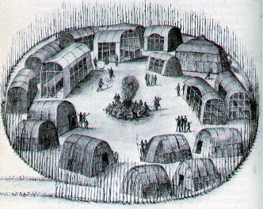
The Catawba
The largest group living in the Piedmont
Known for their burnt-black pottery
Groups moved across the Piedmont, including the Sapona, the Occaneechi
Spoke versions of the Sioux language.
Connected to the Sioux tribes of the Great Plains.

Slide 15
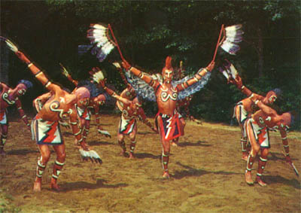
Cherokee
Related to the Iroquois, but had been driven away from their homes.
During the Woodland period, they settled in the mountains.
Controlled 40,000 square miles when the Europeans arrived.

Slide 16
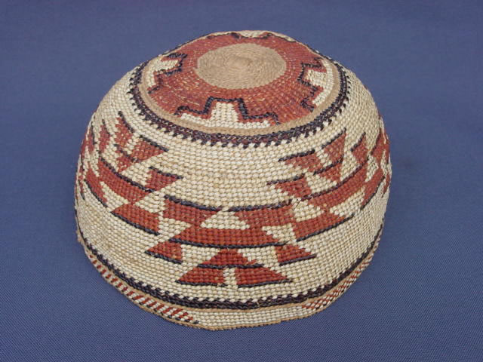
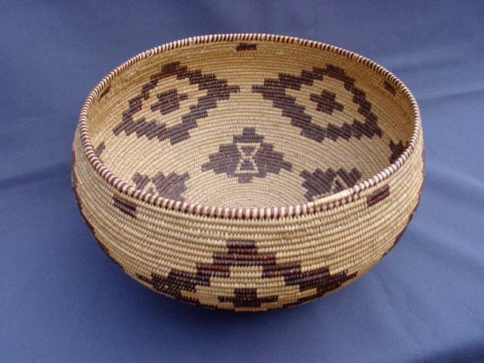
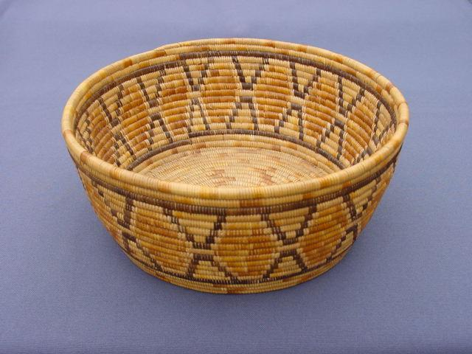
Cherokee Continued
During the Woodland Period, they numbered 30,000 inhabitants
Had a 3 class system- upper, middle, and lower
Made baskets of strips of branches from oak trees.

Slide 17
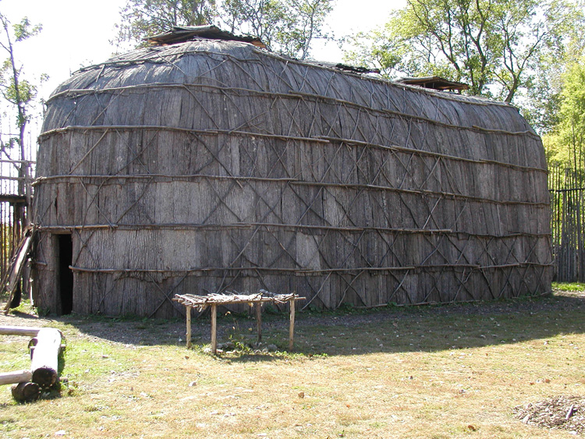
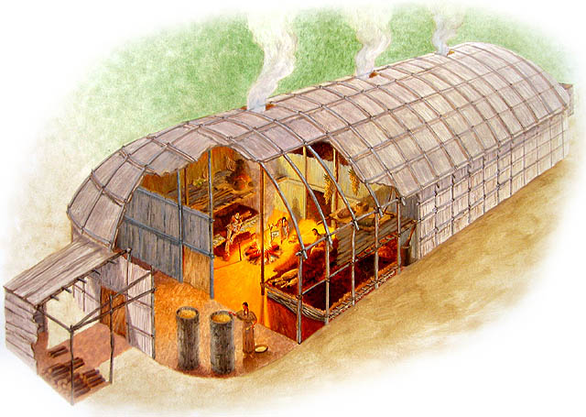
Native American Habits and Beliefs
Woodland culture and customs dominated by the 1500’s.
Villages were built of longhouses or huts.
Clans were connected through the mothers. (matrilineal).

Slide 18
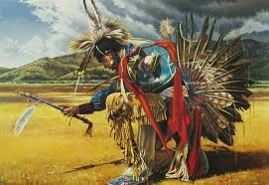
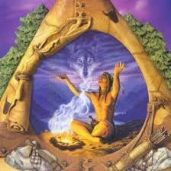
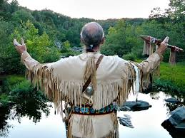
Habits and Beliefs Continued…..
Tribes were governed by consensus, where most members agreed on decisions.
Nature was respected and was at the center of most beliefs.
Europeans brought animals, plants, and diseases that Native Americans had not seen.

Slide 19
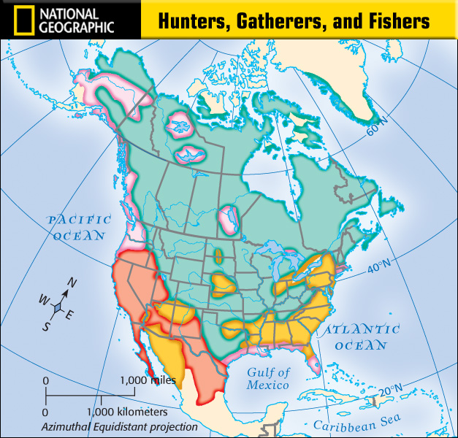

Slide 21
European Explorers Come to North America

Slide 22
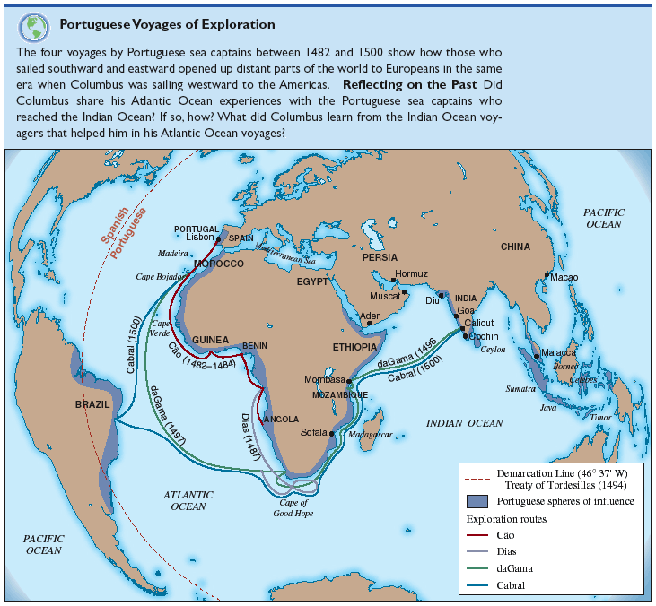

Slide 23
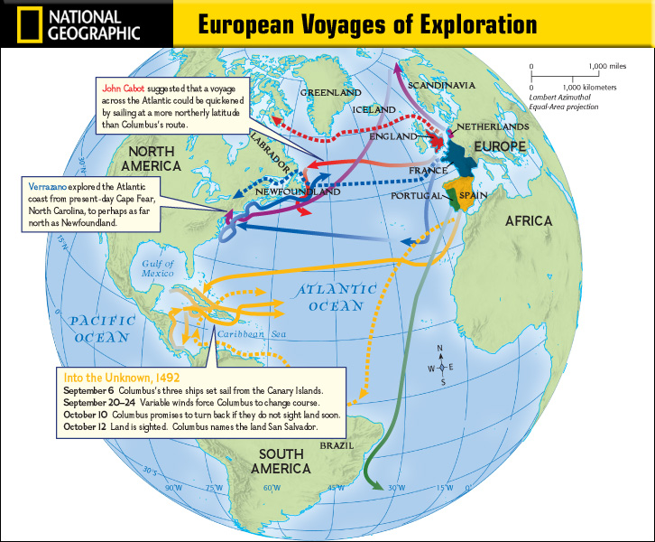

Slide 24
Columbian Exchange
the widespread transfer of
Animals
Plants
Culture
Human populations
Technology
ideas
between the American and Afro-Eurasian hemispheres in the 15th and 16th centuries, related to European colonization and trade after Christopher Columbus's 1492 voyage.

Slide 25
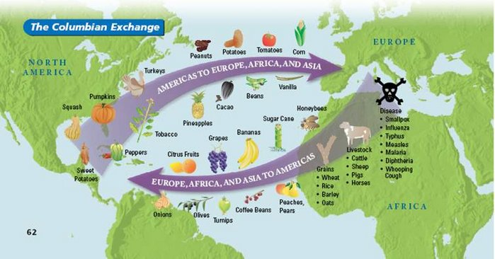

Slide 26
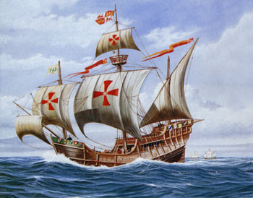
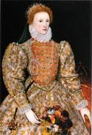
Northwest Passage
British and French explorers were searching for a Northwest passage to Asia in order to avoid purchasing goods from Italian and Muslim merchants.
Expedition- a journey for a specific purpose.
Elizabeth I authorized two expeditions to search for the Northwest Passage.

Slide 27
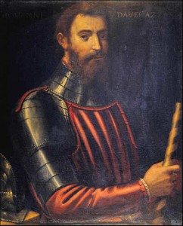
Giovanni da Verrazano (1524)
Verrazano was sent by the French to find a shorter water route to China.
He dropped anchor near Cape Hatteras, thinking he had accomplished his task. He thought that the Albemarle Sound was the Pacific Ocean.

Slide 28
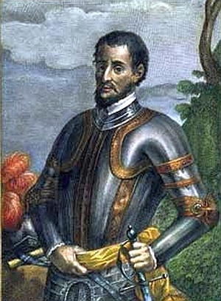
Hernando de Soto (1539)
Explored present day Florida, Georgia, South Carolina, and North Carolina (Southeastern US).
He was known for mistreating the native people with whom he interacted.

Slide 29
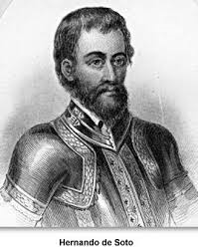
Juan Pardo (1566)
Explored many of the same areas as de Soto and helped to establish several Spanish settlements in the Carolinas.
Led an expedition that traveled in a northwesterly direction to the foot of the Blue Ridge Mountains from what is now St. Helena Sound on the coast of South Carolina.

Slide 30
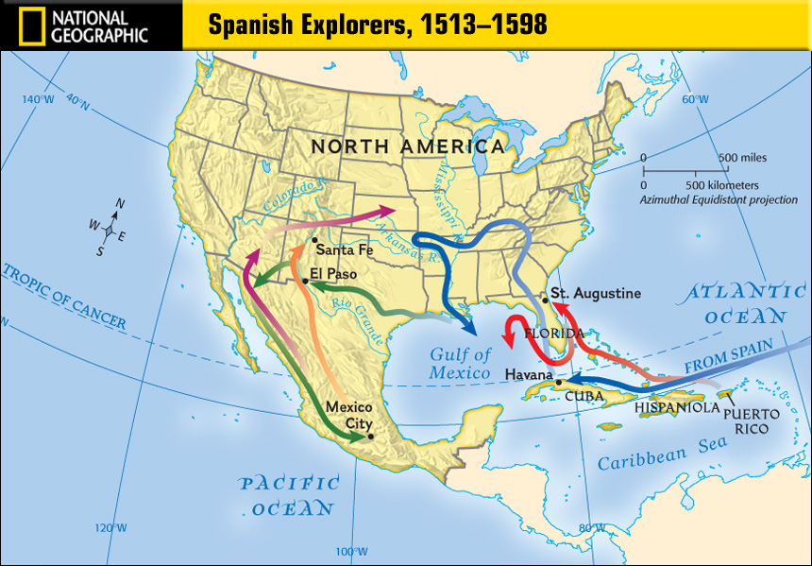

Slide 31
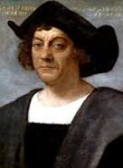
Christopher Columbus
An Italian explorer, navigator, and colonizer
Completed four voyages across the Atlantic Ocean

Slide 32
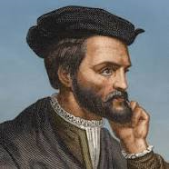
Jaques Cartier
French explorer who founded what is now Canada for France

Slide 33
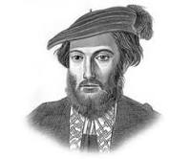
Amerigo Vespucci
An Italian explorer who America was later named after
Navigator and cartographer who first demonstrated that Brazil and the West Indies did not represent Asia’s Eastern outskirts.

Slide 34
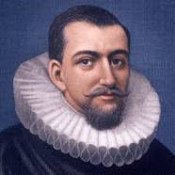
Henry Hudson
Made two attempts on behalf of English merchants to find a Northwest Passage via a route about the Artic Circle.

Slide 35
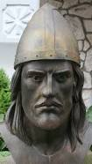
Leif Erikson
A Viking that founded North America before Columbus

Slide 36
Mercantilism
Belief in the benefits of profitable trading
The economic theory that trade generates wealth and is stimulated by the accumulation of profitable balances, which a government should encourage by means of protectionism.

Slide 37
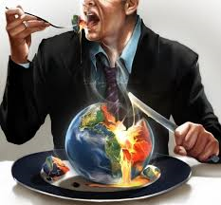
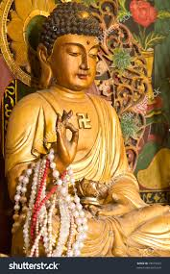
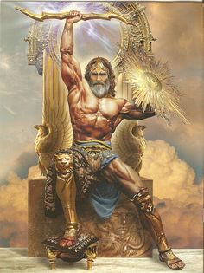
The reasons behind these expeditions
Greed (gold and world power)
Glory (fame)
God (religion)

Slide 38
Sir Walter Raleigh
English adventurer
Sponsored 3 voyages to Roanoke Island
Colony-a settlement far away from home but ruled by the home country.

