Slide 1
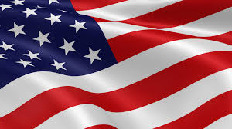
Presidents of the United States
Mr. Condry’s Social Studies Class

Slide 2
This is the list of Presidents up to the Imperialism and World War I Unit

Slide 3
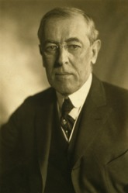
Woodrow Wilson
28th President
March 4, 1913 to March 4, 1921
Political Party
Democratic
Vice President
Thomas R. Marshall
Served 2 terms

Slide 4
Wilson Facts
would paint his golf balls black during the winter so he could continue playing in the snow.
was the first to show a motion picture in the White House: The Birth of Nation, which has become the most banned film in American history.

Slide 5
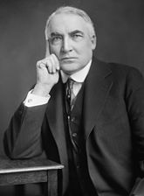
Warren G. Harding
29th President
March 4, 1921 to August 2, 1923
Political Party
Republican
Vice President
Calvin Coolidge
Died serving 1st term

Slide 6
Harding Facts
He had relations with Nan Britton, in a White House closet. On one occasion, Secret Service agents had to stop his wife from beating down the closet door.
was obsessed with poker and once bet an entire set of priceless White House China and lost it.

Slide 7
Harding Facts
was the first president to own a radio
the first to make speech over the radio
the first to ride to his inauguration in a car.
When women got the right to vote, he was the first president they could elect.

Slide 8
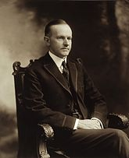
Calvin Coolidge
30th President (took office after Harding died)
August 2, 1923 to March 4, 1929
Political Party
Republican
Vice President
Vacant
Charles G. Dawes
Served 2 terms

Slide 9
Coolidge Facts
Born on 4th of July
liked to have his head rubbed with petroleum jelly while eating his breakfast in bed. Believed it was good for his health
would press all the buttons on the President’s desk and hide and watch his staff run in. He would then pop out from behind the door and say that he was just seeing if everyone was working.

