Slide 1
Presidents of the United States
Mr. Condry’s Social Studies Class

Slide 2
This is the list of Presidents up to the Modern Age Unit

Slide 3
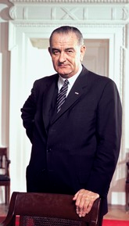
Lyndon B. Johnson
36th President (took over after Kennedy’s assassination)
November 22, 1963 to January 20, 1969
Political party
Democratic
Vice President
Vacant
Hubert Humphrey
Served 2 terms

Slide 4
Johnson Facts
affectionately called the many women he slept with his “harem.” He even had a buzzer system installed that rang inside the Oval Office so that Secret Service could warn him when his wife was coming.

Slide 5
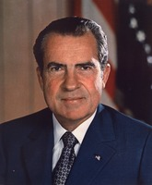
Richard Nixon
37th President
January 20, 1969 to August 9, 1974
Political Party
Republican
Vice President
Spiro Agnew (resigned from office)
Vacant
Gerald Ford
Resigned while serving 2nd term

Slide 6
Nixon Facts
was the first president to visit all 50 states and
the first to visit China.
He is the only president to resign.
The three best known Western names in China are Jesus Christ, Elvis Presley, and Richard Nixon.

Slide 7
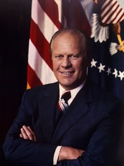
Gerald Ford
38th President
August 9, 1974 to January 20th 1977
Political Party
Republican
Vice President
Vacant
Nelson Rockefeller
Served 1 term

Slide 8
Ford Facts
name before he was adopted was Leslie Lynch King Jr
worked as a model during college. He also worked as a forest ranger at Yellowstone National Park directing traffic and feeding the bears.
was the first person to be both vice president and president without being elected by the people. He was appointed vice president when Spiro Agnew resigned and he succeeded to the presidency when Nixon resigned.

Slide 9
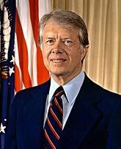
Jimmy Carter
39th President
January 20, 1977 to January 20, 1981
Political Party
Democratic
Vice President
Walter Mondale
Served 1 term

Slide 10
Carter Facts
was the first president to be born in a hospital.
first known president to go on record as seeing a UFO
the first Southerner elected to the presidency following the Civil War, restored U.S. citizenship to Jefferson Davis, president of the Confederate States of America.

Slide 11
Carter Facts
was a wealthy peanut farmer in Plains, Georgia. A farming accident left one of his fingers permanently bent

Slide 12
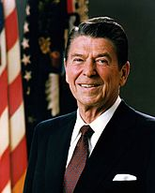
Ronald Reagan
40th President
January 20, 1981 to January 20, 1989
Political Party
Republican
Vice President
George H. W. Bush
Served 2 terms

Slide 13
Reagan Facts
won the Most Nearly Perfect Male Figure Award from the University of California in 1940.

Slide 14
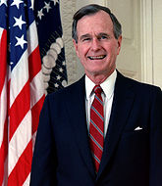
George H.W. Bush
41st President
January 20, 1989 to January 20, 1993
Political Party
Republican
Vice President
Dan Quayle
Served 1 term

Slide 15
H.W. Bush Facts
vomited on the Japanese Prime Minister, a new word entered the Japanese language. Bushusuru means “to do the Bush thing,” or to publicly vomit.
was the first serving vice president to be elected president since Martin Van Buren.
Only president with 4 names George Herbert Walker Bush

