Slide 1
Presidents of the United States
Mr. Condry’s Social Studies Class

Slide 2
This is the list of Presidents up to the Civil Rights Unit

Slide 3
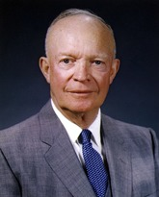
Dwight D. Eisenhower
34th President
January 20, 1953 to January 20, 1961
Political Party
Republican
Vice President
Richard Nixon
Served 2 terms

Slide 4
Eisenhower Facts
was the only president to serve in both WWI and WWII.
had an affair with his wartime driver, Kay Summersby (1908-1975). Kay later wrote a book called Past Forgetting: My Love Affair with Dwight D. Eisenhower in which she claims he was impotent.

Slide 5
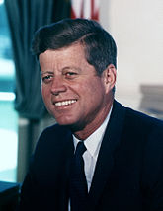
John F. Kennedy
35th President
January 20, 1961 to November 22, 1963
Political Party
Democratic
Vice President
Lyndon B Johnson
Assassinated while serving 1st term

Slide 6
Kennedy Facts
He allegedly slept with Marilyn Monroe, Jayne Mansfield, Audrey Hepburn, Angie Dickinson, stripper Blaze Starr, Marlene Dietrich, and many other women including White House staffers, secretaries, stewardess, campaign workers, strippers, and acquaintances of trusted male friends. The FBI taped sounds of him and Inga Arvad making love.
Youngest president elected at the age of 43

Slide 7
Kennedy Facts
was the first Roman Catholic to be president,
the first Boy Scout to become president
the first president to be born in the twentieth century.

