Slide 1
Presidents of the United States
Mr. Condry’s Social Studies Class

Slide 2
This is the list of Presidents up to the Imperialism and World War 1 Unit

Slide 3
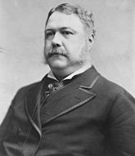
Chester A. Arthur
21st President (Took office after Garfield’s death)
September 19, 1881 to March 4, 1885
Political Party
Republican
Vice President
Vacant
Served 1 term

Slide 4
Arthur Facts
Added “so help me God.” to the end of the presidential oath. He added the phrase when he was sworn into office on September 22, 1881, after the death of President Garfield

Slide 5
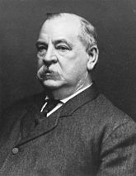
Grover Cleveland
22nd President
March 4, 1885 to March 4, 1889
Political Party
Democratic
Vice President
Thomas A. Hendricks (died in office)
Vacant
Served 1 term

Slide 6
Cleveland Facts
Was the only president in history to hold the job of a hangman.
He was once the sheriff of Erie County, New York, and twice had to spring the trap at a hanging
the only president to be elected to two nonconsecutive terms.

Slide 7
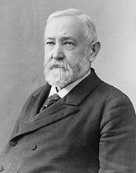
Benjamin Harrison
23rd President
March 4, 1889 to March 4, 1893
Political Party
Republican
Vice President
Levi P. Morton
Served 1 term

Slide 8
Harrison Facts
The body of John Scott Harrison, father of President of Benjamin Harrison, was stolen by grave robbers and sold to Ohio Medical College in Cincinnati for use as a training cadaver. The body was eventually recovered and reburied.
Was so aloof that his nickname was “the human iceberg”

Slide 9
Grover Cleveland
24th President
March 4, 1893 to March 4, 1897
Political Party
Democratic
Vice President
Adlai Stevenson
Served 1 term

Slide 10
Cleland Facts
Was the only president in history to hold the job of a hangman.
He was once the sheriff of Erie County, New York, and twice had to spring the trap at a hanging
the only president to be elected to two nonconsecutive terms.

Slide 11
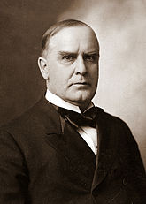
William McKinley
25th President
March 4, 1897 to September 14, 1901
Political Party
Republican
Vice President
Garret Hobart (died in office)
Vacant
Theodore Roosevelt
Served 2 terms (assassinated during 2nd term)

Slide 12
McKinley Facts
was the first to ride in a self-propelled vehicle—the electric ambulance that took him to the hospital after he had been shot

Slide 13
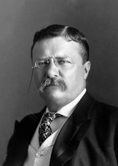
Theodore Roosevelt
26th President (took office after McKinley was assassinated)
September 14, 1901 to March 4, 1909
Political Party
Republican
Vice President
Vacant
Charles W. Fairbanks
Served 2 terms

Slide 14
Roosevelt’s Facts
Every member of Teddy Roosevelt’s family owned a pair of stilts, including the first lady.
Youngest president who became president at the age of 42 after the death of McKinley
“Teddy Bears” were so named when Theodore “Teddy” Roosevelt (1858-1919) refused to shoot a small bear cub one day. The incident was reported in the news, which inspired a toy manufacture to come out with the cute stuffed animals.

Slide 15
Roosevelt Facts
During his second run for presidency, Teddy Roosevelt was shot by a would-be assassin while giving a speech in Milwaukee. He continued to deliver his speech with the bullet in his chest.
last request before dying was “Please put out the light.”

Slide 16
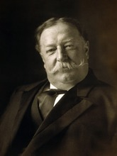
William Howard Taft
27th President
March 4, 1909 to March 4, 1913
Political Party
Republican
Vice President
James S. Sherman (died in office)
Vacant
Served 2 terms

Slide 17
Taft Facts
At 325 pounds, William Howard Taft (1857-1930), who was dubbed “Big Bill,” was the largest president in American history and often got stuck in the White House bathtub. His advisors had to sometimes pull him out.

