Slide 1
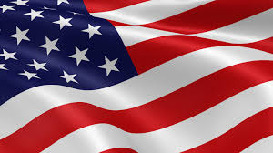
Presidents of the United States
Mr. Condry’s Social Studies Class

Slide 2
The Following is a list of Presidents until the Reconstruction Unit

Slide 3
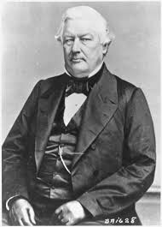
Milliard Fillmore
13th President
July 9, 1850 to March 4, 1853
Political party
Whig
Vice President
Vacant
Served 1 term

Slide 4
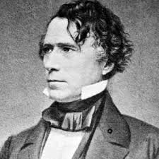
Franklin Pierce
14th President
March 4, 1853 to March 4, 1857
Political Party
Democratic
Vice President
William R. King (March 4, 1853 – April 18, 1853)
Vacant (April 18, 1853 – March 4, 1857)
Served 1 term

Slide 5
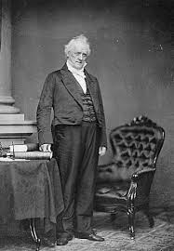
James Buchanan
15th President
March 4, 1857 to March 4, 1861
Political party
Democratic
Vice President
John C. Breckinridge
Served 1 term

Slide 6
Buchanan Facts
quietly but consistently bought slaves in Washington, D.C., and then set them free in Pennsylvania.
he only bachelor president. He was virtually inseparable from William R. King (1786-1853), a senator from Alabama, earning the pair the nickname “Miss Nancy and Aunt Fancy” and “Mr. Buchanan and his wife

Slide 7
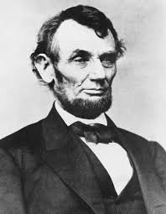
Abraham Lincoln
16th President
March 4, 1861 to April 15, 1865
Political Party
Republican
National Union
Vice President
Hannibal Hamlin
Andrew Johnson
Served 2 terms (Assassinated during 2nd term)

Slide 8
Lincoln Facts
Lincoln logs are named after Abraham Lincoln and the log cabin where he was born.
was also a licensed bartender. He was co-owner of Berry and Lincoln, a saloon in Springfield, Illinois
was the only presidential candidate who was not a Mason in the 1860 election

Slide 9
Lincoln Facts
was the first president to ever be photographed at his inauguration. In the photo, he is standing near John Wilkes Booth, his future assassin.
The first president to be born outside the original 13 States

Slide 10
Lincoln Facts
is the only president to receive a patent (# 6469).
He was the first president to have a beard, at the request from a little girl named Gracie Bedell.
The first child to die in the White House was Abraham Lincoln’s 12-year old son, Willie.
was the tallest president at 6' 4."

Slide 11
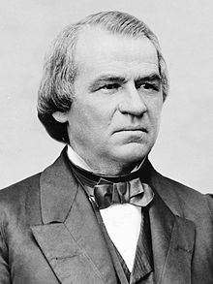
Andrew Johnson
17th President (took office after Lincoln assassination
April 15, 1865 to March 4, 1869
Political Party
Democratic
National Union
No Party
Vice President
Vacant
Served 1 term (First American president to be impeached)

Slide 12
Johnson Facts
Andrew Johnson is the only tailor ever to be president. As president, he would typically stop by a tailor shop to say hello. He would wear only the suits that he made himself.
was the first president to be impeached. He was acquitted by one vote in the Senate. It would be another 131 years before another president, Bill Clinton, would be impeached.

