Slide 1
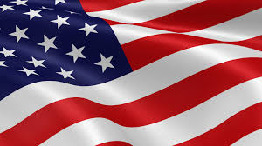
Presidents of the United States
Mr. Condry’s Social Studies Class

Slide 2
The following are a list of Presidents up to Industrial Revolution Unit

Slide 3
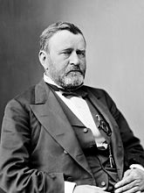
Ulysses S. Grant
18th President
March 4, 1869 to March 4, 1877
Political Party
Republican
Vice President
Schuyler Colfax
Henry Wilson
Served 2 terms

Slide 4
Grant Facts
smoked at least 20 cigars a day and, after a brilliant war victory, a nation of well wishers sent him more than 10,000 cigars. He later died of throat cancer.
It was so cold at Ulysses S. Grant’s presidential inauguration that the canaries that were supposed to sing at the inaugural ball froze to death

Slide 5
Grant Facts
Given a $20.00 speeding ticket for riding his horse and buggy too fast

Slide 6
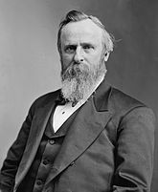
Rutherford B. Hayes
19th President
March 4, 1877 to March 4, 1881
Political Party
Republican
Vice President
William A. Wheeler
Served 1 term

Slide 7
Hayes Facts
fought lyssophobia, or the fear of going insane
banished alcohol from the White House and held gospel sing-alongs every night in the White House.

Slide 8
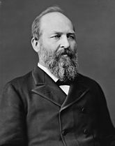
James A. Garfield
20th President
March 4, 1881 to September 19, 1881
Political Party
Republican
Vice President
Chester A. Arthur
Died while serving 1st term

Slide 9
Garfield Facts
the first president to ever talk on the phone. When he spoke to Alexander Graham Bell, who was at the other end 13 miles away, he said: “Please speak a little more slowly.”
could write Latin with one hand and Greek with the other hand simultaneously.
An anarchist and lawyer named Charles Guiteau shot James Garfield in the back with a five-barrel, .44-caliber pistol called a British Bulldog in 1881. He said he chose the gun because it would look good on a display in a museum someday. No one currently knows where the gun is.

Slide 10
Garfield Facts
didn’t die from the gunshot wounds from his assassin’s gun; he died of blood poisoning after doctors and experts (including Alexander Graham Bell) tried to remove the bullet from his back with their dirty fingers and instruments, causing him to linger in pain for 80 days before dying. His assassin, Charles Guiteau, later claimed that he didn’t kill the president, the doctors had.

