Slide 1
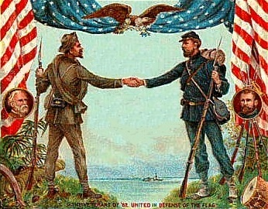
Reconstruction and the New South
Mr. Condry’s Social Studies Class

Slide 2
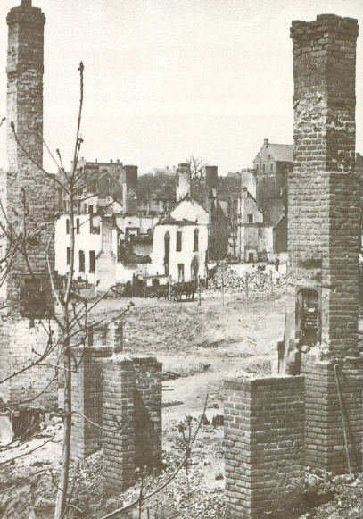
Reconstruction
The period of time when the South was rebuilt as well as the federal government’s program to rebuild it.

Slide 3
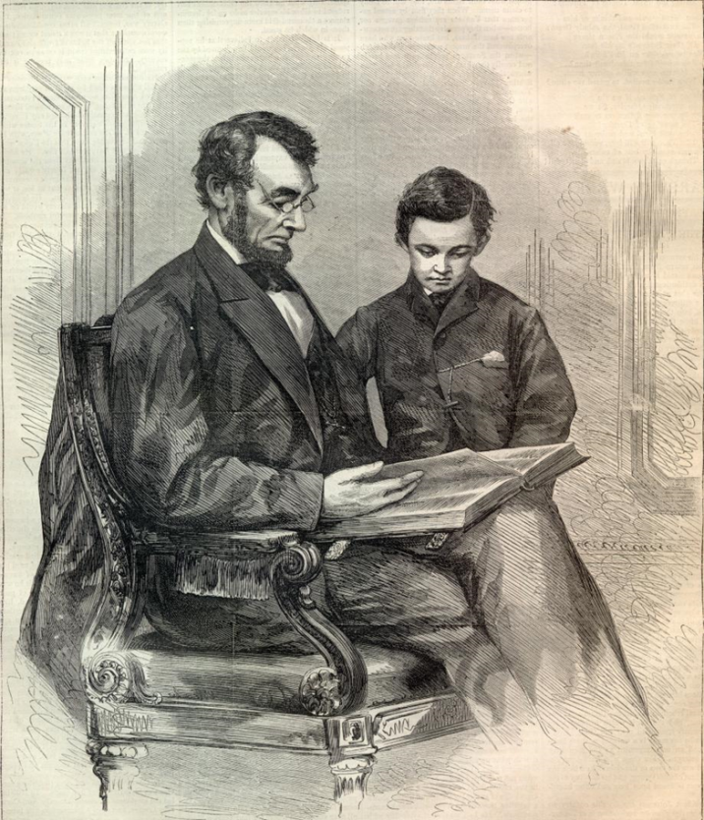
Reconstruction
Ten Percent Plan was outlined by Lincoln in 1863
Under the plan, a southern state could form a new government after 10 percent of its voters swore an oath of loyalty to the United States
Plan also offered amnesty, or government pardon, to confederates who swore loyalty to the Union

Slide 4
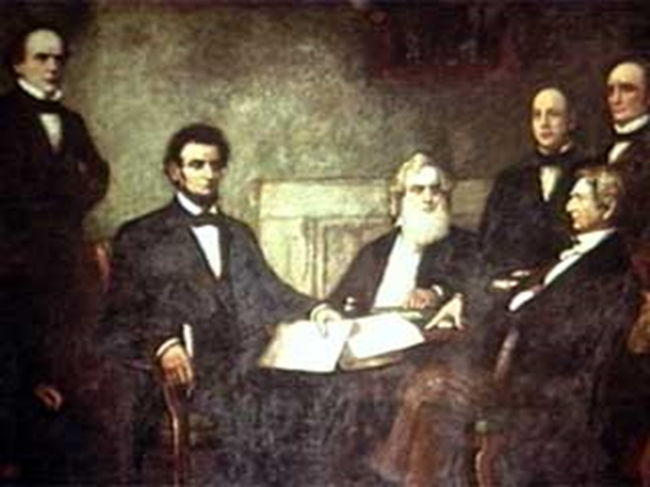
Wade-Davis Bill
Passed by Congress in 1864
Required a majority of white men in each southern colony to swear loyalty

Slide 5
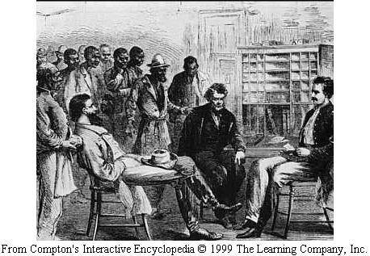
The Freemen’s Bureau
Nearly four million men and women who had been slaves became known as freedman

Slide 6
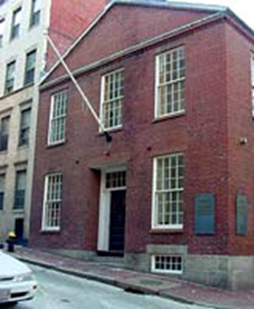
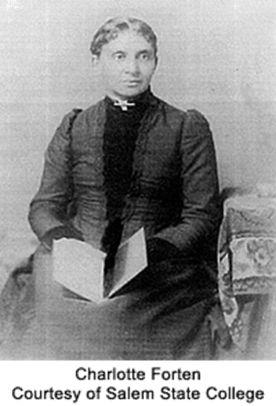
The Freedmen’s Bureau
Provided food, clothing, and medical care to the former Confederate states.
Set up schools for freed slaves
Most of the teachers were volunteers, often women.
Charlotte Forten was a teacher
The bureau set the groundwork for our public school system.

Slide 7
Charlotte Forten
Came from a wealthy Northern African American family.
As a young girl she had private tutors.
She was a strong abolitionist that was dedicated to improving the quality of life for African Americans
Had to teach reading, writing, and arithmetic without books or supplies.
Classes were large and they included students of all ages.

Slide 8
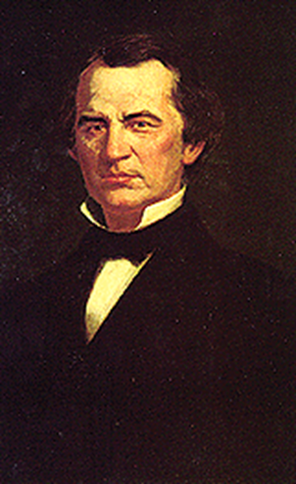
13th Amendment
Ratified January 31, 1865 by Andrew Johnson
Banned slavery throughout the nation

Slide 9
13th Amendment
Section 1:
Neither slavery nor voluntary servitude, except as a punishment for crime where of the party shall have been duly convicted, shall exist within the United States, or any place subject to their jurisdiction.
Section 2:
Congress shall have power to enforce the article by appropriate legislation.

Slide 10
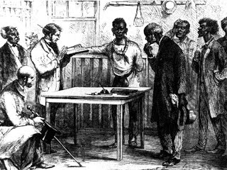
Black Codes
Forbade African Americans to:
Vote
Own guns
Serve on juries.
In some states African Americans were permitted to work only as servants or farm laborers.

Slide 11
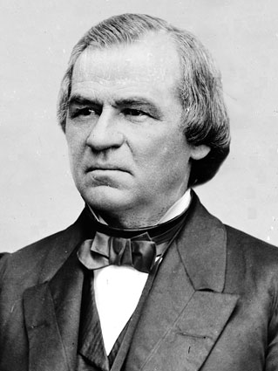
14th Amendment
Passed by President Johnson in 1866
Solved the conflict between the congress and the black codes.
Grants equal protection under the law.

Slide 12
14th Amendment
Section 1:
No State shall make or enforce any law which shall abridge the privileges or immunities of citizens of the United States

Slide 13
Radical Reconstruction
In 1867 Congress passed the Reconstruction Act. It threw out any state governments that refused to ratify the 14th Amendment.
President Johnson refused to sign and enforce the Reconstruction Acts.
Republicans in Congress decided to impeach Johnson

Slide 14
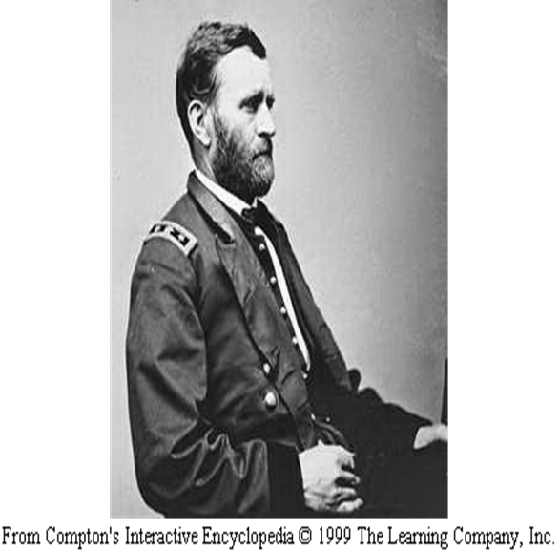
President Ulysses S. Grant
Won the 1868 election
New southern states allowed African Americans to vote.
About 500,000 blacks went to the polls to vote in the 1868 election.

Slide 15
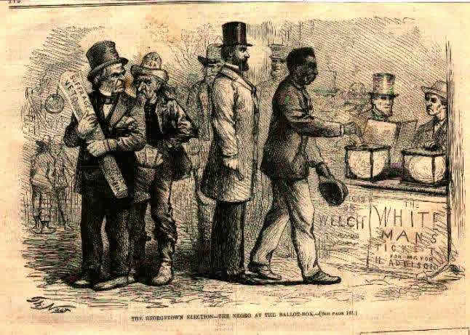
15th Amendment
Proposed by Republicans in 1869
Forbade any state from denying African Americans the right to vote because of race.
Amendment was called Negro Suffrage

Slide 16
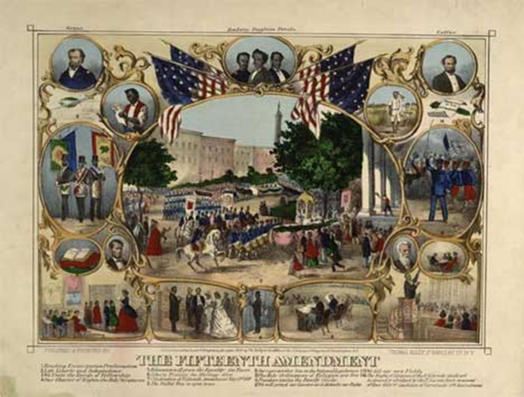
15th Amendment
Section 1:
The right of citizens of the United States to vote shall not be denied or abridged by the United States or by any state on account of race, color, or previous condition of servitude.

Slide 17
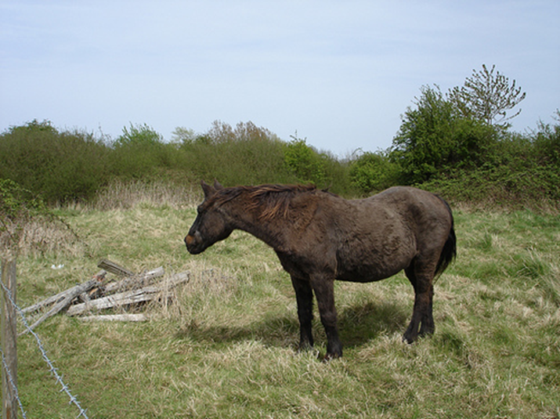
The South under Reconstruction
Many whites in the South felt that any southerner who helped the Republicans was a traitor.
They called the white southern Republicans scalawags, a word used for small, scruffy horses.

Slide 18
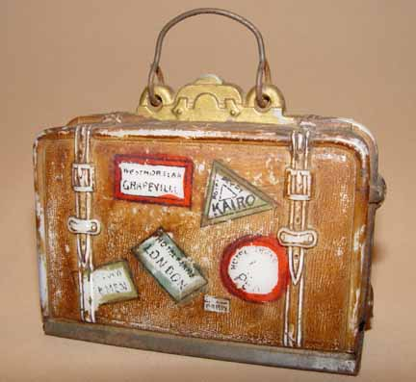
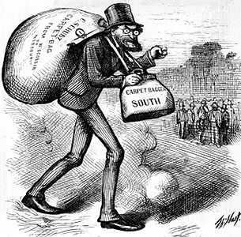
Carpetbaggers
A southern term for northerners who appeared to be in such a hurry they had time only to fling a few clothes into cheap suitcases or carpetbags.

Slide 19
New Jobs for African Americans
African Americans became:
Sheriffs
Mayors
Legislators
16 African Americans were elected to Congress between 1869 and 1880

Slide 20
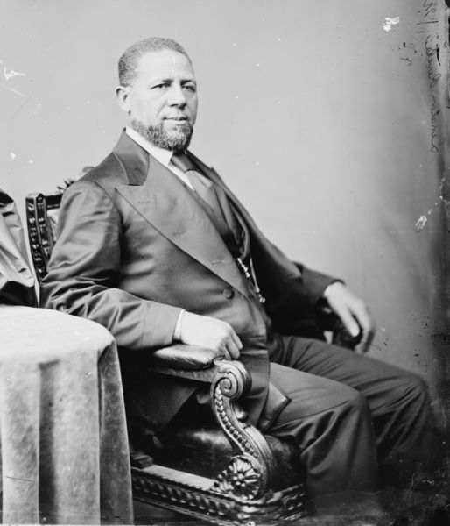
Hiram Revels
A clergyman and teacher, became the nation’s first black senator in 1870
He completed the unfinished term of former Confederate president Jefferson Davis

Slide 21
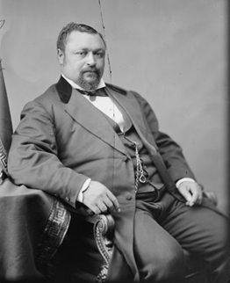
Blanche K. Bruce
Became the first African American to serve full term in the senate in 1874

Slide 22
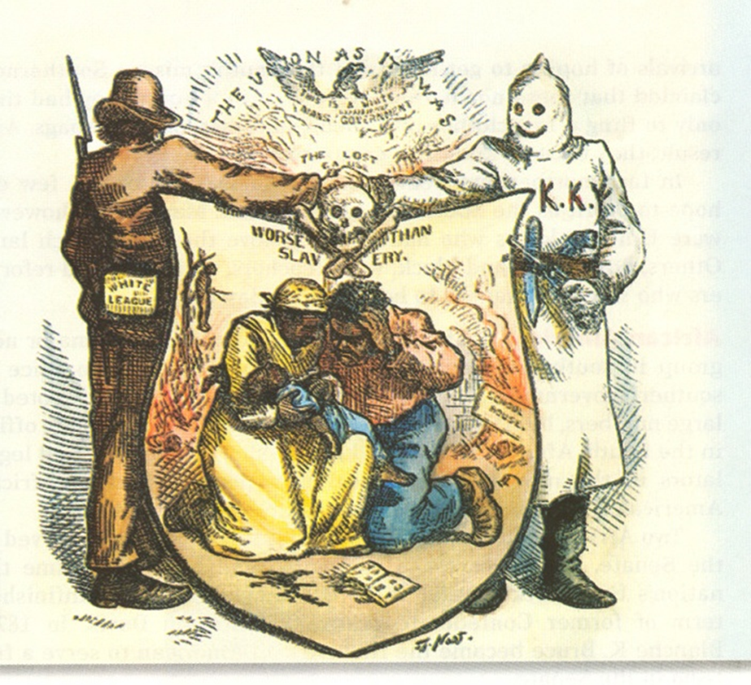
Ku Klux Klan
Secret society to try to help the South regain its power.
They used violence to murder and scare African Americans and their allies.
In 1870, Congress acted to stop the KKK’s violence by making it a crime to use force to keep people from voting.

Slide 23
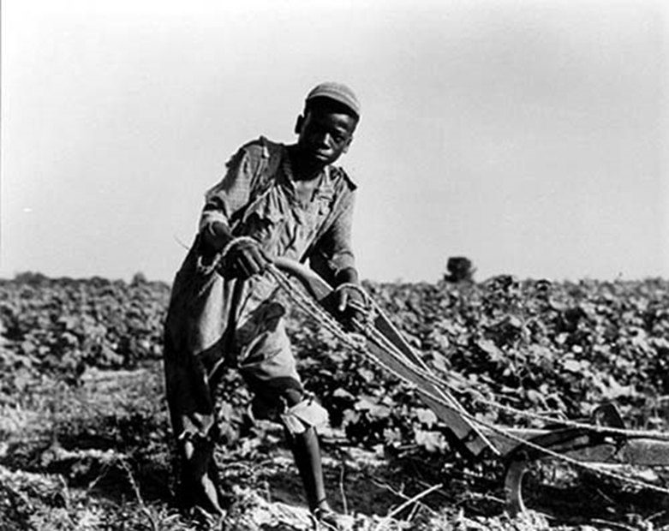
The Cycle of Poverty
Many freedman and poor whites became share croppers.
They were unable to earn money or to buy their own land.

Slide 24
The End of Reconstruction
In 1876 Americans flocked to the centennial celebration of the United States in Philadelphia.
Centennial = 100 years
The telephone and steam engine were introduced at this fair

Slide 25
Voting Restrictions
Many southern states passed
polling taxes: Required voters to pay a fee every time they voted.
Literacy tests: Test required voters to read and explain a difficult part of the Constitution
Grandfather Clause If a voter’s father or grandfather voted in an election the voter did not have to take the literacy test.

Slide 26
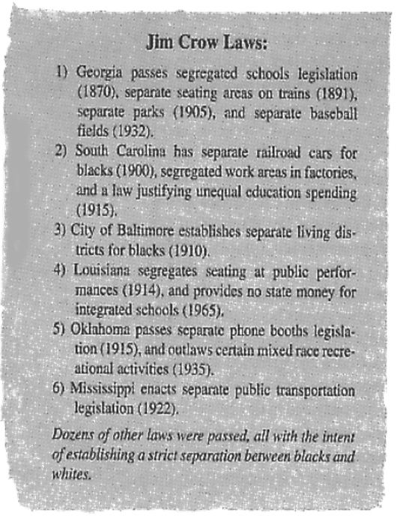
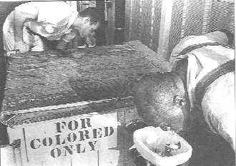
Jim Crow Laws
separated blacks and whites in schools, restaurants, theaters, trains, streetcars, playgrounds, hospitals, and even cemeteries.
Segregation: Separating people of different races

Slide 27
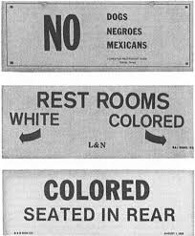
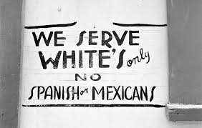
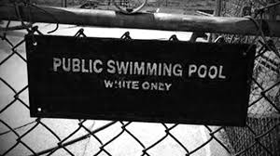
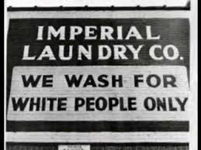
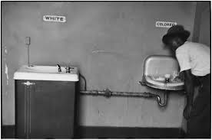
Plessy vs. Ferguson
Supreme Court ruled that segregation was legal so long as facilities for whites and blacks were equal.

Slide 28
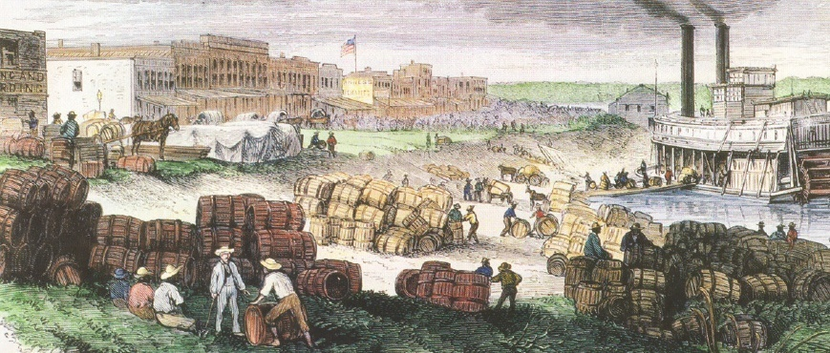
Industry in the New South
After the Civil War the South focused on it’s ability to use natural resources to build it’s own industry instead of depending on the North

