Slide 1
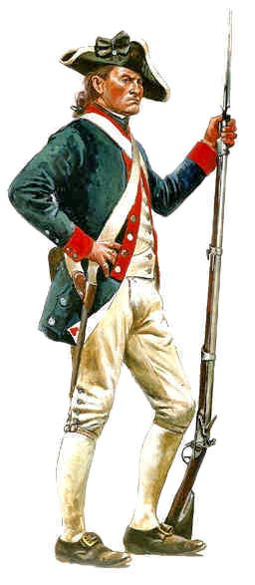
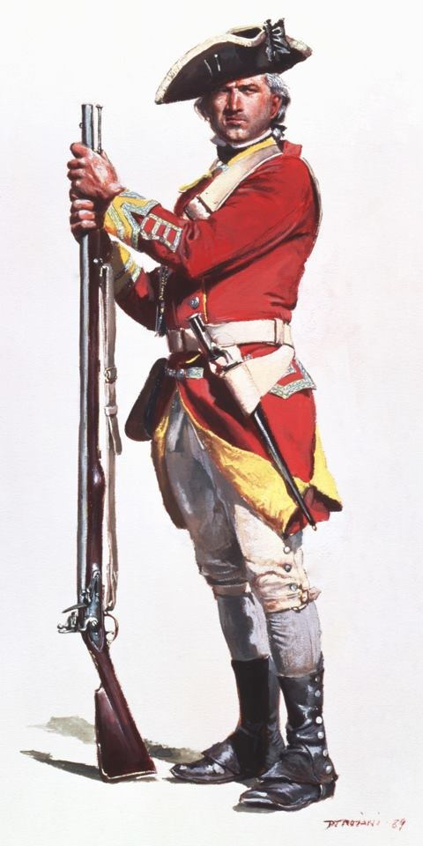
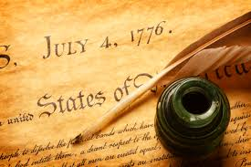
Road to Independence
Mr. Condry’s Social Studies Class

Slide 2
Lexington and Concord
1st battle of the American Revolution
British troops were sent to confiscate colonial weapons in Concord
Paul Revere and William Dawes warn the colonist

Slide 3
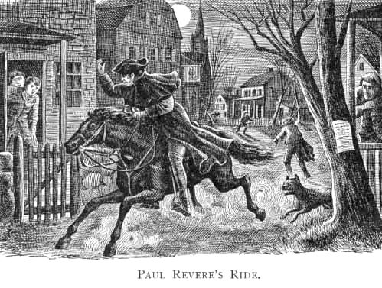

Slide 4
Lexington and Concord
700 British soldiers were defeated by a ragtag army of angry and untrained militia
This surprise victory bolsters confidence in a war.
Known as the “Shot heard around the world”
No one is actually sure who fired the first shot or if it was an American or British soldier.

Slide 5
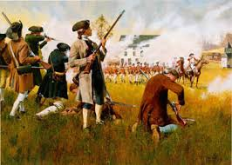

Slide 6
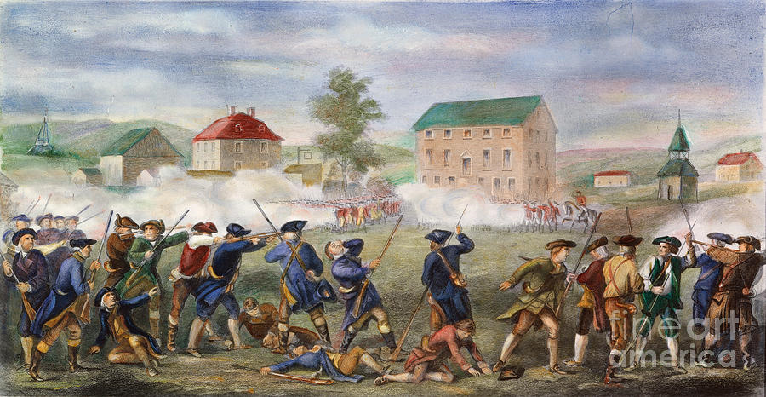

Slide 7
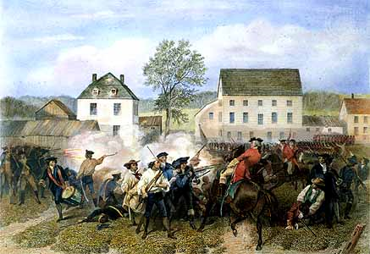
Lexington and Concord
The militia will grow from 80 at the battles of Lexington and Concord to 15,000.

Slide 9
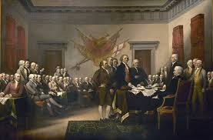
Second Continental Congress
Meet in 1775 in Philadelphia

Slide 10
Second Continental Congress
Establishes:
Olive Branch Petition
Continental Army
Declaration of Independence (separate PowerPoint)

Slide 11
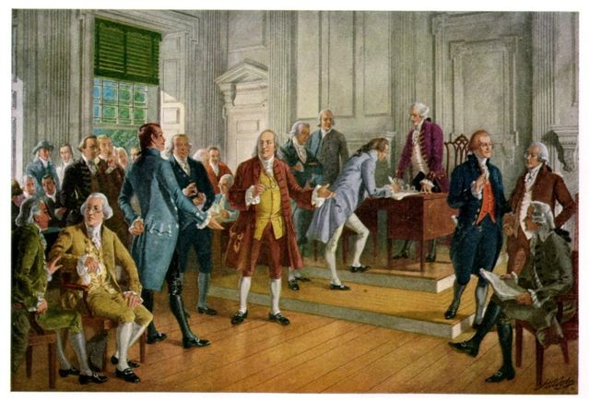
Olive Branch Petition
Sent petition to King George III asking to restore peace.
King refuses petition
Petition urged a return to the “former harmony” between Britain and the colonies
King ordered a naval blockade of the American coast

Slide 12
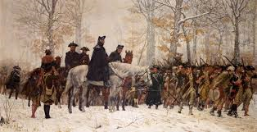
Continental Army
created an army to prepare for war under the command of George Washington.

Slide 13
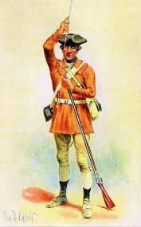
The Continental Army
Made up of:
Farmers
Frontiersmen
Townspeople
At first they had to provide their own weapons, ammunition, and uniforms
Overtime, they would be formed into regular units with uniforms and proper equipment
Many believed the war would be short

Slide 14
What colonist thought of the idea of an American Revolution
Advantages
Disadvantages
Fighting for their homes, families, lives, and freedom.
George Washington
Home ground
Ben Franklin got the French to help
Many of the English generals were afraid to make mistakes
The English people would get tired of a long war.
Poorly trained army and no navy
No money to fight a war
Weak, inexperienced government
2/3 of population wee wither Tories or didn’t care.
Professional English army, Hessians, and Indians against them.
Poor Equipment and lack of food.
Soldiers could leave at will.

Slide 15
What the British thought of the idea of an American Revolution
Advantages
Disadvantages
Professional army and navy
Factories to make war materials
Money to feed and supply an army
A government to make decisions
2/3 of the American Population were Tories or neutral
Hessians and Indians on British side
Americans were poorly supplied and trained
England had a 3000 mile supply line
English Soldiers were fighting because they were told to fight
America is a large piece of land and not easy to control or conquer.
Many of the English generals were afraid to make mistakes

Slide 16
What did the Army Eat?
Continental Army
British Army
1 ½ pounds of flour or bread
1 pound of beef or fish OR ¾ pounds of pork
1 gill (5 oz.) of whiskey
1 ½ Pounds flour or Bread
1 pound of beef or a ½ pound of pork
¼ pint of canned Peas or 1 ounce of rice
1 ounce of butter
1 ½ gills (8 oz) of Rum

Slide 17
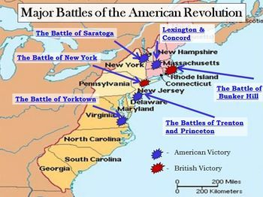

Slide 18
Battle of Bunker Hill
Fought on June 17, 1775
1,200 colonial troops under the command of William Prescott stealthily occupy Bunker Hill
British army attacks rebels to drive them back.
Beaten back twice
“Don’t shoot until you see the white of their eyes”
Third attack took the hill after the colonist run out of ammunition.

Slide 19
Casualties of Bunker Hill
Continental Army
British Army
115 killed
305 wounded
30 Captured
20 POWs died
5 out of 6 Cannons
Total: 450
19 officers killed
62 officers wounded
207 soldiers killed
766 soldiers wounded
Total 1,054

Slide 20
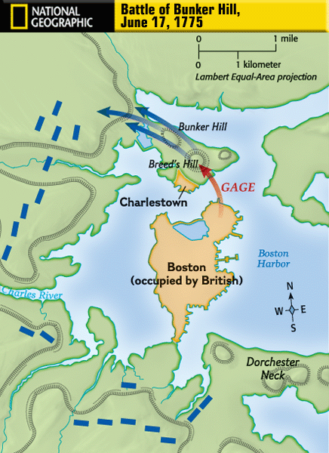
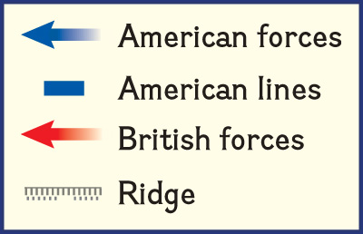

Slide 21
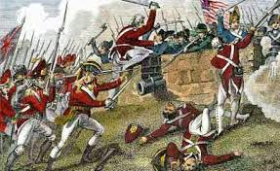

Slide 22
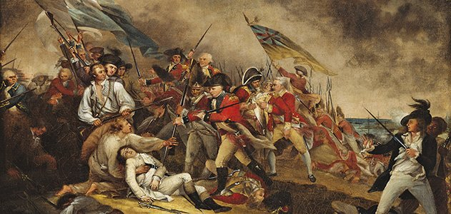

Slide 23
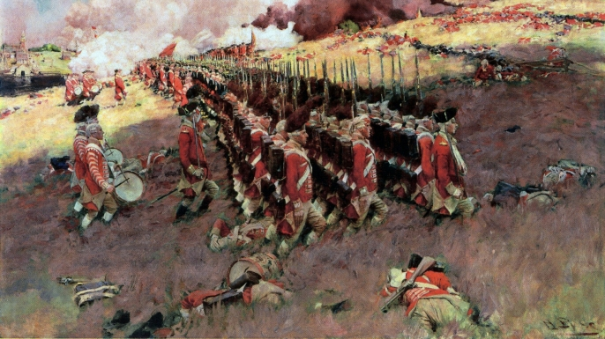

Slide 24
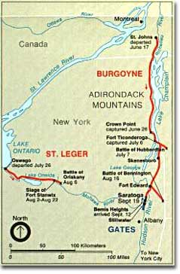
Battle of Saratoga (New York)
The British planned a 3 pronged attack to capture the Hudson River Valley and cut off New England from the rest of the Colonies

Slide 25
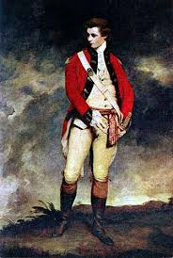
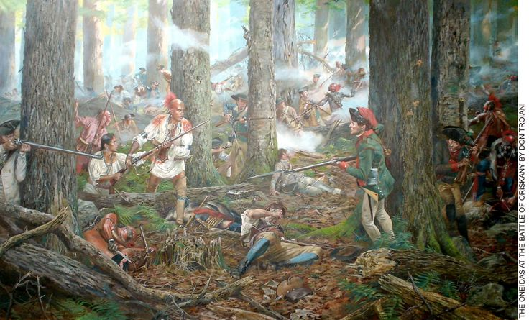
Battle of Saratoga
General St. Leger would march east from the Great Lakes to Albany.
Was defeated at Battle of Oriskany

Slide 26
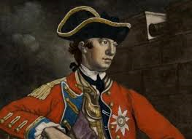
Battle of Saratoga
General Howe would march north from New York City to Albany
Never moved north

Slide 27
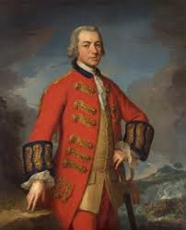
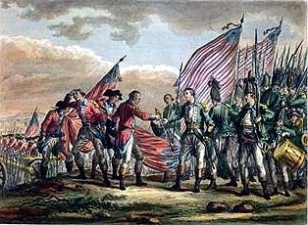
Battle of Saratoga
General Burgoyne would march south from Canada to take Albany.
Was on his own when he met the American army

Slide 28
Battle of Saratoga
British Army
Colonial Army
Commander: General John Burgoyne
Force: 7200
Killed: 140
Wounded: 370
Captured: 390
Commander: Benedict Arnold, Daniel Morgan, Horatio Gates
Force: 9000
Killed: 60
Wounded: 260
Captured: 0

Slide 29
Battle of Trenton (New Jersey)
General George Washington’s crossing of the Delaware.
Let the main body of the Continental Army against the Hessian soldiers garrisoned at Trenton.
After a brief battle, nearly all the entire Hessian force was captured

Slide 30
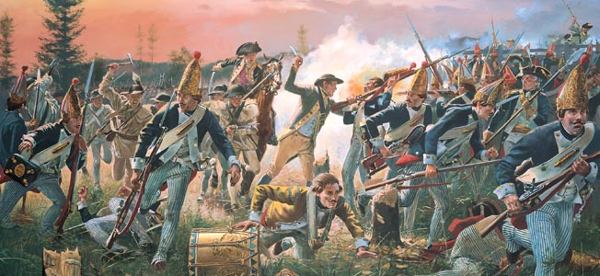
What is a Hessian?
30,000 German troops hired by the British to help fight during the American Revolution

Slide 31
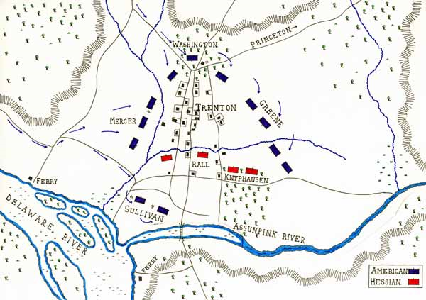

Slide 32
Battle of Trenton
British Army
Continental Army
Commander: Johann Rall
Force: 1520
Killed: 22
Wounded: 86
Captured: 906
Commander: George Washington
Force: 2400
Killed: 2
Wounded: 5

Slide 33
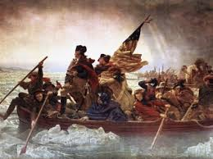

Slide 34
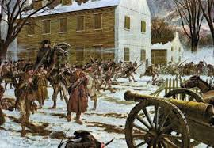

Slide 35
Battle of Yorktown
Begins September 28, 1781
Ends October 19, 1781
A decisive victory by a combined force of American Continental Army and the French Army
This will end the war

Slide 36
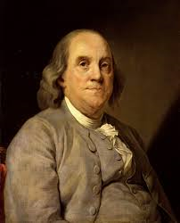
Benjamin Franklin
Living in France
Convinced the French to Help Americans

Slide 37
Battle of Yorktown
British Army
Continental Army
Commander: Lord Charles Cornwallis
Force: 8980
Killed: 309
Wounded: 326
Captured: 8007
Commander: George Washington
Force: 20600
Killed: 72
Wounded: 180
Captured: 0

Slide 38
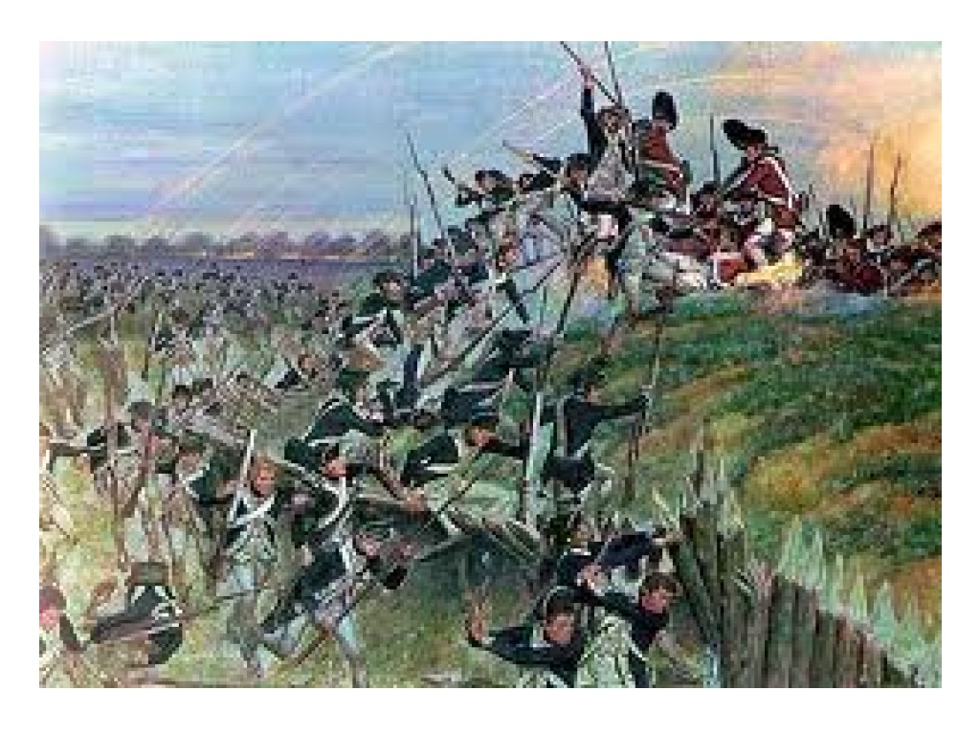

Slide 39
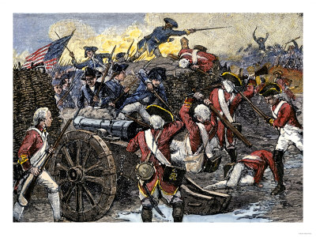

Slide 40
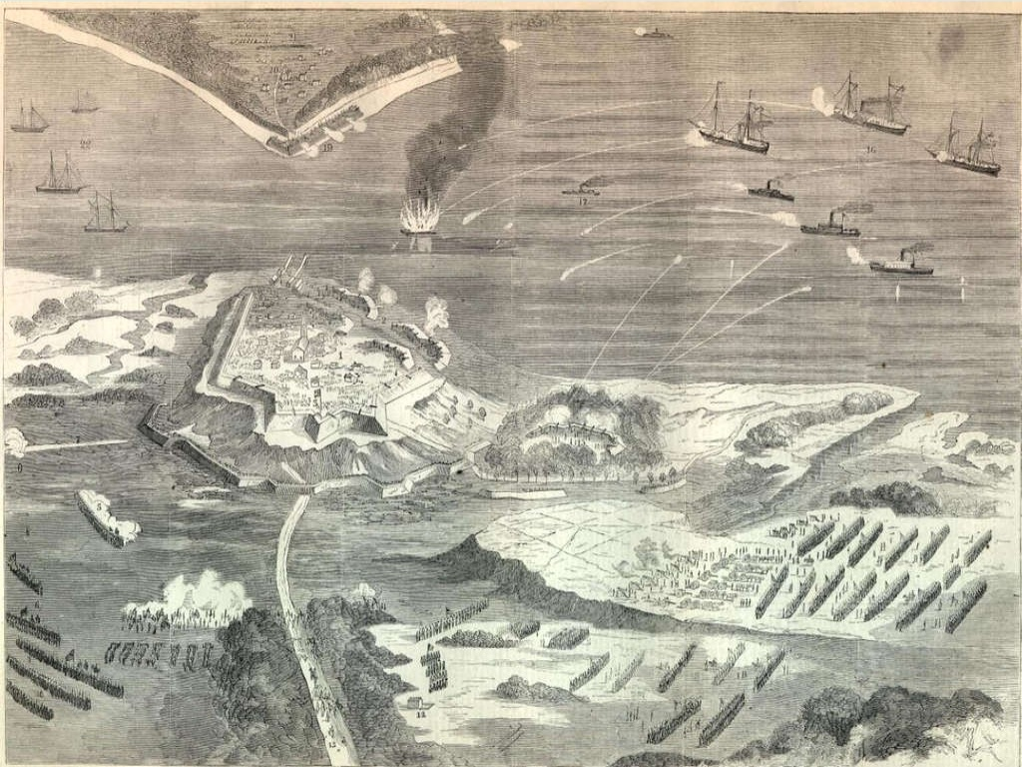

Slide 41
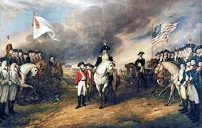

Slide 42
Casualties of the War
United States: 6,824 Killed in Battle
25,000-70,000 dead from all causes
Overall casualties up to 50,000
Great Britain: 4,000 army troops killed in Battle
27,000 army troops died of disease
1,243 killed in naval battles
42,000 deserted
18,500 died from disease
At least 51,000 dead from all causes

Slide 43
Casualties of the War
France: 10,000 battle deaths (75% at sea)
Spain: 5,000 killed
Netherlands: 500 Killed
Germans: 1,800 killed in battle
4,888 deserted
7,774 dead from all causes

Slide 44
Britain's Cost of War
Spent about £80 million ($129,60,000,000.00)
National debt of £250 million ($40,500,000,000.00)
£9.5 million a year in interest. ($1,539,000,000.00)

Slide 45
France’s Cost of War
Spent 1.3 billion livres (about £56 million) ($9,072,000,000.00)
Their total national debt was £187 million ($30,294,000,000.00)

Slide 46
America’s Cost of War
spent $37 million at the national level plus $114 million by the states.
This was mostly covered by loans from France and the Netherlands, loans from Americans, and issuance of an increasing amount of paper money

