Slide 1
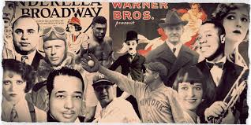
“Roaring 20s”
Mr. Condry’s Social Studies Class

Slide 2
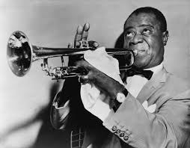
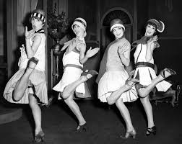
1920s
Also known as the:
Jazz age
Roaring 20s

Slide 3
Life in the 1920s: Changing Role of Women
19th Amendment (1920) – granted women suffrage (right to vote)
New jobs opened up during WWI and the women didn’t want to give their jobs up when the men came back home – so…more women began to go to college

Slide 4
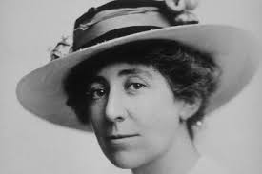
Life in the 1920s: Changing Role of Women
Jeanette Rankin – first woman elected to Congress (1916) – served throughout the 1920s

Slide 5
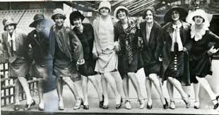
Flappers
modern women of the 1920s
young, rebellious, fun-loving, and bold
short hair, short dresses (to the knees), more makeup (esp. lipstick)
attitudes changes – ex: began to smoke and drink in public

Slide 6
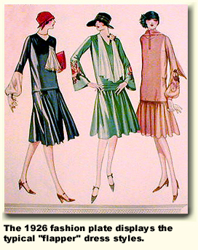
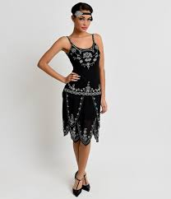

Slide 7
Life in the 1920s: Prohibition Era
Prohibition Era (1919-1933):
18th Amendment (1919) – prohibited the making, selling, or transportation of alcohol
Volstead Act – law passed by Congress to enforce prohibition – ignored by most of the cities on the east coast

Slide 8
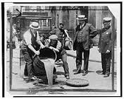
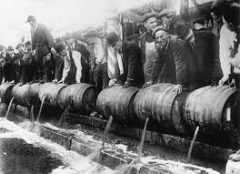
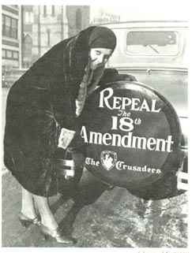
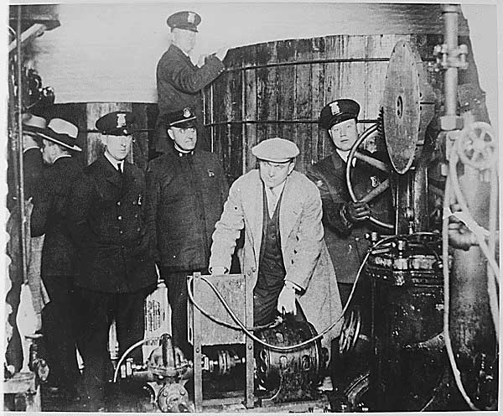
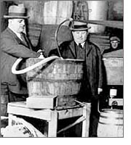

Slide 9
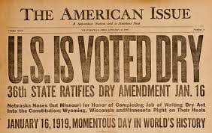
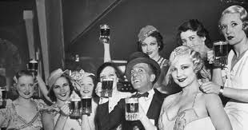
Life in the 1920s: Prohibition Era
Success
Failures
-consumption of alcohol
decreased
-arrest for drunkenness decreased
Not enforced
Corrupt police departments
Police depts. didn’t care
Fear of gangsters
Was not taken seriously taken by citizens

Slide 10
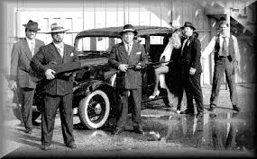
Life in the 1920s: Crime wave
The crime wave that began made most people think that the amendment should be repealed
-organized crime got involved in bootlegging (the illegal selling of alcohol)
-the most famous gangster of the 1920s was Al Capone from Chicago

Slide 11
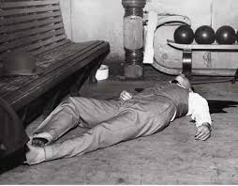
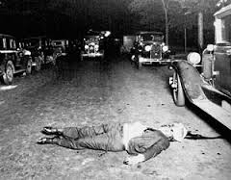
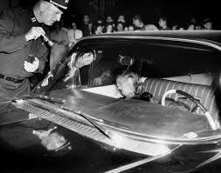
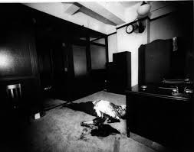
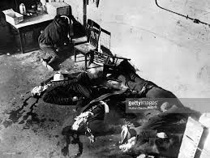
Gangsters Violence During the Prohibition

Slide 12
Life in the 1920s: Al Capone
Al Capone – nicknamed “Scarface”
had a talent for avoiding jail by buying off policemen, city officials, and politicians
made up to $60 million a year from bootlegging
convicted of tax evasion in 1931 and sent to prison
released in 1939 after becoming ill with syphilis – died in 1947

Slide 13
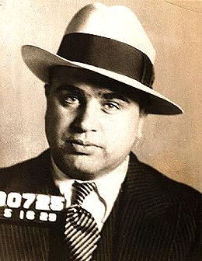
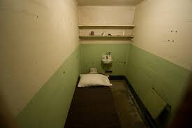
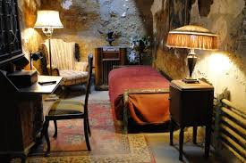
Al Capone Valentines Day Massacre
Alcatraz Cell Al Capone’s Cell

Slide 14
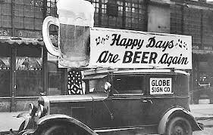
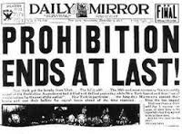
21st Amendment
Passed in 1933
repealed the 18th Amend. and allowed local communities to decide whether or not to legalize alcohol

Slide 15
Slang Words from Prohibition Era:
bathtub gin: refers to any style of homemade spirit made in amateur conditions
Moonshine: 'white liquor', white lightning, mountain dew, hooch, homebrew, white whiskey, and corn liquor are terms used to describe high-proof distilled spirits .
Speakeasy: a secret club or bar usually in a basement and you needed a password to get in

Slide 16
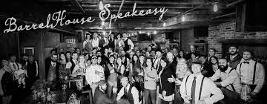
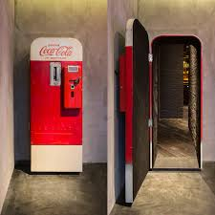
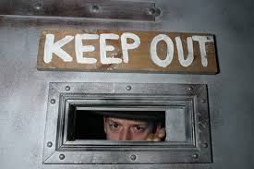

Slide 17
I. Life in the 1920s: Entertainment
Shorter working hours and higher wages gave Americans more spare time and more money for entertainment
Radio – first radio station in Pittsburgh, PA in Nov. 1920 . It only had news at first, baseball and music broadcasted later

Slide 18
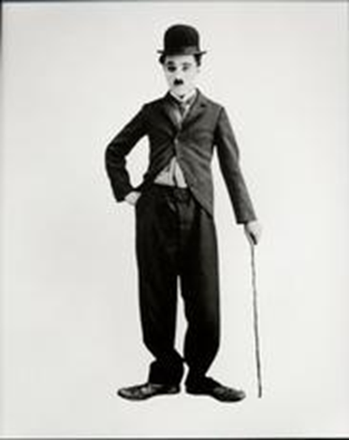
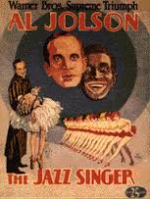
Life in the 1920s: Entertainment
Moving Picture Shows– all movies were silent films at first (had music but no talking)
Charlie Chaplin was the most famous silent film star
first “talking” movie was The Jazz Singer (1927) staring Al Jolston

Slide 19
Life in the 1920s: Entertainment
Sports – the 1920s is often called the “Golden Age of Sports”
radio made sports more popular
baseball became “America’s Favorite Pastime”

Slide 20
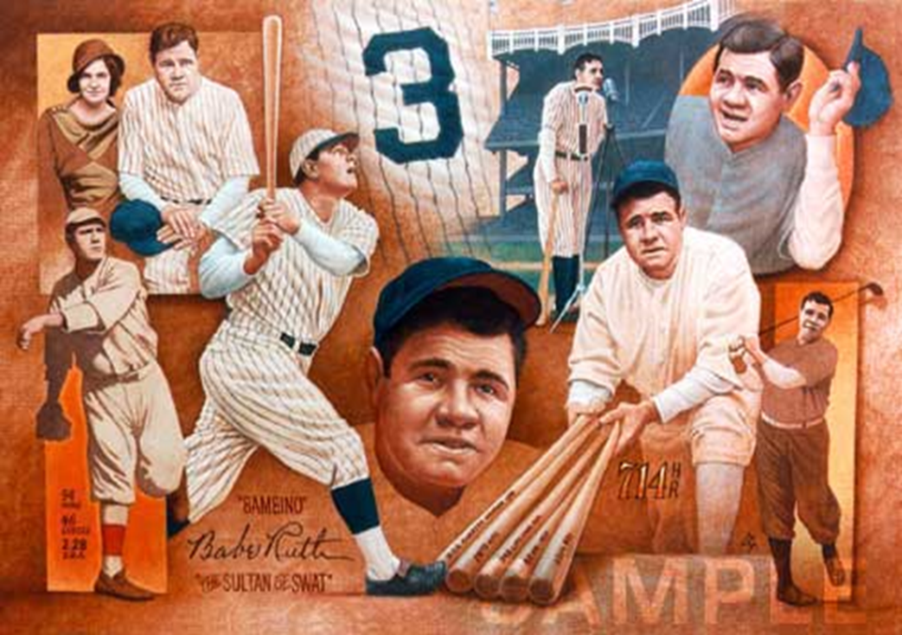
Life in the 1920s: Famous Athletes
Babe Ruth – nicknamed “The Sultan of Swat” or “The Great Bambino”
-most famous baseball player of the 20s
-played most of his career with the NY Yankees
-hit 60 homeruns in 1927 (remained a record until 1961)
-hit 714 career homeruns (remained a record nearly 40 years)

Slide 21
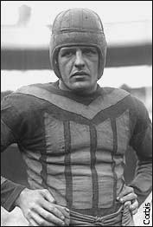
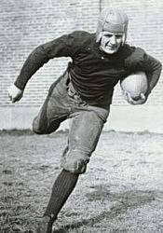
Life in the 1920s: Famous Athletes
Harold “Red” Grange – famous football player
nicknamed “The Galloping Ghost”
played for Illinois Univ. and Chicago Bears
made Pro football very popular

Slide 22
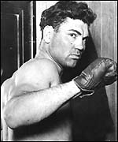
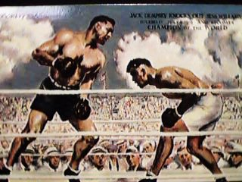
Life in the 1920s: Famous Athletes
Jack Dempsey – famous heavyweight boxer
over 100,000 attended his 2nd match with Gene Tunney, which Dempsey lost

Slide 23
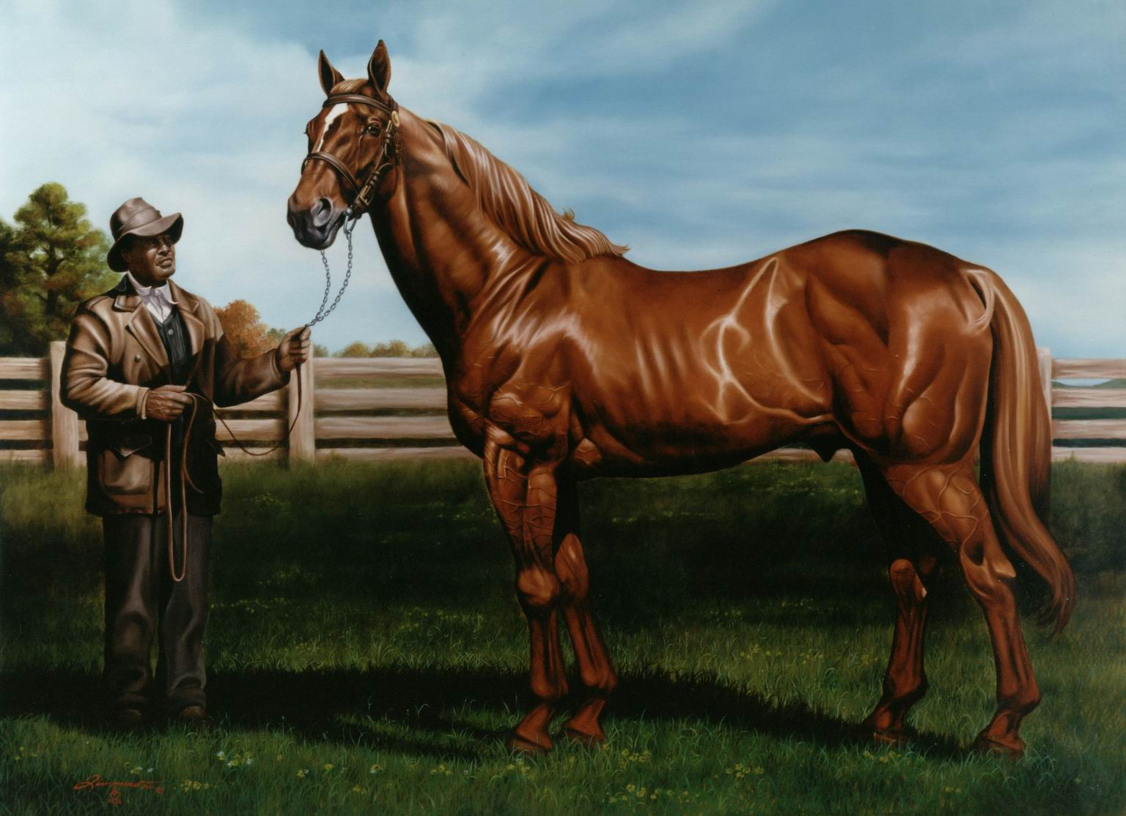
Life in the 1920s: Famous Athletes
Man “o” War – famous race horse
named horse of the century
lost only 1 time in 21 races
the horse that beat him was named…
Upset

Slide 24
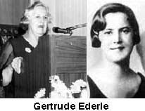
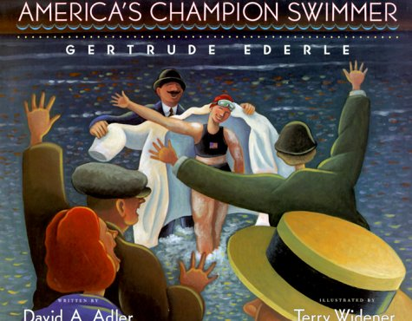
Life in the 1920s: Famous Athletes
Gertrude Ederle – 1st woman to swim across the 35 mile wide English Channel
her time beat the men’s record by nearly 2 hours

Slide 25
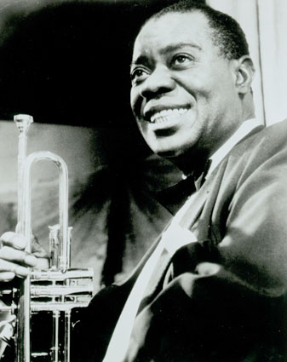
Life in the 1920s: Music/Dance
the radio made music more popular
Jazz was the most popular music of the 20s it started in New Orleans
Louis Armstrong was the most popular jazz musician of the 20s

Slide 26
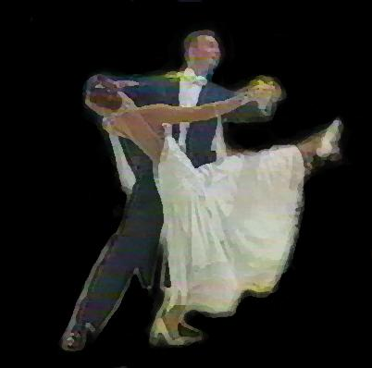
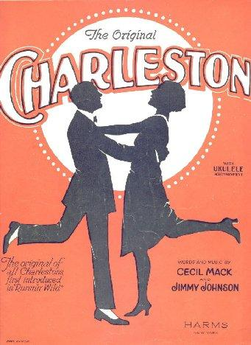
Life in the 1920s: Music/Dance
George Gershwin was a popular composer he wrote “Rhapsody in Blue”
popular dances included:
Charleston
Fox-trot
Tango

Slide 27
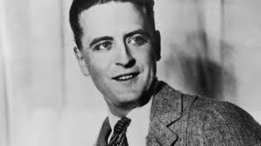
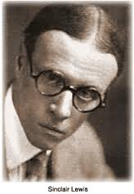
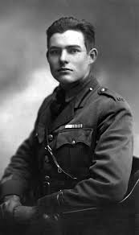
Life in the 1920s: Literature
Famous authors included:
F. Scott Fitzgerald – The Great Gatsby
Sinclair Lewis – Main Street
Ernest Hemingway – A Farewell to Arms

Slide 28
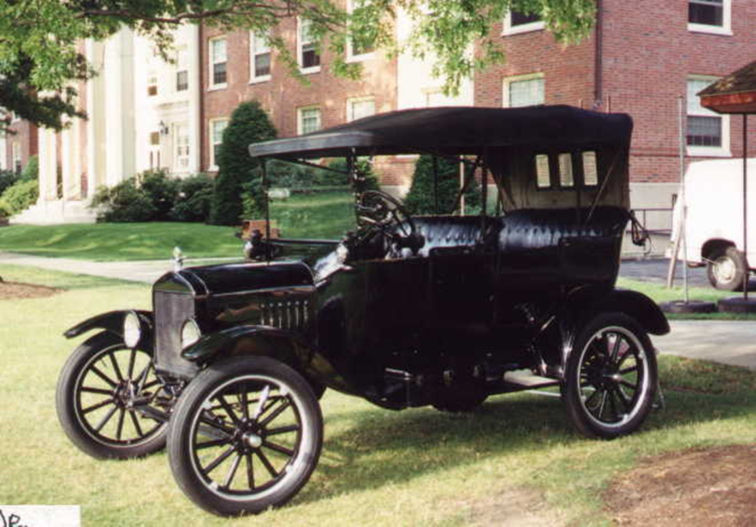
Life in the 1920s: Transportation
Henry Ford – “made the 20s happen”
responsible for changing the automobile industry by using the assembly line – each worker had a specific job
1920 – 8 million cars on the road
1929 – 23 million
developed the Model T car (every one was exactly the same)

Slide 29
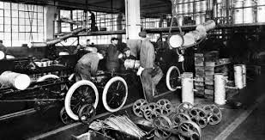
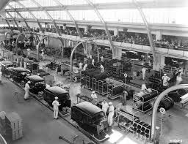
Life in the 1920s: Transportation
Car manufacturing went from 12 hours to 28 minutes after the creation of the assembly line.

Slide 30
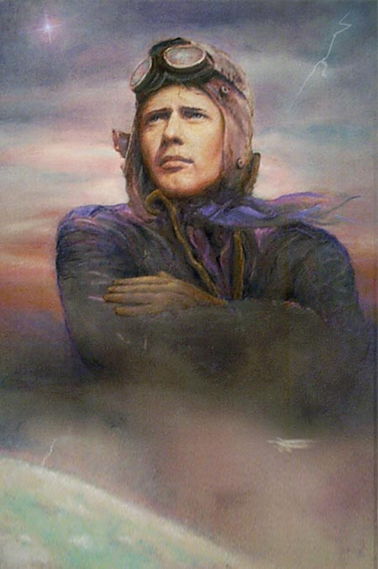
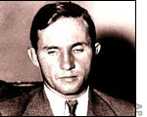
Life in the 1920s: Transportation
Charles Lindbergh – nicknamed “Lucky Lindy” or the “Lone Eagle”
the first to fly solo, non-stop across the Atlantic
flew from NYC to Paris May 20th and 21st of 1927
no parachute, no radio, no heat, no sleep

Slide 31
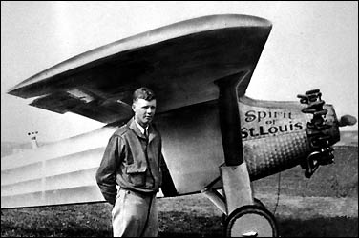
Life in the 1920s: Transportation
name of the airplane was “Spirit of St. Louis”
son was kidnapped and killed in the early 1930s (great mystery)

Slide 32
Life in the 1920s: Transportation
Amelia Earhart – the 1st woman to fly across the Atlantic without stopping (1932)
disappeared while trying to fly around the world

Slide 33
Life in the 1920s: Return of the Ku Klux Klan
From the Greek word kyklos which means “circle”
Revived in the 1920s
Attacked African Am.’s, Jews, Catholics, and immigrants
Membership:
1916- 100,000
1924- 2 million
1928- 4 million
today- approx. 6,000

Slide 34
Life in the 1920s: Politics
Scopes / “Monkey” Trial
The state of TN passed a law in 1925 that made it illegal to teach evolution (Charles Darwin theory) in public schools
John Scopes, a teacher from Dayton, TN, was chosen by the ACLU to challenge the law

Slide 35
I. Life in the 1920s:
He was arrested and charged – defense attorney was Clarence Darrow
William Jennings Bryan was the prosecutor
The judge refused to allow scientists to testify for the defense since “they were not around during creation”
Scopes was found guilty and fined $100, however the law was later changed

Slide 36
Life in the 1920s: Politics
The Red Scare- the fear of radicals especially communists and socialists.
Causes:
the communist revolution in Russia (1917) scared many Americans – “If it can happen there, it can happen here.”
terroristic violence in the U.S. – mail bombs were sent to local, state, and national leaders

Slide 37
Life in the 1920s: Politics
Because of the Red Scare and the power of the KKK, limits were placed on immigration
Sacco and Vanzetti Case – two Italian immigrants, who were anarchists, were accused of killing 2 men during a robbery in Massachusetts
convicted without a fair trial – both were executed in 1927

