Slide 1
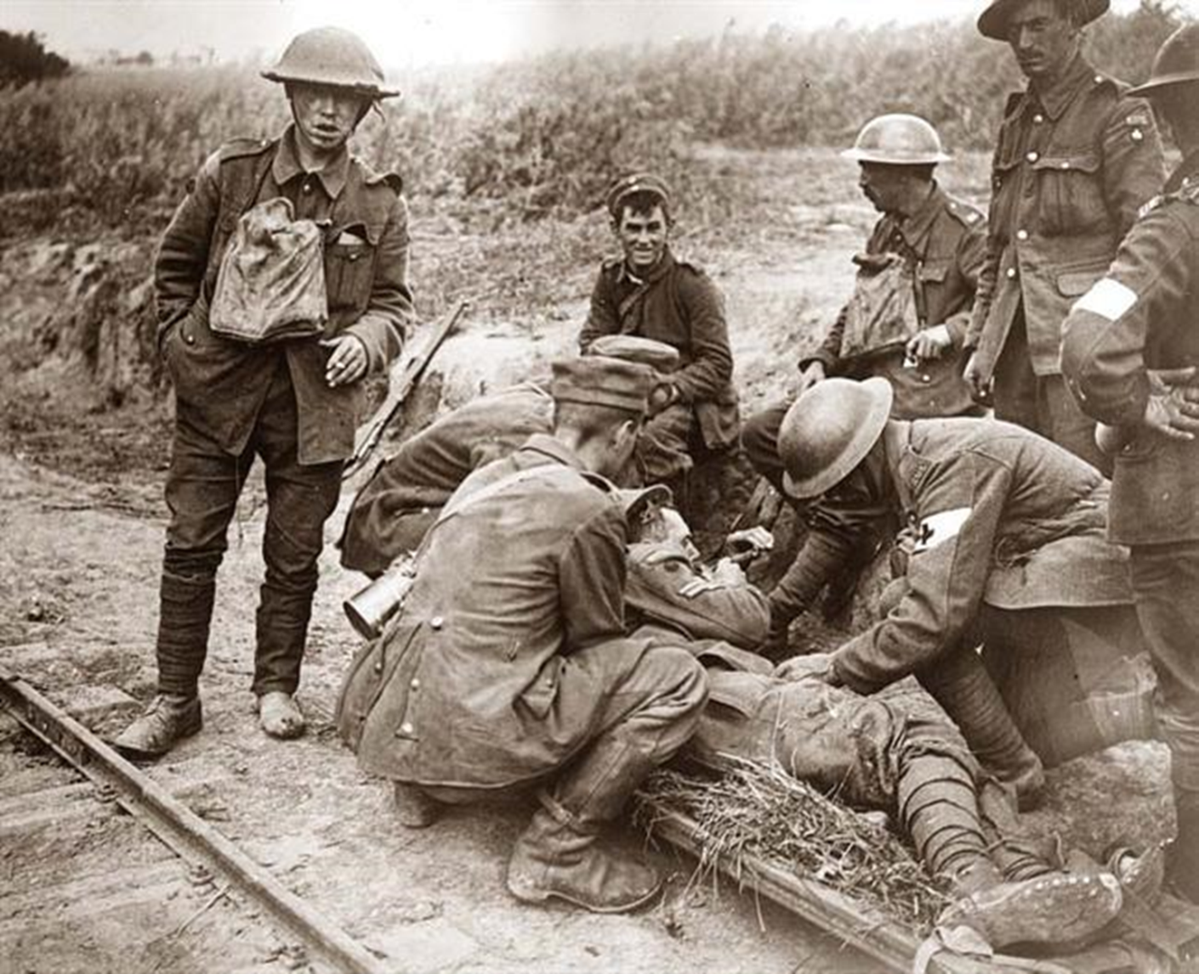
The First World War 1914 - 1918
Mr. Condry’s Social Studies Class

Slide 2
The Entente Powers
Andorra
Armenia
Arab Rebels
Belgium
Brazil
China
Costa Rica
Cuba
Czechoslovak Legions
Emirate of Nejad and Hasa
France
Greece
Guatemala
Haiti
Honduras
Japan
Liberia
Nepal
New Hebrides
Nicaragua
Panama
Portugal
Romania
Russia
Serbia
Siam
United Kingdom
Canada
India
Newfoundland
Australia
New Zealand
Malta
South Africa
Rhodesia
United States
Alaska
Hawaii
Philippine Islands
Puerto Rico

Slide 3
Central Powers
Austria-Hungary
Azerbaijan Democratic Republic
Bulgaria
Banat Republic
Duchy of Courtland
Sernigallia
Dervish State
Democratic Republic of Georgia
Germany
Jabal Shammar
Kingdom of Lithuania
Ottoman Empire
South Africa Republic
Senussi
Kingdom of Poland
Sultanate of Darfur
Ukrainian State

Slide 4
Neutral Countries
Afghanistan
Principality of Albania
Argentina
Bolivia
Bhutan
Chile
Denmark
Ecuador
El Salvador
Ethiopia
Liechtenstein
Luxembourg
Bogd Khaanate of Mongolia
Mexico
Monaco
The Netherlands
Norway
Paraguay
Peru
Iran
San Marino
Spain
Spitsbergen
Sweden
Switzerland
Uruguay
Venezuela

Slide 5
Causes of the War
Historians believe there are four long term causes of the First World War
Nationalism
Imperialism
Militarism
Alliance System

Slide 6
Nationalism
A devotion to the interests and culture of one’s nation

Slide 7
Nationalism
Led to rivalries and conflicts between nations.
Various ethic groups resented domination by others and wanted independence
Russia and Austria-Hungary disagreed over the treatment of Serbs in central Europe

Slide 8
Imperialism
Economic and political control over weaker nations

Slide 9
Imperialism
For many centuries, European nations built empires.
Colonies supplied raw materials and provided markets for manufactured goods.
As Germany industrialized, it competed with other nations and colonies making it more competitive.

Slide 10
Militarism
The growth of nationalism and imperialism led to increased military spending

Slide 11
Militarism
Empires had to be defended and European nations increased military spending enormously in the late 19th and early 20th Century.
By 1890 the strongest nation militarily in Europe was Germany.
Germany had a strong army and built up a nave to rival England’s.
France, Italy, Japan, and the United States quickly joined in the naval buildup.

Slide 12
Battleships were being stockpiled by European nations, Japan, and America in the late 19th and early 20th Century.

Slide 13
Alliance System
By 1907 Europe was divided into two armed camps

Slide 14
Alliance System
By 1907 there were two major defense alliances in Europe.
The Triple Entente, later known as the Allies, consisted of France, Britain, and Russia.
The Triple Alliance, later known as the Central Powers, consisted of Germany, Austria-Hungary, the Ottoman Empire and Italy

Slide 15
The Spark: The Beginning of World War 1
The Balkan region was considered “the powder keg of Europe” due to competing interests in the area.
Russia wanted access to the Mediterranean Sea.
Germany wanted railroad access to the Ottoman Empire.
Austria-Hungary, which had taken control of Bosnia in 1878, accused Serbia of Subverting its rule over Bosnia.

Slide 16
The Spark: The Beginning of World War 1
June of 1914, Archduke Franz Ferdinand, heir to the Austrian throne was gunned down
Killed by a Serbian radical named Gavrilo Princip a member of the Black Hand

Slide 17
The Fighting Begins
The Alliance System pulled one nation after another into the conflict
The Great War had begun on August 3, 1914.
Germany invaded Belgium, following a strategy known as the Schlieffen Plan.

Slide 18
Schlieffen Plan
Quick strike attacks
Attack Belgium to Paris, France
Germany would attack Russia
The plan was designed to prevent a two-front war for Germany.

Slide 19
The War Becomes a Stalemate
Unable to save Belgium, the Allies retreated to the Marne River where they stopped the German advance in September of 1914.
Both sides dug in for a long siege.
By the spring of 1915, two parallel systems of deep trenches crossed France from Belgium to Switzerland.
Between enemy trances was “no man’s land”

Slide 20
Dangers in the Trench: Rats

Slide 21
Dangers in the Trench: Trench Foot

Slide 22
Dangers in the Trench: Lice

Slide 23
Dangers in the Trench: Mustard Gas

Slide 24
First Battle of the Somme
Began on July 1, 1916 and lasted until mid-November
British suffered 60,000 casualties on the first day.
Trench warfare lasted for 3 years.
In 3 year period 1.2 million men killed and only 7 miles of ground was gained.

Slide 25
First Battle of the Somme
Allies Powers
Central Powers
Strength
51 British and 48 French Divisions
Casualties
420,000 British
200,000 French
Strength
50 Divisions
Casualties
434,000 – 500,000 German

Slide 26
Americans Question Neutrality
In 1914, most Americans saw no reason to join a struggle 3,000 miles away – they wanted neutrality.
Some German-Americans supported Germany in World War 1.
Many Americans felt closer to the British because of a shared Ancestry and language.
American economic interests were far stronger with the allies.

Slide 27
The War Hits Home
During the first two years of the war America was providing the allied forces with:
Dynamite
Cannon Powder
Submarines
Copper wire
Tubing
Other war materials.

Slide 28
The War Hits Home
Both the Germans and British imposed naval blockades on each other.
The Germans used U-boats to prevent shipments to the North Atlantic.
Any ship found in the waters around Britain would be sunk.

Slide 29
The Lusitania Disaster
A British passenger liner that carried 1,198 persons.
Set sailed on May 7, 1915
A German U-boat sank the British liner killing all aboard including 128 American tourists.
The Germans claimed the ship was carrying Allied ammunition
Americans were outrages and public opinion turned against Germany and the Central Powers.

Slide 30
1916 Election
Woodrow Wilson vs. Charles Evans Hughes
Wilson won a close election using the slogan, “He kept us out of war.”
Within a few months the United States would be embroiled in World War I.

Slide 31
America Edges Closer to War
Several factors brought America into the war:
Germany ignored Wilson’s plea for peace.
The Zimmerman Note
Sinking of the Lusitania

Slide 32
Zimmerman Telegraph
A telegram from the German foreign minister to the German Ambassador in Mexico.
Proposed an alliance with Mexico and a return of their “lost territory” in Texas, New Mexico, and Arizona.

Slide 33
America Declares War
April 2, 1917
Wilson said, “The world must be made safe for democracy.”
Congress declares war a few days later.

Slide 34
American Power Tips the Balance
America was not ready for war
Only 200,000 men were in service when was declared.
Congress passed the Selective Service Act in May of 1917.
By the end of 1918
24 million had signed up
Almost 3 million were called to duty
About 2 million American troops reached Europe

Slide 35
Fresh U.S. Soldiers Join the Fight
After 2 ½ years of fighting, the Allied forces were exhausted.
Main contributions of the Americans was fresh and enthusiastic troops
American infantry were nicknamed “doughboys” because of their white belts.
Most doughboys had never ventured far from the farms or small towns they lived in.

Slide 36
Important New Weapons: Machine Guns
Guns could now fire 600 rounds per minute.
Vickers K Machine Gun
M1917 Browning Machine Gun

Slide 37
Important New Weapons: The Tank
New steel tanks ran on caterpillar treads
Char d’Assault Schneider- French assault tank
Char d’Assault St. Chamond- French self-propelled gun tank

Slide 38
Important New Weapons: Airplanes
Early dogfights resembled duals, however by 1918 the British had a fleet of planes that could deliver bombs.
Countries different contributions
Canada- 2 planes (bomber, fighter)
France- 166 planes (bombers, fighters, reconnaissance, trainers)
Italian- 26 planes (bombers, fighters, reconnaissance)
Japan- 1 plane (reconnaissance)
Romania- 1 plane (trainer)
Russia- 18 planes (Patrol seaplane, trainer, reconnaissance, fighter, bomber)
England- 149 planes (bombers, patrol seaplane, trainer, reconnaissance, fighter, bomber, zeppelin fighter, patrol blimp, zeppelin airship)
United States- 47 planes (trainer, patrol blimp, reconnaissance, bomber, fighter.

Slide 39
Important New Weapons: Poison Gas
Mustard Gas was used to subdue the enemy

Slide 40
Other Weapons & Equipment: Howitzers

Slide 41
Other Weapons & Equipment: Flame Throwers

Slide 42
Other Weapons & Equipment: Torpedoes

Slide 43
Other Weapons & Equipment: U-boats

Slide 44
Other Weapons & Equipment: Phosphorus Grenades

Slide 45
Other Weapons & Equipment: Field Phones

Slide 46
Other Weapons & Equipment: Search Lights

Slide 47
Other Weapons & Equipment: Gas Masks

Slide 48
Other Weapons & Equipment: Camouflage

Slide 49
Other Weapons & Equipment: Railroad Guns

Slide 50
Other Weapons & Equipment: Blimps

Slide 51
Royal Air Force (RAF)
The United Kingdom’s aerial warfare force.
Formed towards the end of the first world war on April 1, 1918.
The oldest independent air force in the world.

Slide 52
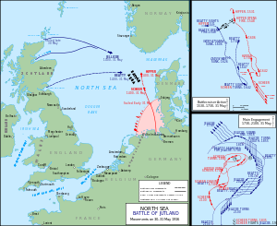
Battle of the Jutland
The only real major naval battle of the war.
Between Germany’s battleships and Britain’s battleships.

Slide 53
Battle of the Jutland
United Kingdom
Germany
Strengths
28 battleships
9 battlecruisers
8 armored cruisers
26 light cruisers
78 destroyers
1 minelayer
1 seaplane carrier
Casualties
6,094 killed
674 wounded
177 captured
3 battlecruisers
3 armored cruisers
8 destroyers.
Strength
16 battleships
5 battlecruisers
6 pre-dreadnoughts
11 light cruisers
61 torpedo-boats
Casualties
2,551 killed
507 Wounded
1 battle cruiser
1 pre-dreadnought
4 light cruisers
5 torpedo-boats

Slide 54
American Troops Go On the Offensive
When Russia surrendered to the Germans in 1917, the Central Powers were able to focus on the Western Front.
By May, the Germans were within 50 miles of Paris. The Americans arrived and immediately played a major role in pushing the Germans back
In July and August the Americans helped the Allies win the Second Battle of the Marne.

Slide 55
Germany Collapses, War Ends
On November 3, 1918, Austria-Hungary, surrendered to the Allies.
That same day, German sailors mutinied against their government.
Other revolts followed, and Germany was too exhausted to continue.
So at the eleventh hour, on the eleventh day, of the eleventh month of 1918, Germany signed a truce ending the Great War.

Slide 56
The War at Home
The Entire U.S. Economy was focused on the war effort.
The shift from a consumer economy to war economy required a collaboration between business and government.
In the process, the power of the U.S. government expanded.
Congress gave President Wilson direct control over the economy.

Slide 57
The War at Home: War Industries Board
The War Industries Board (WIB) encouraged companies to use mass-production techniques.
Under the WIB industrial production and wages increased 20% and union membership increased from 2.5 million to 4 million.
To deal with disputes between management and labor, President Wilson set up the Nation War Labor Board in 1918.

Slide 58
The War at Home: Victory Gardens
To conserve food, Wilson set up the Food Administration (FA) which declared one day a week “meatless,” another “sweetless,” and two days “wheatless.”
Homeowners planted “victory gardens” in their yards and school children worked after school growing tomatoes and cucumbers in public parks.
Farmers increased production by almost 30% by adding 40 million acres of farmland.

Slide 59
The War at Home: Selling the War
The U.S. had two major tasks:
Raising money
Convincing the public to support the war.
The U.S. spent $35.5 billion on the war effort
The government raised about 1/3 of that through an income tax and “sin” taxes.
The rest was raised through war bonds sold to the public (Liberty Loans & Victory Loans).

Slide 60
The War at Home: Propaganda
To popularize the war, the government set up the nations first propaganda agency called the Committee on Public Information (CPI)
George Creel led the agency
He persuaded many of the nation’s artists to create thousands of paintings , posters, cartoons, and sculptures to promote the war.

Slide 61
War at Home: Attack on Civil Liberties
As the war progressed, civil liberties were compromised.
Anti-immigrant feelings were openly expressed especially anti-German and Austrian-Hungarian.
Espionage and Sedition Acts were passed by congress. These two acts were designed to prevent anti-war protests but went against the spirit of the First Amendment.
Socialist and labor leaders were targeted for disloyalty.

Slide 62
Wilson Fights for Peace
Despite the hero’s welcome he received in Europe, Wilson’s plan for peace would be rejected by the Allies.
Wilson’s plan was called the “Fourteen Points” and included:
No secret treaties
Freedom of the seas
More free trade
Reduction of arms
Less colonialism
A League of Nations to promote peace through collective security.
Wilson’s 14 points in his own short hand

Slide 63
Treaty of Versailles
The “Big Four” leaders worked out treaty details:
Wilson (U.S.)
Clemenceau (France)
Orlando (Italy)
Lloyd George (England)
Wilson conceded on most of his 14 points in return for the establishment of the League of Nations
On June 28, 1919 the Big Four and the leaders of the defeated nations gathered in the Hall of Mirrors at Versailles and signed the Treaty of Versailles.

Slide 64
Treaty of Versailles
The treaty established nine new nations including Poland, Czechoslovakia, and Yugoslavia
It broke p the Austro-Hungarian empire and the Ottoman Empire
It barred Germany from maintaining an army, required them to give Alsace-Lorraine back to France, and forced them to pay $33 billion in reparations to the Allies.

Slide 65
The Weakness of the Treaty
The harsh treatment of Germany prevented the treaty from creating a lasting peace in Europe
The treaty humiliated the Germans by forcing them to admit sole responsibility for the war (War-Guilt Clause)
Germany would never be able to pay $33 billion in reparations.

Slide 66
Debate Over Treaty at Home
In the United State, the treaty was hotly debated especially the League of Nations.
Conservative senators, headed by Henry Cabot Lodge, were suspicious of the leagues’ joint suspicious of the leagues’ joint economic and military commitments.
Many wanted the U.S. Congress to maintain the right to declare war itself.
Congress rejected U.S. involvement in the very league the U.S. President had created.

Slide 67
The Legacy of the War
At home, the war strengthened both the military and the power of the government.
The Propaganda campaign provoked powerful fears in society.
For many countries the war created political instability and violence that lasted for years.
Russia established the first Communist state during the war.
Americans called World War 1, “the war to end all wars”
Unresolved issues would eventually drag the U.S. into an even deadlier conflict.

