Slide 1
The Great Depression and The New Deal
Mr. Condry’s Social Studies Class

Slide 2
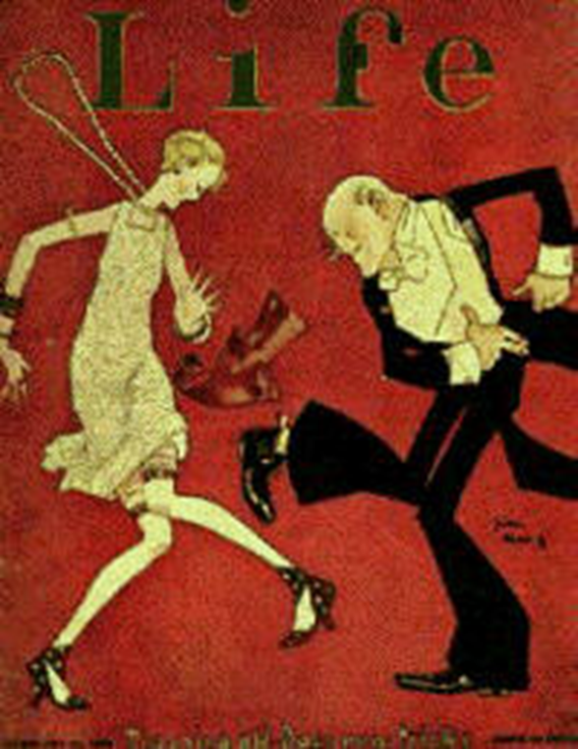
The Roaring 20’s
The new concept of “credit”
People were buying:
Automobiles
Appliances
Clothes
Fun times reigned
Dancing
Flappers
Drinking

Slide 3
Why was credit bad?
People didn’t really have the money they were spending.
The U.S. was a major credit loaner to other nations in World War 1
Many of these nations could not pay us back

Slide 4
The Stock Market
People bought stocks on margins
If a stock is $100 you can pay $10 now and the rest later when the stock rose
Stocks fall
Now the Person has less than $100 and no money to pay it back

Slide 5
The Stock Market
With people panicking about their money investors tried to sell their stocks
This leads to huge decline in stocks
Stocks were worthless now
People who bought on “margins” now could not pay
Investors were average people that were now broke

Slide 6
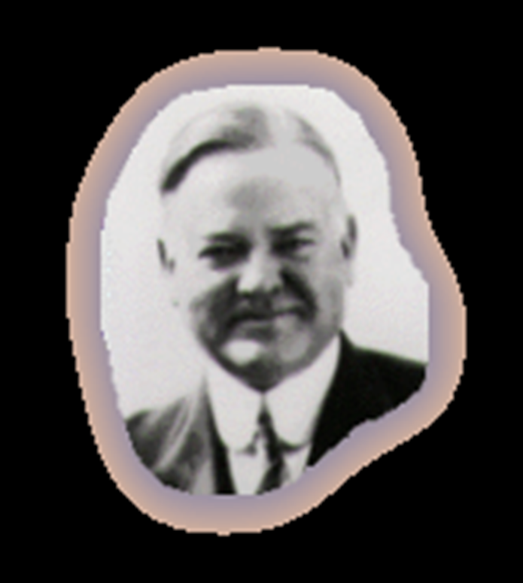
President Hoover
Herbert Hoover was president at the start of the stock market crash
His philosophy: “We’ll make it!”
Was viewed as a “do-nothing president”
The poor were looking for help and no ideas on how to correct or help were coming.

Slide 7
Voluntary Measures
Hoover eventually established two privately-funded organizations:
The National Credit Association
provided $1/2 billion to businesses for emergency loans, but it was too under-funded to do much good.
The Organization for Unemployment Relief
was a clearing house for relief agencies. However, state and local governments were already in too much debt to benefit from it.

Slide 8
Limited Government Intervention
In the end, Hoover resorted to government intervention:
The Reconstruction Finance Corp
gave $1-1/2 billion in federal loans to banks, insurance companies, and industry to prevent bankruptcies, but it was too little, too late.
The Home Loan Bank Act
provided federal loans to homeowners to prevent foreclosures, but got bogged down in red tape.

Slide 9
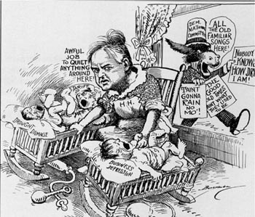
Reasons for Ineffectiveness
Hoover thought business should be self-regulating.
He had a mania for a balanced budget.
He lacked political finesse.

Slide 10
What about the people?
Farmers were already feeling the effects
Prices of crops went down
Many farms foreclosed
People count not afford luxuries
Factories shut down
Businesses went out
Banks could not pay out money
People could not pay their taxes
Schools shut down due to lack of funds
Many families became homeless and had to live in shanties

Slide 11
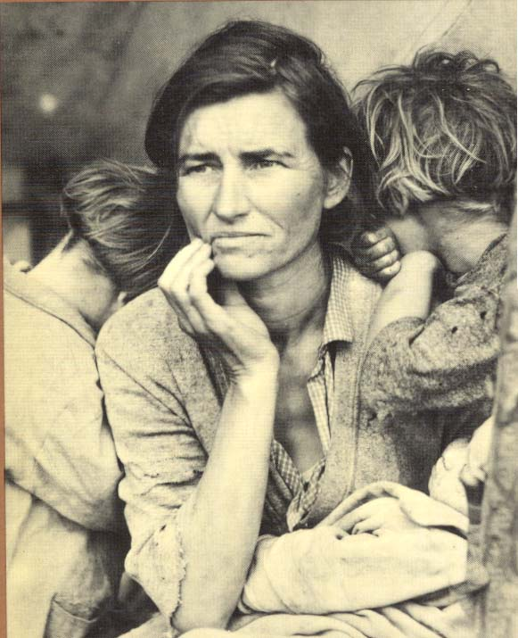
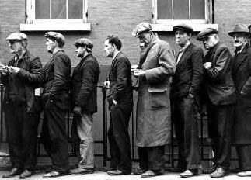
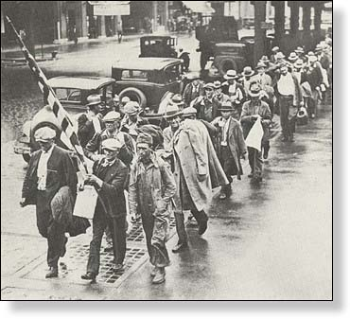

Slide 12
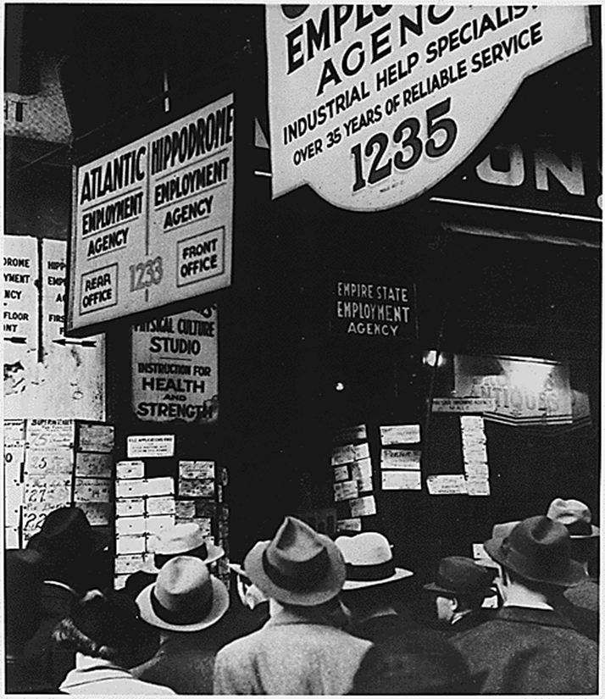
Many waited in unemployment lines hoping for a job.

Slide 13
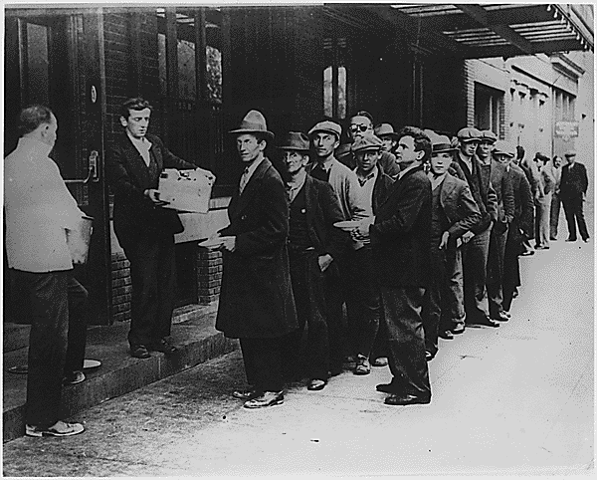
People in cities would wait in line for bread to bring to their family.

Slide 14
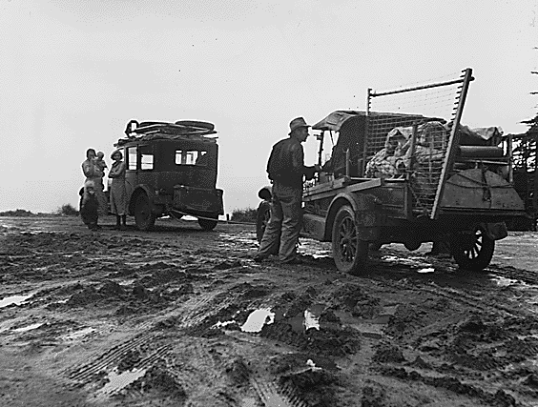
Some families were forced to relocate because they had no money.

Slide 15
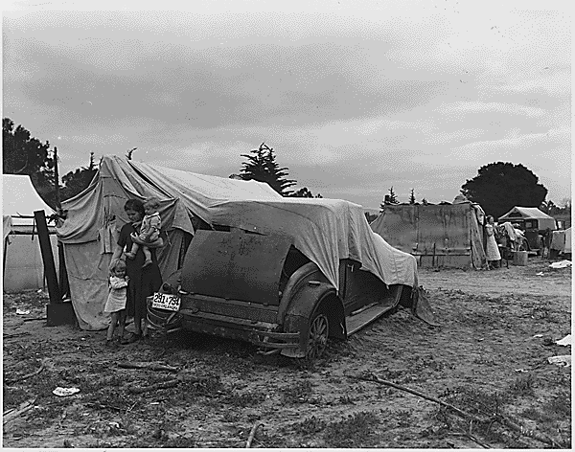
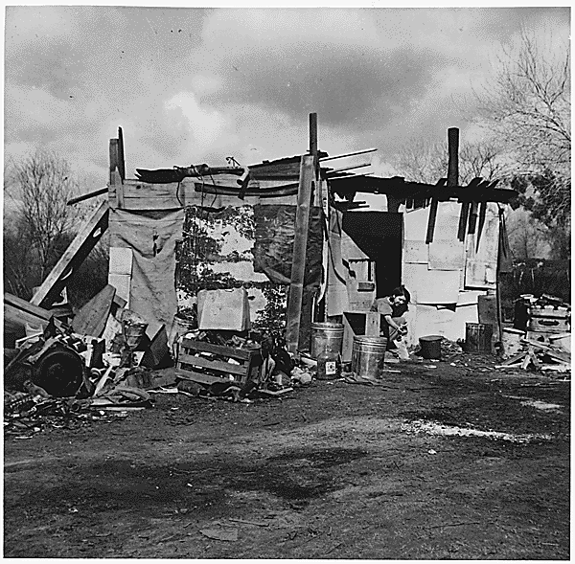
“Hooverville”
Some families were forced to live in shanty towns
A grouping of shacks and tents in vacant lots
They were referred to as “Hooverville” because of President Hoover’s lack of help during the depression

Slide 16
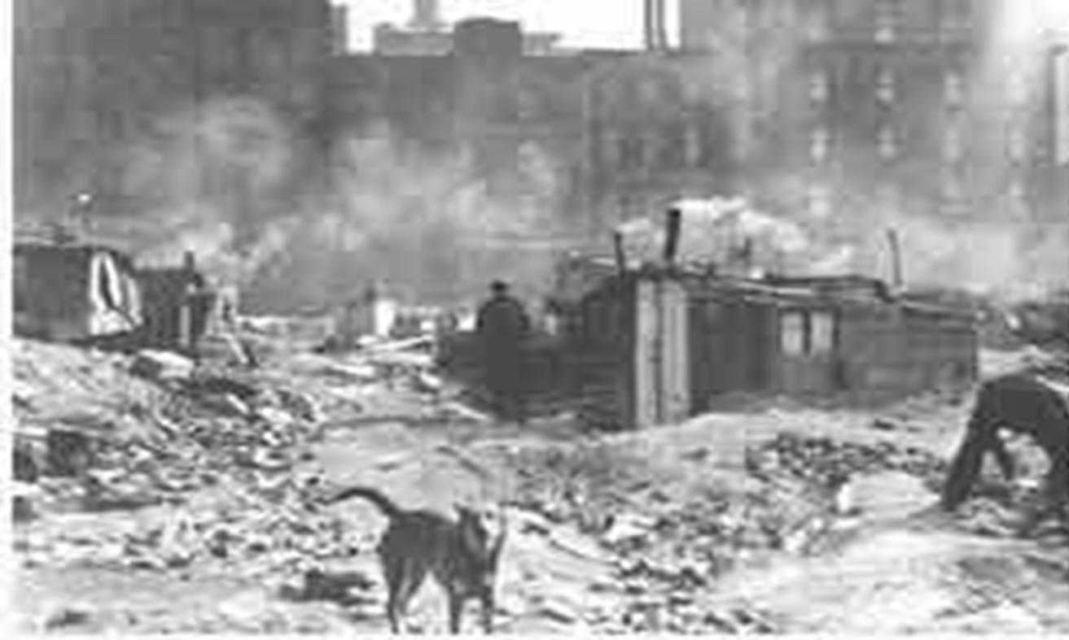

Slide 17
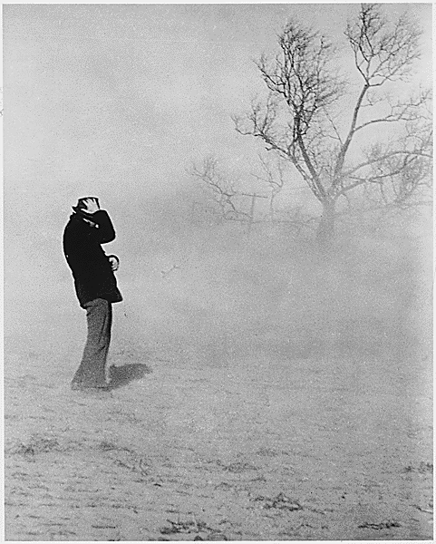
Dust Bowl
A drought in the South lead to dust storms that destroyed crops.

Slide 18
Dust Bowl
Crops turned to dust
Homes buried
Fields blown away
South in state of emergency
The #1 weather crisis of the 20th century

Slide 19
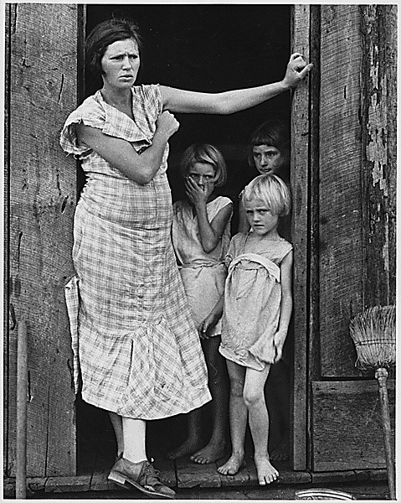
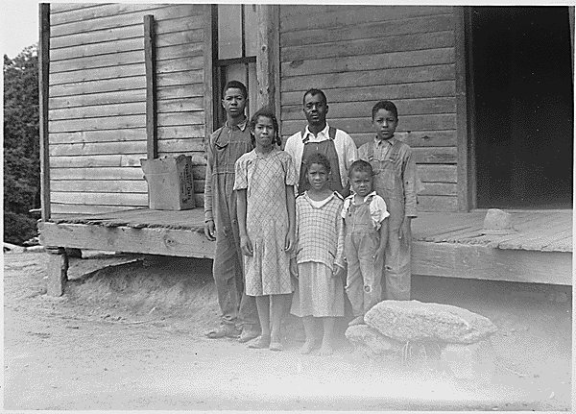
Two families during the depression

Slide 20
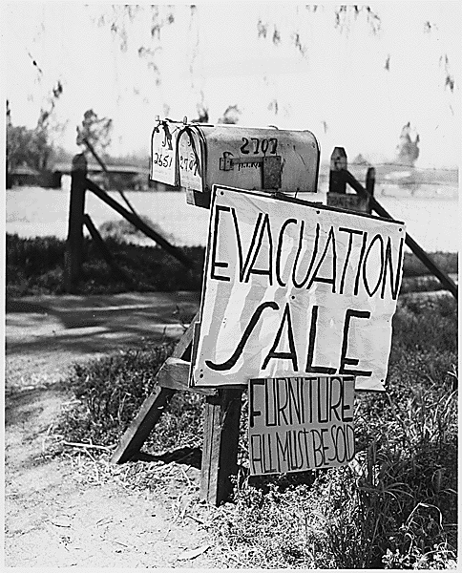
A farm foreclosure

Slide 21
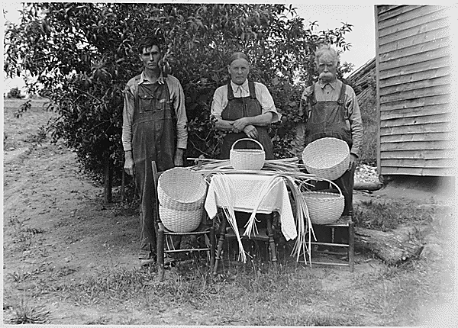
Some families tried to make money by selling useful crafts like baskets

Slide 22
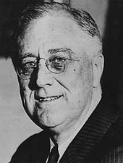
Franklin Delano Roosevelt
Won the 1932 election and was seen as a man of action.
When he was inaugurated unemployment had increased by 7 million.
Poor sections (like Harlem) had 50% of the population unemployed.
Instituted the “New Deal”

Slide 23
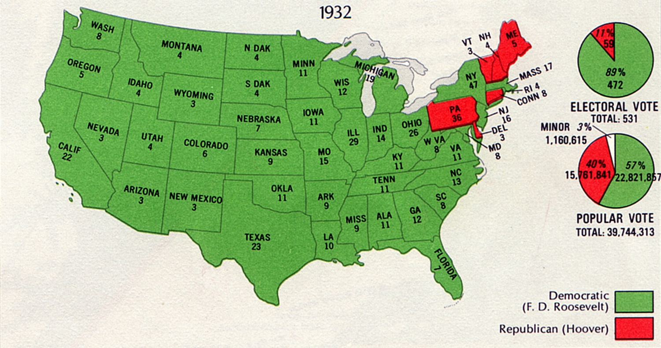

Slide 24
Franklin Delano Roosevelt
People everywhere were effected by the depression
It wasn’t till President Roosevelt took over and tried to put the economy back together that people even saw a glimmer of hope.

Slide 25
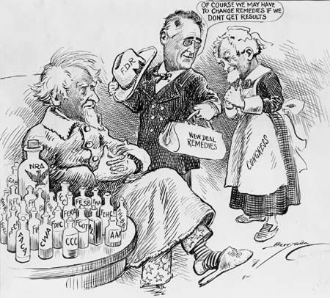
Purposes of the New Deal
Relief: to provide jobs for the unemployed and to protect farmers from foreclosure
Recovery: to get the economy back into high gear, “priming the pump”
Reform: To regulate banks, to abolish child labor, and to conserve farm lands
Overall objective: to save capitalism

Slide 26
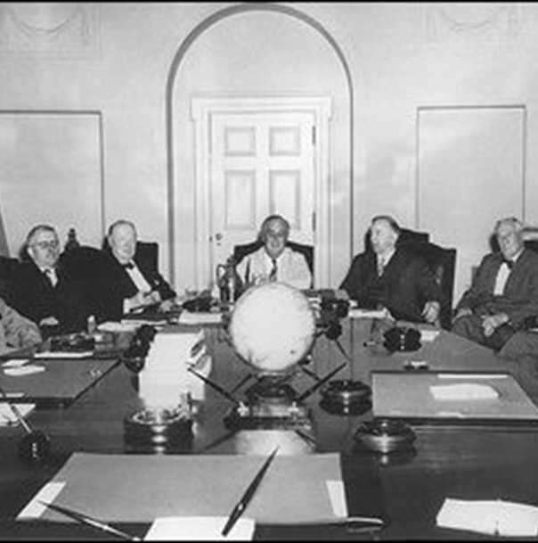
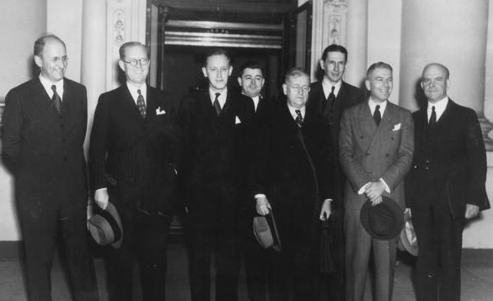
Sources of New Deal Ideas
Brain Trust:
Specialists and experts, mostly college professors, idea men.
New Economists:
Government spending, deficit spending and public works, government should prime economic pump
Roosevelt Cabinet:
Included conservatives, liberals, Democrats, Republicans, inflationist, anti-inflationist

Slide 27
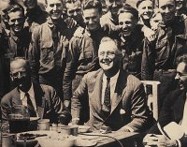
First New Deal (1933-1934)
Emphasis: reform
Political Position: conservative
Primary aim: economic recovery
Philosophy: economic nationalism and economic scarcity (i.e., raise prices by creating the illusion of scarcity)
Objectives: higher prices for agriculture and business
Beneficiaries: big business and agricultural business

Slide 28
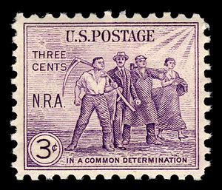
National Recovery Act (NRA)
Purpose: recovery of industry
Created a partnership of business, labor, and government to attack the depression with such measures as price controls, high wages, and codes of fair competition

Slide 29
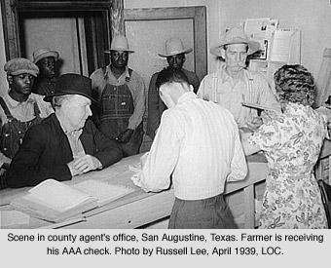
First Agricultural Adjustment Act (AAA)
Purpose: the recovery of agriculture
Paid farmers who agreed to reduce production of basic crops such as cotton, wheat, tobacco, hogs, and corn
Money came from a tax on processors such as flour millers and meat packers who passed the cost on to the consumer

Slide 30
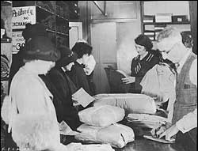
Federal Emergency Relief Admin (FERA)
Purpose: relief
Gave money to states and municipalities so they could distribute money, clothing, and food to the unemployed

Slide 31
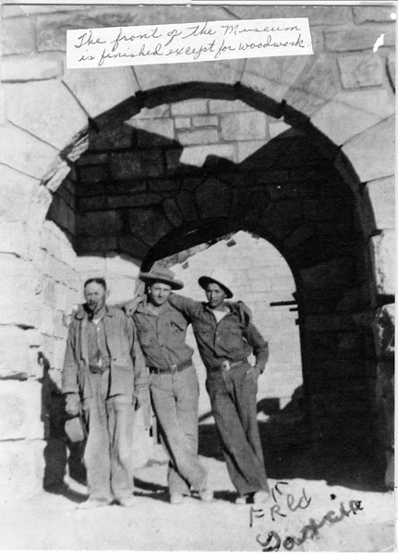
Civilian Conservation Corp (CCC)
Purpose: relief
Gave outdoor work to unemployed men between the ages of 17 and 29
They received $30 per month, but $22 went back to the family

Slide 32
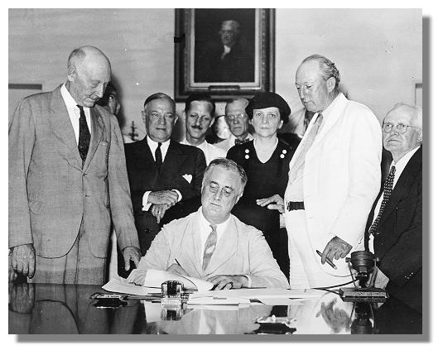
Second New Deal (1934-1941)
Emphasis: reform
Political Position: liberal
Primary aim: permanent reform
Philosophy: international economic cooperation and economic abundance
Objectives: increased purchasing power and social security for public
Beneficiaries: small farmers and labor

Slide 33
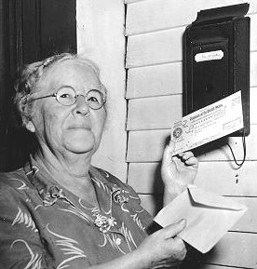
Social Security Act
Purpose: reform
Gave money to states for aid to dependent children, established unemployment insurance through payroll deduction, set up old-age pensions for retirees.

Slide 34
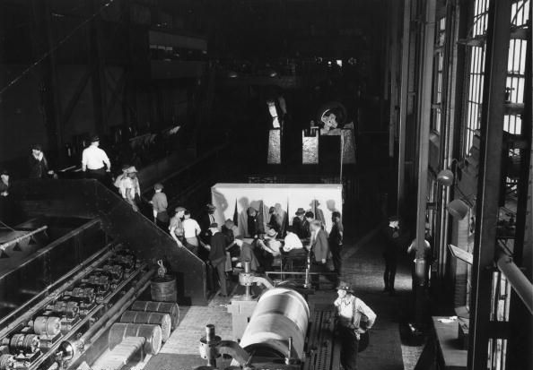
National Labor Relations Act
Purpose: reform
Put restraints on employers and set up a National Labor Relations Board to protect the rights of organized labor to bargain collectively with employers.

Slide 35
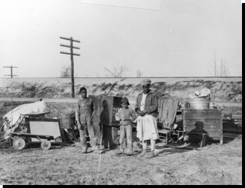
Second Agricultural Adjustment Act
Purpose: recovery for agriculture
Paid farmers for conservation practices, but only if they restricted production of staple crops.

Slide 36
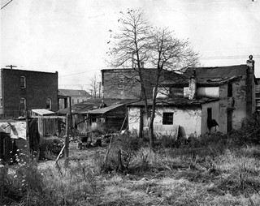
U.S. Housing Authority
Purpose: recovery and reform
Used federal funds to tear down slums and construct better housing.

Slide 37
The New Deal on Trial
By 1935, political disunity was evident. There were critics on the right and the left.
NEW DEAL

Slide 38
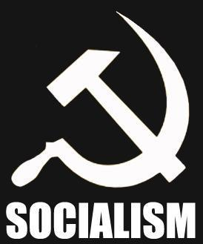
Criticisms of Conservative Opponents
Conservative opponents said the New Deal went too far:
It was socialism (killed individualism)
It added to the national debt ($35 billion)
It wasted money on relief and encouraged idleness
It violated the constitution & states rights
It increased the power of the Presidency
(FDR was reaching toward dictatorship, Congress a rubber stamp, independence of judiciary threatened, separation of powers shattered)

Slide 39
Anti-New Deal Organization
Conservative opponents to the New Deal had an organization called the American Liberty League. They had money but were small in numbers, so FDR was not worried.

Slide 40
Criticisms of Radical Opponents
Radical opponents said the New Deal did not go far enough.
They were demagogues (rabble-rousers) and had popular followings, so FDR was concerned.

Slide 41
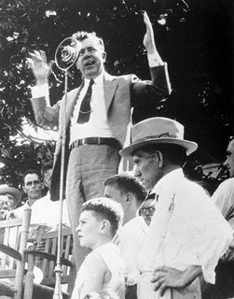
Senator Huey Long (LA)
Senator Huey Long said New Deal relief measures were mere crumbs and advocated a share the wealth plan
(i.e., a guaranteed annual income of at least $5,000 for every American, financed by confiscating wealth of people who made over $5 million per year).

Slide 42
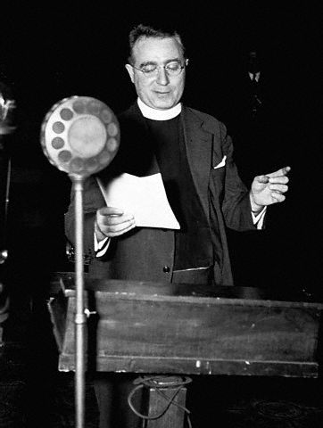
Father Charles E. Coughlin
Father Charles Coughlin was a rabble-rousing radio priest from Detroit.
His broadcasts were called the “Golden Hour of the Little Flower.”
He claimed there was an international bankers conspiracy and Jews were responsible.
He advocated nationalization of banking and currency and national resources and demanded a “living wage.”

Slide 43
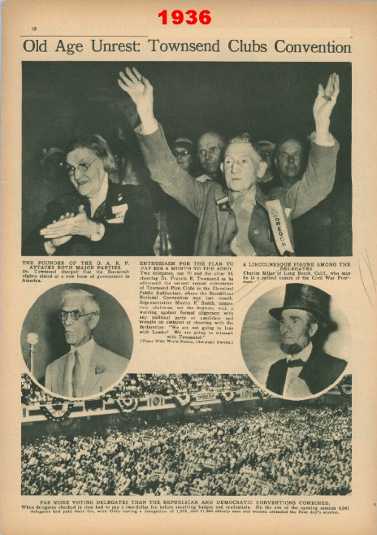
Dr. Francis E. Townsend
Dr. Francis E. Townsend was an elderly physician from CA.
He had a plan for the federal government to pay $200 per month to unemployed people over 60.
The program would be financed by a 2% national sales tax and each pensioner would be required to spend the money in 30 days. This would stimulate the economy.

Slide 44
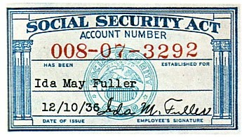
Moderate Legislation
FDR sponsored moderate legislation to silence radical opposition:
Revenue Act of 1935 – Response to Huey Long. Increased taxes on large incomes and corporations.
Banking Act of 1935 – Response to Coughlin. Extended federal control over private banking practices.
Social Security Act of 1935 Response to Townsend. Included provisions for unemployables (dependent children, the disabled, blind), unemployment insurance, and old-age pensions.

Slide 45
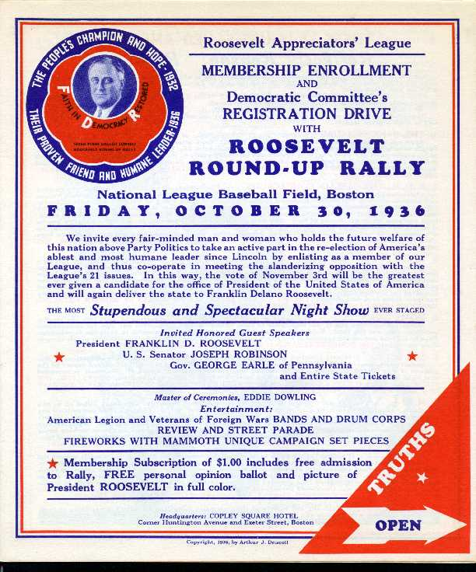
The Election of 1936
The Election of 1936:
Made the Democratic party the majority party
Created a new Democratic coalition composed of both traditional elements and new elements
Showed that the American people rejected radical solutions to depression

Slide 46
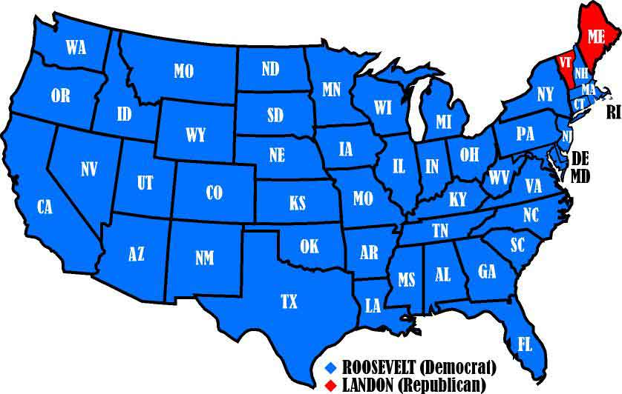

Slide 47
The Election of 1936
Candidate | Party | % Popular Vote | Electoral Votes
FDR | Democratic | 60.3% | 523
Alfred E. Landon | Republican | 36.56% | 8
William Lemke | Radical | 1.93%
Norman Thomas | Socialist | 0.41% (2.21 in 1932)
Earl Browder | Communist | 0.17 (0.25 in 1932)

Slide 48
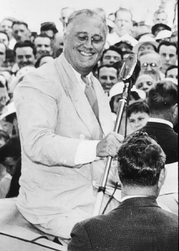
The Roosevelt Coalition
While Republicans were still relying on their traditional base of political support (big business, big farmers, and conservatives)
Democrats broadened their constituency by appealing to small farmers in the Midwest, urban political bosses, ethnic blue collar workers, Jews, intellectuals, and African Americans.

Slide 49
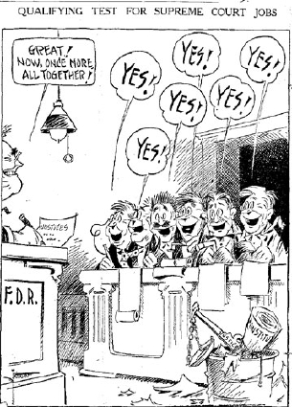
Protection of New Deal Accomplishments
Steps FDR took to protect New Deal accomplishments (both failed):
Court-Packing Plan (proposed increasing Supreme Court from 9 to 15 members, caused in revolt in Dem. Party)
Purge of the Democratic Party in the Election of 1938 (came out strongly in favor of liberal Dem. Candidates, evidence that he interfered in a state campaign, Republicans gained strength in both houses of Congress)

Slide 50
Decline of New Deal Reform after 1937
Reasons for decline of New Deal reform after 1937:
Court-packing plan made Congress irritable.
Recession of 1937-38 weakened confidence in New Deal measures. Republicans gained strength in both houses.
Attempted purge of Democratic party failed.
Conservative Democrats were elected to office. Resentful of attempted party purge, they joined ranks with Republicans to block New Deal legislation.
Increasing focus on foreign affairs.

Slide 51
The Significance of the New Deal

Slide 52
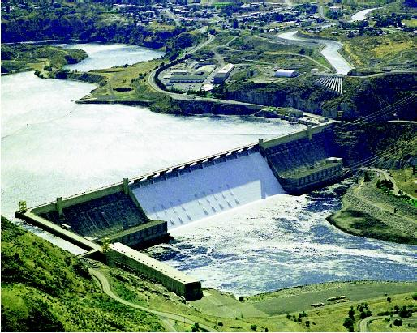
Physical Rehabilitation of Country
Attacked soil erosion
Built dams and planted trees to prevent floods
Reclaimed the grasslands of the Great Plains
Developed water power resources
Encouraged regional reconstruction projects like the TVA and Columbia River project

Slide 53
Human Rehabilitation
Established the principle that government has responsibility for the health, welfare, and security, as well as the protection and education of its citizens
Embraced social security, public health, housing
Entered the domain of agriculture and labor

Slide 54
Revitalization of Politics
Strengthened executive branch
Reasserted presidential leadership
Revitalized political party as a vehicle for the popular will and as an instrument for effective action.

Slide 55
Extension of Democracy
Redefined the concept of democracy so that it included not only political rights but economic security and social justice as well.

Slide 56
Maintenance of a Democratic System
The New Deal maintained a democratic system of government and society in a world threatened by totalitarianism.
Increased size and scope of government to meet needs of the depression
Provided the leadership that enabled Congress to put through the necessary relief, recovery, and reform measures.
Sponsored moderate legislation to neutralize the popularity of radical opponents

Slide 57
Government Expenditures
The total cost of the current bailout now exceeds $4.6 trillion dollars. It has cost more than all of these government expenditures combined. Figures in parentheses have been adjusted for inflation:
Marshall Plan: Cost: $12.7 billion ($115.3 billion)
Louisiana Purchase: Cost: $15 million ($217 billion)
Race to the Moon: Cost: $36.4 billion ($237 billion)
S&L Crisis: Cost: $153 billion ($256 billion)
Korean War: Cost: $54 billion ($454 billion)
The New Deal: Cost: $32 billion est.($500 billion est.)
Invasion of Iraq: Cost: $551billion ($597 billion)
Vietnam War: Cost: $111 billion ($698 billion)
NASA: Cost: $416.7 billion ($851.2 billion)
TOTAL: $3.92 trillion

