Slide 1
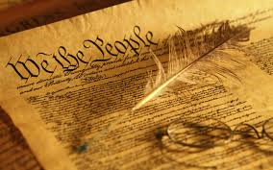
The United States Constitution
Mr. Condry’s Social Studies Class

Slide 2
What is the U.S. Constitution?
The supreme law of the United States
It is the foundation and source of the legal authority underlying the existence of the United States of America and the Federal Government of the United States
It provides the framework for the organization of the United States Government.

Slide 3
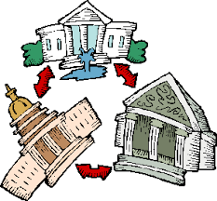
What are the basic principals of the Constitution?
Popular Sovereignty
  Government power resides in the people
Limited Government
  Government is not all powerful, can only do what the people let it.
Separation of Powers
  Helps prevent one branch from becoming too powerful
  Checks and Balances
Federalism
  Division of power among national and state governments

Slide 4
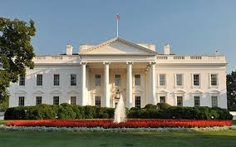
What are the Checks and Balances?
Executive Branch
  Grant reprieves pardons
  Appoint Judges to fill vacancies in the court
  Authority to call special sessions of congress
  President is Commander-in-Chief

Slide 5
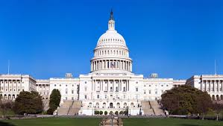
What are the Checks and Balances?
Legislative Branch
  Power to institute new courts
  Authority to impeach
  Approve Judicial appointments made by president
  Approve presidential appointments

Slide 6
What are the Checks and Balances?
Legislative
  Authority to bring impeachment hearings
  Power to override presidential vetoes
  Control Appropriations
  Ratify treaties
  Declare war

Slide 7
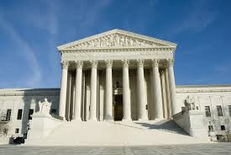
What are the Checks and Balances?
Judicial Branch
  Interpret laws
  Determine constitutionality
  Serve for life
  Interpret laws and presidential actions
  Judges appointed by the president

Slide 8
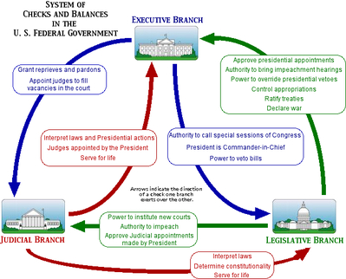

Slide 9
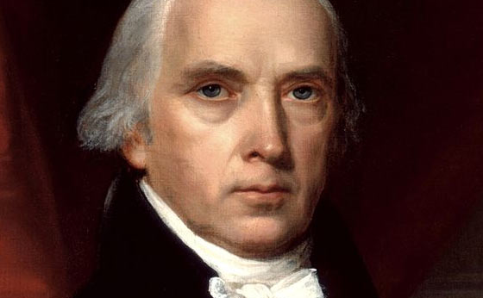
Who wrote the Constitution?
James Madison (4th President 1809-1817) is considered “the father of the Constitution.”
His important contributions:
  The Virginia Plan
  Separation of Powers
  Bill of Rights

Slide 10
Why was it written?
After the Revolutionary War, the Articles of Confederation set up the structure of the U.S. Government.
The federal government was extremely weak and this created many problems such as:
  No separation of powers – only unicameral legislature
  Weak central government – states had most power.
  Congress did not have the power to tax – this means they could not get their finances in order.

Slide 11
Why was it written?
More problems with the Articles of Confederation:
  In order to change the Articles, all thirteen states had to approve of the changes. This made it essentially impossible to make any changes
  For any major laws to pass they had to be approved by 9 or the 13 states which was difficult
  Congress did not have the power to regulate commerce which caused competition between states. It also caused diplomatic issues when states refused to pay for goods they received from other nations.

Slide 12
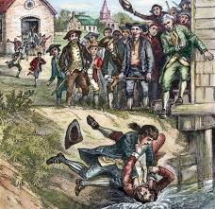
Shay’s Rebellion
An uprising of farmers in Massachusetts led by Daniel Shays in 1786 and 1787.
Against state and local enforcement of tax collections and judgments for debt.
Helped convince leaders that a strong central government was needed

Slide 13
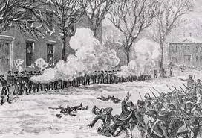

Slide 14
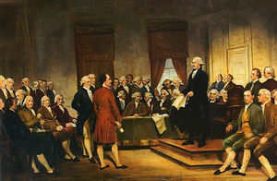
When was it written?
May 25th to September 17th, 1787
Philadelphia
Intention was to revise Articles of Confederation
Ended up replacing the Articles and creating a new government
Called the “Constitutional Convention.”

Slide 15
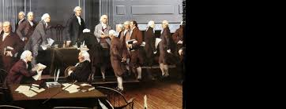
What were the important outcomes of the Constitutional Convention
Virginia Plan
New Jersey Plan
Great Compromise

Slide 16
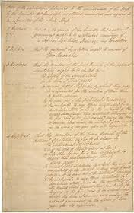
Virginia Plan
Separation of powers
Bicameral legislature based on population
Federal government had increased powers

Slide 17
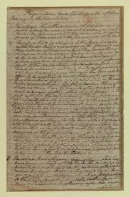
New Jersey Plan
Unicameral legislature where every state received equal representation

Slide 18
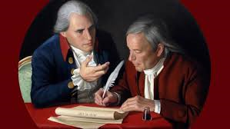
Great Compromise
Hybrid of Virginia and New Jersey Plans
  Bicameral Legislature
    House of Representatives based on population
    Senate based upon equal representatives
  Three-Fifth’s Clause:
    Slaves count as 3/5’s of a person for representation purposes.

Slide 19
Ratification Debate
Needed 9 out of 13 states to ratify or official approve of the Constitution before it went into effect
A huge debate emerged between two sides.
  Federalists
  Anti-Federalists

Slide 20
Federalists v. Anti-Federalists
Federalists:
Anti-Federalists:
Supported the Constitution and a strong central government
Alexander Hamilton, James Madison, John Jay
Federalist Papers
  Series of articles written in defense of the constitution
Supported a weaker central government
  Felt too much power was taken away from the states
Opposed the Constitution
Wanted a Bill of Rights
Samuel Adams, Patrick Henry

Slide 21
Ratification
Officially adopted after ratified by New Hampshire
Once the new government convened they added a Bill of Rights to the Constitution

Slide 22
Structure of the Constitution
Preamble
  Statement of Purpose
Articles:
  I: Legislative Branch
  II: Executive Branch
  III: Judicial Branch
  IV: Relations among the states
  V: Amendment Process
  VI: Federal Power
  VII: Ratification
Amendments:
  27 Total
  1st ten are the Bill of Rights

Slide 23
Article I: Legislative Branch
Bicameral:
  House of Representatives
    Based on Population
  Senate
    2 senators for each state
Reps serve for 2 year terms
Senators serve for 6 year terms
Important Powers:
  Make laws
  Set taxes
  Declare war
  Override vetoes
  Borrow Money
  Print money
  Regulate international and national trade

Slide 24
Article II: Executive Branch
President and Vice President are elected to 4 year terms
Elected by the Electoral College
Qualifications
  At least 35 years old
  15 year resident of the United States
  Natural born Citizen
Important powers:
  Commander-in-Chief
  Grant pardons
  Make treaties
  Appoint federal officers
  Ensure laws are executed

Slide 25
Article III: Judicial Branch
Supreme Court judges serve for life unless impeached
Judicial power rests with U.S. Supreme Court and other courts created by Congress.
Important Powers:
  Decides cases of Constitutional law and federal law
  Cases involving ambassadors go straight to Supreme Court
  Judicial Review comes later (1803- Marbury v. Madison)

Slide 26
Other Important Articles:
Article V: Amendments:
  Amendments are proposed when 2/3 of House Senate deem it necessary
  Amendments are proposed when 2/3 states deem it necessary
  Amendments must be ratified by ¾ of state legislatures or by conventions in ¾ of states.
Article VI: Federal Power
  Supremacy Clause: Federal law is supreme to state law
  No religious tests for public office.

Slide 27
Bill of Rights
Freedom of religion, of speech, of the press to assemble, and to petition
Right to bear arms
No quartering of soldiers
No unreasonable search and seizure
Indictments; Due process; self-incrimination; Double jeopardy, and rules for Eminent Domain.

Slide 28
Bill of Rights
6. Right to a fair and speedy public trial, Notice of accusations, confronting one’s accuser, Subpoenas, Right to counsel
7. Right to trial by jury in civil cases
8. No excessive bail and fines or cruel and unusual punishment
9. There are other rights not written in the Constitution
10. All rights not given to Federal Government belong to states and people.

Slide 29
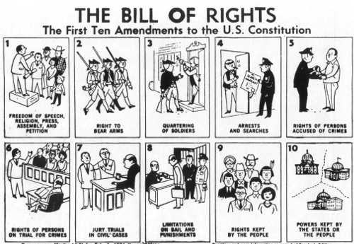

Slide 30
Other important Amendments:
13th Amendment
  Abolished slavery
14th Amendment
  Due process and equal protection under the law
  All persons born in the U.S. are citizens
15th Amendment
  Right to vote regardless of race, color, or previous servitude

Slide 31
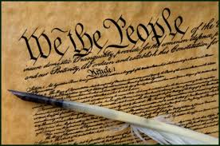
Other important Amendments
18th Amendment
  Prohibition of alcohol
19th Amendment
  Women’s suffrage
21st Amendment
  Repeals prohibition
22nd Amendment
  Presidential term limits
24th Amendment
  Prohibits poll taxes
26th Amendment
  Lowers voting age to 18

