Slide 1
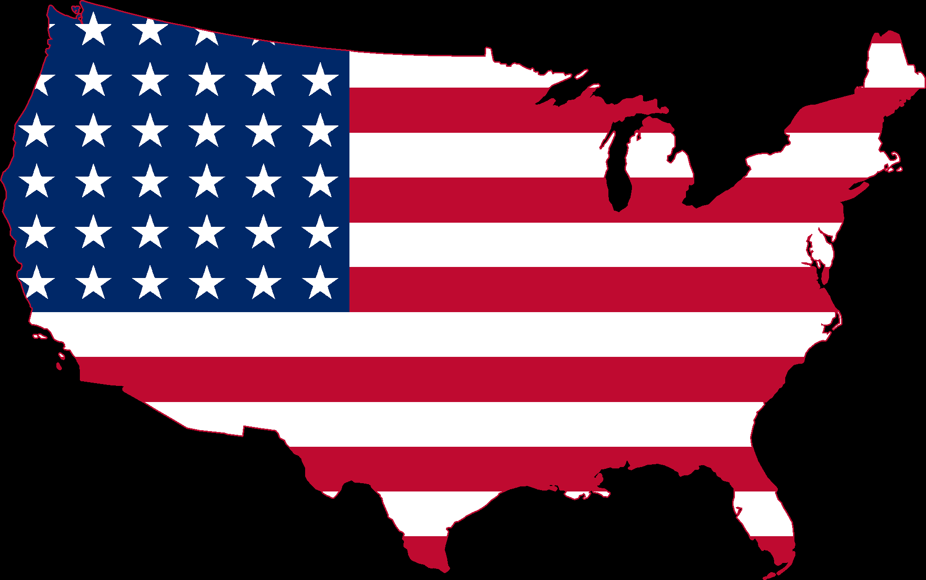
United States Entry into the Union 1858-1876
Mr. Condry’s Social Studies Class

Slide 2
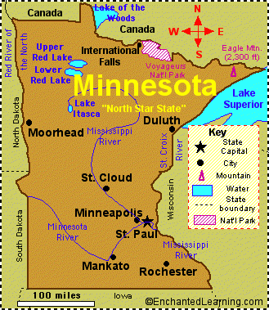
Minnesota
May 11, 1858
State Capital- St. Paul
Largest City- Minneapolis
Name for Residents- Minnesotans
Major Industries- farming (corn, soybeans, sugar beats, wheat, dairy products), paper pulp, mining (iron ore)

Slide 3
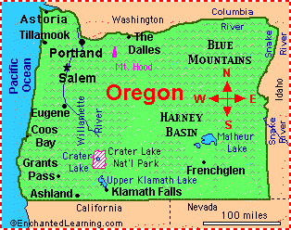
Oregon
February 14, 1859
State Capital- Salem
Largest City- Portland
Name for Residents- Oregonians
Major Industries- timber, paper products, farming (wheat, cattle), mining (coal), computer equipment, electronics

Slide 4
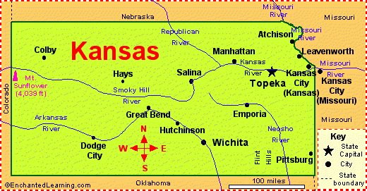
Kansas
January 29, 1861
State Capital- Topeka
Largest City- Wichita
Name for Residents- Kansans
Major Industries- agriculture (wheat and other grains), aircraft manufacturing, automobile manufacturing

Slide 5
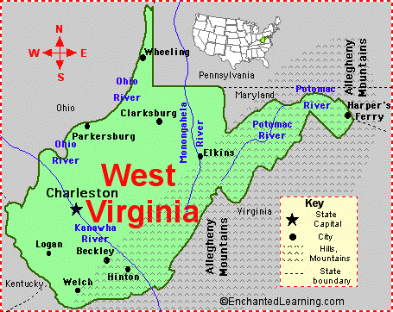
West Virginia
June 20, 1863
State Capital- Charleston
Largest City- Charleston
Name for Residents- West Virginians
Major Industries- mining (coal), livestock, chemical manufacturing, glass products, tourism

Slide 6
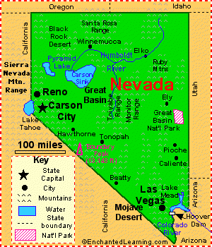
Nevada
October 31, 1864
State Capital- Carson City
Largest City- Las Vegas
Name for Residents- Nevadans
Major Industries- tourism, mining (gold, silver), hydro-electric power

Slide 7
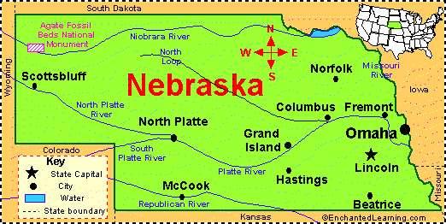
Nebraska
March 1, 1867
State Capital- Lincoln
Largest City- Omaha
Name for Residents- Nebraskans
Major Industries- farming (corn, soybeans, wheat, sorghum), grain processing, meat-packing, the Air Force Strategic Air Command.

Slide 8
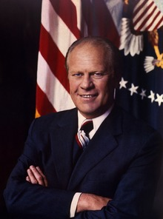
Nebraska
Presidential Birthplace:
Gerald Rudolph Ford

Slide 9
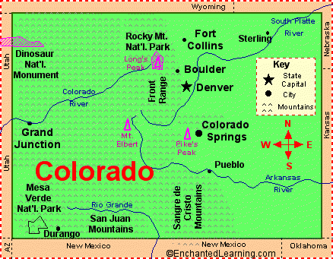
Colorado
August 1, 1876
State Capital- Denver
Largest City- Denver
Name for Residents- Coloradans
Major Industries- agriculture (wheat, cattle, sheep), tourism (especially skiers), mining (gold, silver), oil, finance, and manufacturing

