Slide 1
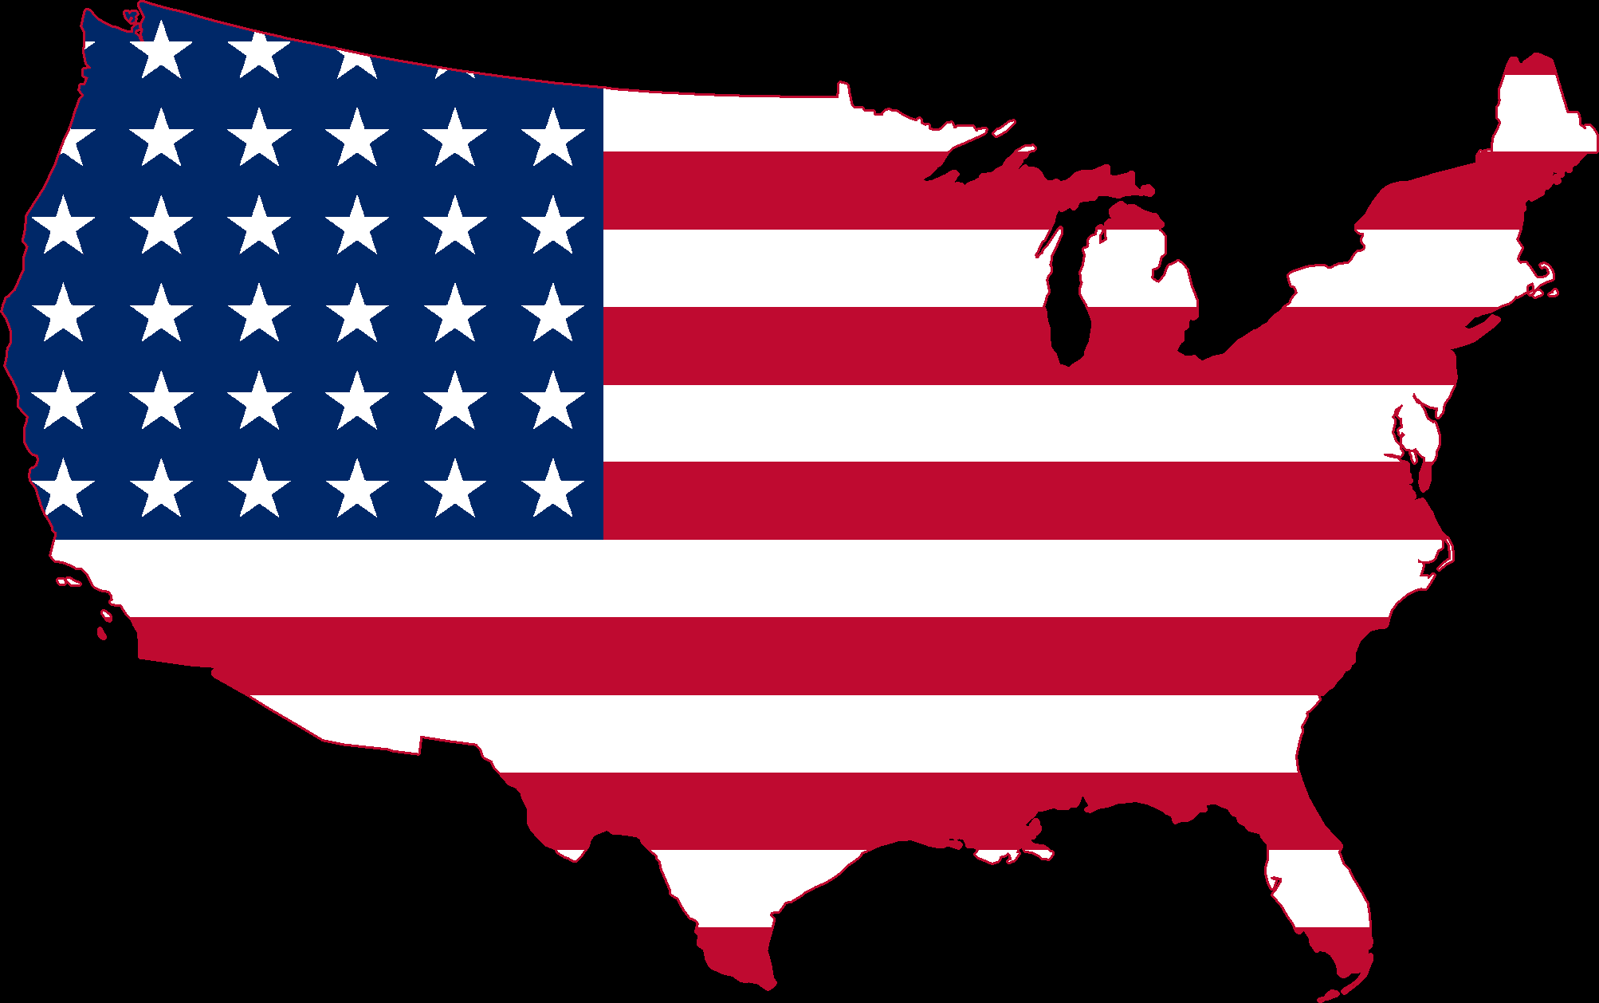
United States Entry into the Union 1889-1912
Mr. Condry’s Social Studies Class

Slide 2
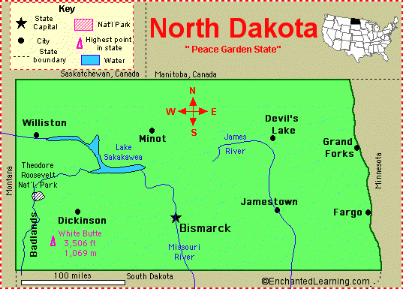
North Dakota
November 2, 1889
State Capital- Bismarck
Largest City- Fargo
Name for Residents- North Dakotans
Major Industries- farming (wheat, barley, oats, flaxseed), cattle, mining (lignite, soft coal), electrical power generation

Slide 3
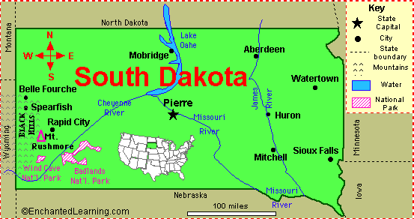
South Dakota
November 2, 1889
State Capital- Pierre
Largest City- Sioux Falls
Name for Residents- South Dakotans
Major Industries- agriculture (hay, sunflowers, rye, honey, soybeans, corn, wheat, and cattle), tourism

Slide 4
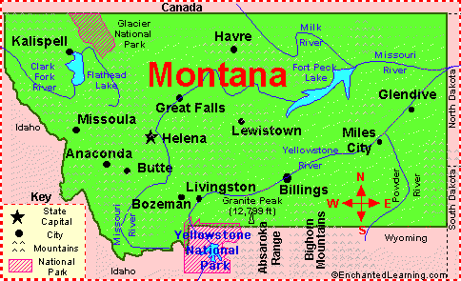
Montana
November 8, 1889
State Capital- Helena
Largest City- Billings
Name for Residents- Montanans
Major Industries- farming (wheat, sugar beets), cattle ranching, mining (gold, silver, coper; coal), oil, lumber, tourism

Slide 5
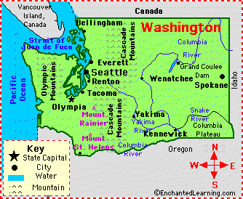
Washington
November 11, 1889
State Capital- Olympia
Largest City- Seattle
Name for Residents- Washingtonians
Major Industries- farming (fruit, berries, nuts, cattle, wheat), lumber, tourism, hydroelectric power, computer software, aircraft, aluminum refining

Slide 6
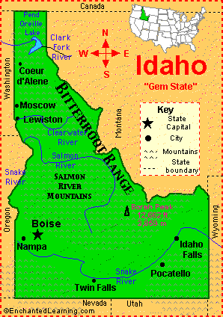
Idaho
July 3, 1890
State Capital- Boise
Largest City- Boise
Name for Residents-Idahoans
Major Industries- agriculture (potatoes, wheat, sugar beets, barley), lumber, mining

Slide 7
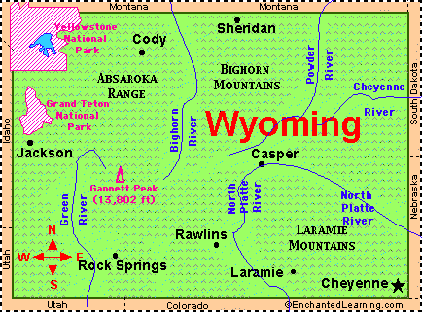
Wyoming
July 10, 1890
State Capital- Cheyenne
Largest City- Cheyenne
Name for Residents- Wyomingites
Major Industries- farming (cattle, sheep), mining (coal, uranium), oil, natural gas, tourism

Slide 8
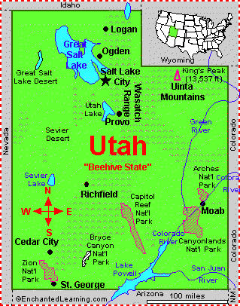
Utah
January 4, 1896
State Capital- Salt Lake City
Largest City- Salt Lake City
Name for Residents- Utahans or Utahns
Major Industries- oil, natural gas, mining (coal, copper, iron ore, silver, gold), steel making, farming (cattle, sheep, dairy products), tourism (especially skiing)

Slide 9
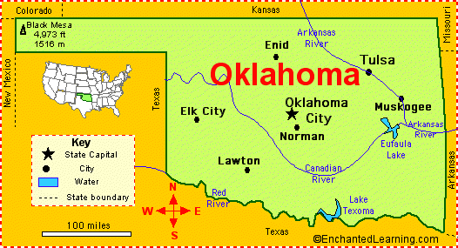
Oklahoma
November 16, 1907
State Capital- Oklahoma City
Largest City- Oklahoma City
Name for Residents- Oklanhomans
Major Industries- farming (wheat, cattle), oil, natural gas

Slide 10
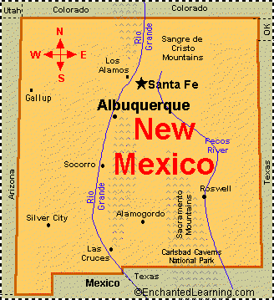
New Mexico
January 6, 1912
State Capital- Santa Fe
Largest City- Albuquerque
Name for Residents- New Mexico
Major Industries- mining (potash, copper, silver, uranium), oil, natural gas, tourism

Slide 11
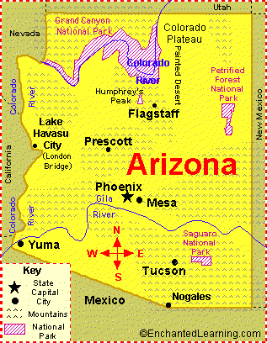
Arizona
February 14, 1912
State Capital- Phoenix
Largest City- Phoenix
Name for Residents- Arizonans
Major Industries- mining (copper, molybdenum, gold, and silver), manufacturing, and tourism

