Slide 1
World War 2
Outcome: The Pacific Theater

Slide 2
The Pacific Theater
Setting the Stage: Aggression in Asia
  1931: Japan invaded Manchuria (NE province of China rich in minerals)
  1937: Japan invaded China who was experiencing a civil war
  Japan needed raw materials especially oil to be #1 in Asia

Slide 3
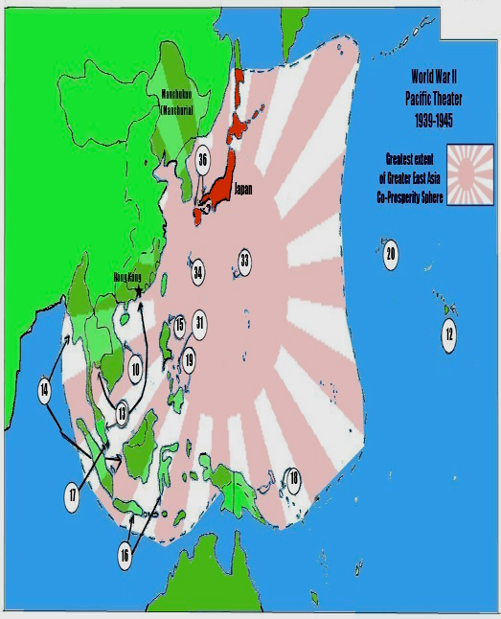

Slide 4
The Pacific Theater
2. Attack at Pearl Harbor
Japan had hoped to cripple the U.S. Pacific fleet
Several carriers were out to sea when Japan attacked on December 7, 1941
Japan also attacked Guam, Wake Island, Midway Islands, and the Philippine Islands on the same day
Once the home front mobilization hit high production, Japan truly did awaken a sleeping giant.

Slide 5
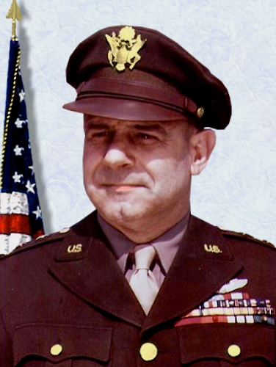
James Doolittle

Slide 6
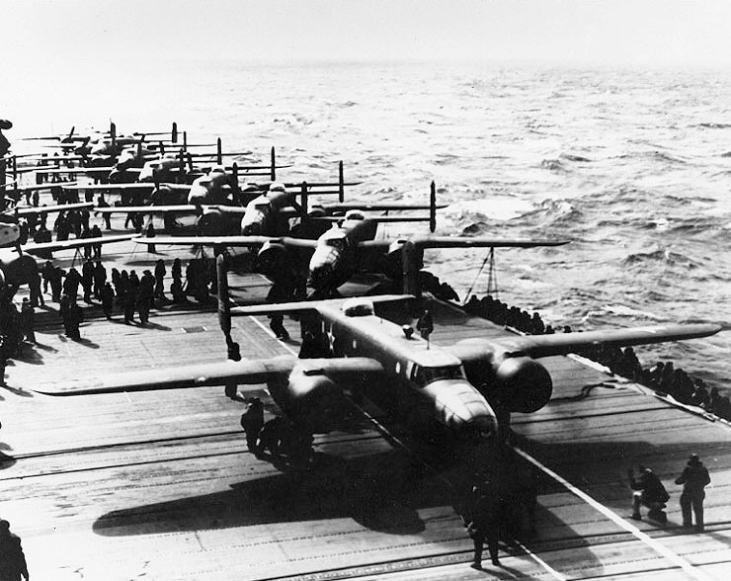
The Pacific Theater
3. Doolittle Raid
James Doolittle led a raid on Tokyo with B-25 Bombers
Helped boost American Morale
Showed the Japanese were not invincible
Inflicted little damage to the city

Slide 7
General Douglas MacArthur

Slide 8
The Pacific Theater
4. Island Hoping
The Supreme allied Commander for the Pacific Theater was General Douglas MacArthur
The U.S. adopted the Island Hopping or Leap Frog strategy moving rom island to island.
The Fighting in the Pacific was difficult for several reasons:
  100 degree heat ---> humidity caused jungle rot & diseases
  Many islands
  Japanese motto “Death before dishonor”
  Kamikaze attacks suicide attacks damaged 300 ships and caused 15,000 casualties.

Slide 9
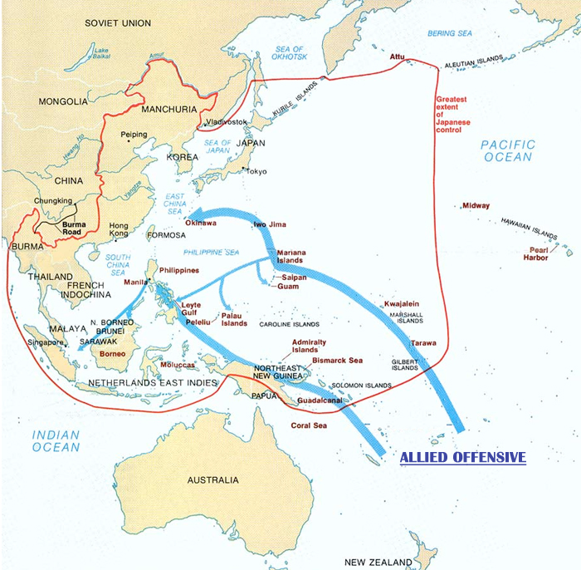

Slide 10
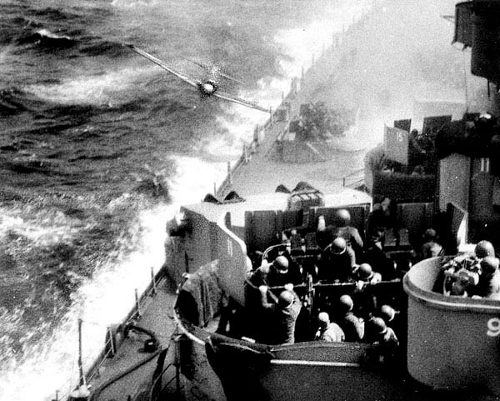
Kamikaze

Slide 11
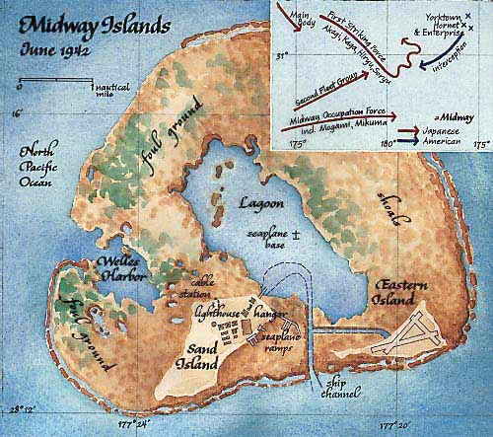
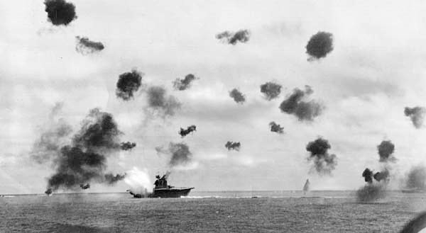
The Pacific Theater
5. Key Victories for the Allies
Battle of Midway
  Japanese hoped to use Midway as a base to neutralize Pearl Harbor
  Balance of Power in the Pacific shifted towards the Allies

Slide 12
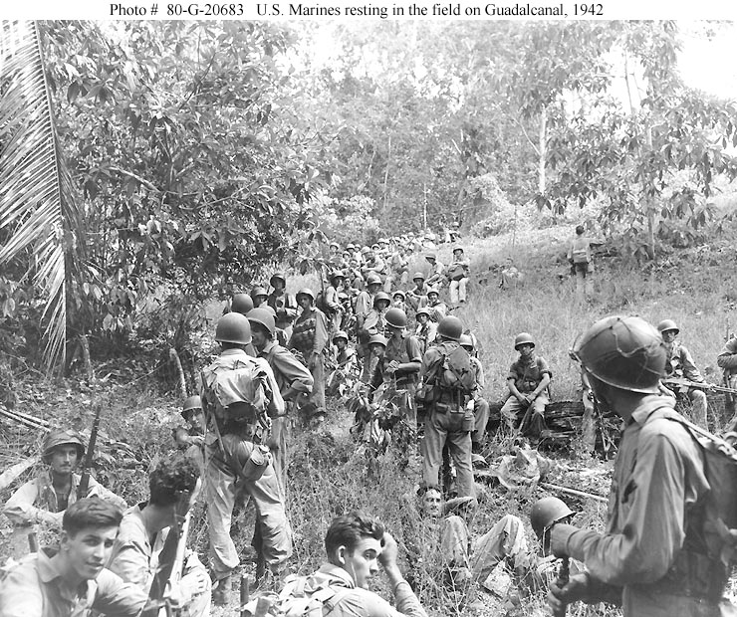
The Pacific Theater
b. Battle of Guadalcanal
The Japanese advance was stopped
All momentum shifted to the U.S.

Slide 13
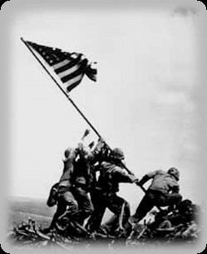
The Pacific Theater
c. Battle of Iwo Jima
20,500 Japanese killed and 6,000 U.S. lives lost
Put Americans within striking distance of Japanese home islands.

Slide 14
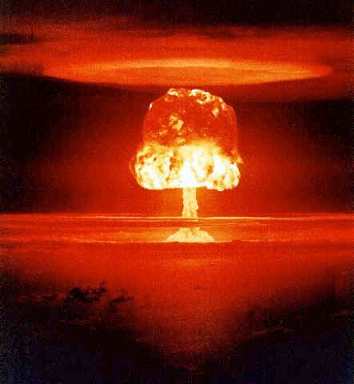
The Pacific Theater
6. Possible options for finishing off the Japanese
Invasion of Japan which could cost over 1,000,000 Allied soldiers
Use of the Atomic Bomb (secret)

