Slide 1
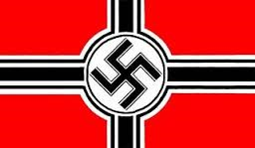
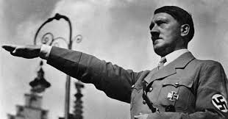
World War II
Outcome: The Rise of Adolf Hitler

Slide 2
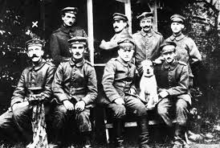
Young Hitler

Slide 3
The Rise of Adolf Hitler
Setting the Stage: World War I
Although an Austrian, Hitler joined the German army in WWI
Hitler was never an officer and was wounded in the leg
Temporarily blinded by mustard gas; while in the hospital he became convinced that his purpose in life was “Save Germany”
On Nov 11, 1918, Germany agreed to an armistice. This angered Hitler
Hitler called those who surrendered “November Criminals”

Slide 4
The Rise of Adolf Hitler
Setting the Stage: World War I
f. In 1919 Germany forced to accept term of the Treaty of Versailles:
i. War Guilt clause: Blame
ii. Loss of land
iii. Loss of money (34 million)
iv. Disarmament
v. Made to form a democracy: Weimar Republic

Slide 5
The Rise of Adolf Hitler
2. Rise of Nazi Party
In 1920, Hitler helps form the Nazi party (German Nationalist Socialists Party)
Beer Hall Putsch: Hitler and his Nazis try to overthrow the new democracy in a large beer hall in Munich
16 of his men are killed. Hitler flees and is later arrested on high treason.
While in prison Hitler writes “Mein Kampf”
Learns lesson: Must destroy democracy from within
Served 8 months and was released.

Slide 6
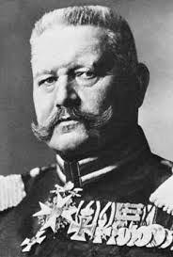
Paul von Hindenburg

Slide 7
The Rise of Adolf Hitler
3. Hitler Takes Control
In 1925 Paul von Hindenburg was elected President of the Weimar Republic
By 1932 the Nazi Party had become largest party in the Reichstag; 38% majority (Similar to Parliament or Congress)
Hitler was appointed Chancellor in 1933 (2nd in command)
February 1933 the Reichstag burned down; blamed on Communists
Reichstag responded by suppressing communists and others and passed the “Enabling Act” which transferred its power to the president (dissolved the power of the Reichstag)
1934 President Von Hindenburg died and Hitler was declared “The Fuhrer”

Slide 8
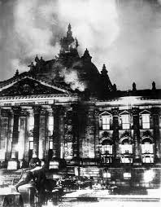
Reichstag Fire

Slide 9
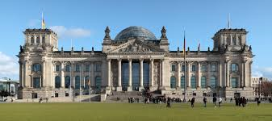
Reichstag Today

Slide 10
The Rise of Adolf Hitler
4. Prelude of the Holocaust and World War II
Anti-Semitism, or hatred of Jews, already existed in the hearts of many Europeans
Nuremberg Laws were passes allowing government to legally discriminate against Jews
Examples of Nuremberg Laws:
i. Jews were stripped of German citizenship (could no longer vote)
ii. Marriage between Jews and Germans was forbidden
iii. Jews were excluded from public office, practicing law, medicine, teaching
iv. Jews had curfews, had to wear yellow star for public ID
v. Allowed for open and legal terrorism against Jews

Slide 11
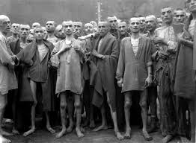
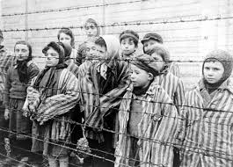
The Rise of Adolf Hitler
d. This led to a 3 step process:
i. Development of Jewish ghettos in cities
ii. Concentration Camps became sites of forced labor and murder
iii. Genocide- mass killing of over 6 million Jews.

Slide 12
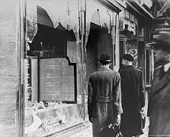
The Rise of Adolf Hitler
e. 1938 Kristallnacht:
i. The Night of Broken Glass: anti-Semitic riots in Germany and Austria.
ii. 30,000 Jews rounded up and taken to concentration camps
iii. Homes, businesses, and synagogues destroyed

Slide 13
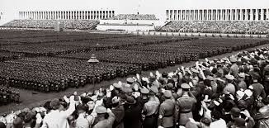
The Rise of Adolf Hitler
f. 1939 Hitler invades Poland and starts World War II
g. He continued efforts to unite all people of German blood or Aryans under “The Master Race”
h. He called his empire the Third Reich

Slide 14
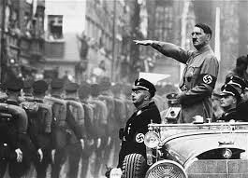
The Rise of Adolf Hitler
Result: Hitler used democracy to destroy democracy. Once he became “Der Fuhrer,” he ruled Germany as a ruthless dictator and used his power to take over several countries and murder millions

